Slide 1
Oldham Covid Community Champions Training
The Key Messages

Slide 4
Conversations with people
To share the facts, make sure people are informed and can share with you what matters to them.

Slide 5
We don’t want to go back to this

Slide 7
Wear a face covering
Just because it’s not regulation now, doesn’t mean that its not still a good idea! It protects you and others, especially indoors and in crowded places.

Slide 8
Wash hands
It’s as important now as it was at the start of the pandemic!

Slide 9
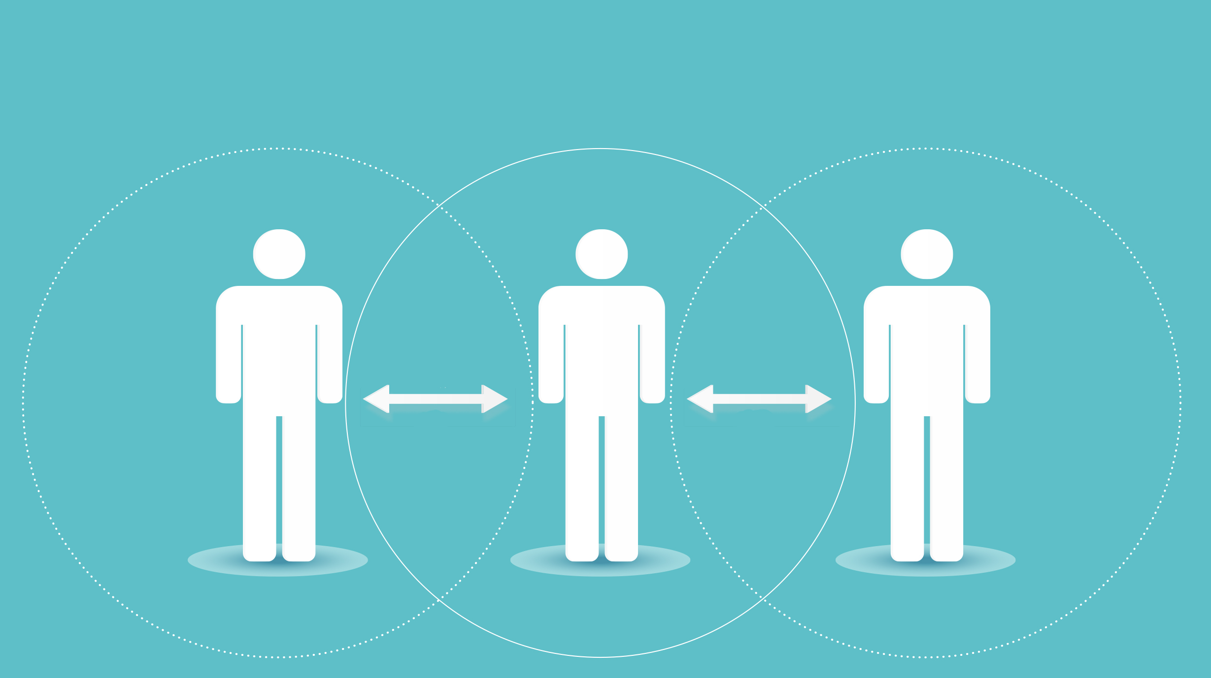
Socially distance
Keep your distance where you can…it really does stop the virus spreading!

Slide 10
Fresh Air
Meeting with people outside and opening windows at home when you have people over is a really good idea.
As much fresh air circulating as you can manage reduces the risk of the virus spreading.

Slide 11
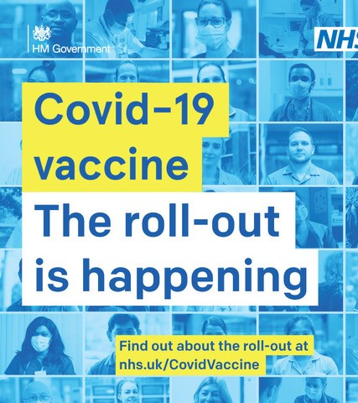
Get Vaccinated
Anyone who gets COVID-19 can become seriously ill or have long-term effects (long COVID). The COVID-19 vaccines are the best way to protect yourself and others. Research has shown the vaccines help:
reduce your risk of getting seriously ill or dying from COVID-19
reduce your risk of catching or spreading COVID-19
protect against COVID-19 variants
The 1st dose should give you some protection from 3 or 4 weeks after you've had it. But you need 2 doses for stronger and longer-lasting protection.

Slide 12
Get Vaccinated
There are other benefits to getting your Covid-19 Vaccines done, on top of the protection it gives you from the virus.
Travelling Abroad – You need to be able to show that you have had both your vaccines before you are able to travel outside of the UK, whether that’s for a holiday, or to visit family abroad.
No More Isolating! – From 16 August 2021 if you have had both your jabs or you are under 18 you will no longer need to self-isolate if you come into close contact with someone with COVID-19 (As long as you get a test and a negative test result!)

Slide 13
Getting a Vaccination in Oldham
First vaccinations are available to all over 18s in Oldham
Second vaccinations from 8 weeks after this
People can get a vaccination in Oldham by:
booking online
Calling in at one of the walk-in clinics

Slide 14
Key Messages on Testing

Slide 15
Get a test
Oldham is offering FREE testing to anyone in Oldham who wants one, this is because we know some people who have the infection don’t realise they have it and they can then spread it to others. We want to stop this spread.

Slide 16
How to get a test
No symptoms: get a rapid test (lateral flow test) from:
a local pharmacy,
order a home testing kit
attend a local pop-up testing site
Symptoms: get a PCR test by booking on the Government website

Slide 17
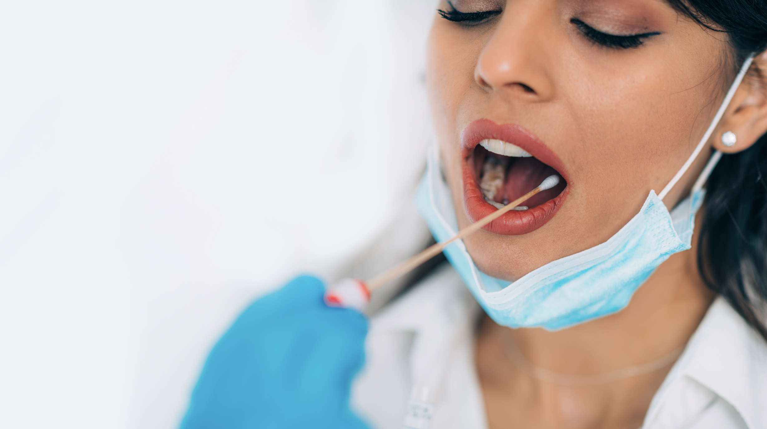
How to take a test
How to take a Lateral Flow Test Video

Slide 18
Positive Test Results
If you or a household member have a positive test result you must:
Isolate for 10 days.
Everyone in your household MUST isolate at the same time.
Isolate means not leaving the house at all for 10 days and no one should visit the household. The reason for this is to stop other people from getting covid.
Everyone should be tested.

Slide 19
Support for isolation
We have support available for people who are isolating, there are grants to help if you can’t work, there is support with activities, shopping and medicines contact the Oldham Helpline by ringing 0161 770 7007

Slide 20
Reinforce the Key Messages
Coronavirus levels continue to be high in Oldham
Continue to wear a face covering especially in indoor crowded places
Wash your hands regularly
Try and keep space between you and other people where you can
Try and keep fresh air circulating indoors
Get vaccinated if you are over 18 – both jabs
Get tested – regular testing at home if you don’t have symptoms, go to a test centre if you have symptoms
Isolate (do not leave your home for any reason) if you or a member of your household tests positive for Covid-19 – there is help for you if you need it.

