Slide 1


Clerks and Governor Support Service Briefing Session
Gerri Barry
Information and Advice Service Manager
Tuesday 15 September 2020

Slide 2

Thank YOU
Thank you for responding so quickly and coping so well during this pandemic. You’ve adapted to changes and new virtual ways of working so well. Thank YOU!

Slide 3
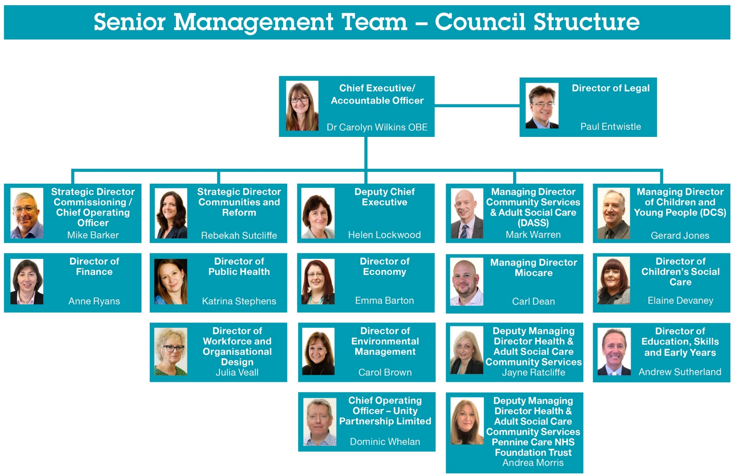
Interim Director of Education, Skills & Early Years
Tony Shepherd

Slide 4
Interim Arrangements
Richard Lynch the new Director of Education, Skills and Early Years is expected to join the Council in the latter part of 2020.
During the intervening period, Tony Shepherd will continue to lead as Interim Director, and there will be some changes to our Interim Operating Structure:
Assistant Director (SEND) David Shaw will oversee SEND, Inclusion & post 16 participation and Lifelong Learning, Employment & Skills.
Assistant Director (Integration) Karen Rose will oversee Children’s’ Integration & Transformation, Early Years, Mental Health & Wellbeing and the Vulnerable Children programme.
Oldham Learning Chief Executive Adrian Calvert will oversee Performance and Improvement.
Gerard Jones
Managing Director of Children & Young People

Slide 5
School Support Services - Staff Structure September 2020
ANDY WOOD
Education Provision Manager
RITA ARYA
Senior Admissions & Place Planning Officer
JENNY MELIA RAY WHARMBY
Admissions & Appeals Officer
ANN HARVEY/VACANT
School Admissions Support Officer
VACANT
Transfers Officer
VACANT
Quality Assurance Officer
ANDY COLLINGE
Head of School Support Services
GERRI BARRY
Information & Advice Service Manager
JEAN REID
SEND, Governance & FIS Coordinator
ABDUL SALAM
Education Support Services Officer
CLERK TO THE GOVERNING BODY x 26
VACANT
Trainee – SEND Communication Info & Advice
SUE CARROLL (0.6)
KIM HARTLEY
SAMUEL LEES/WENDY WHITEHEAD
Governor Support Officers
GOW – Work Experience Placements

Slide 6

Welcome to the digital world! What this continues to mean
No more black books
No more paper copies
No more travelling to and from the Civic Centre
Currently ONLY virtual meeting can take place due to the COVID-19 restrictions. This is also the advice of NGA and NCOGS

Slide 7


Microsoft Teams – Preferred Platform
Join a meeting using the app which you can download onto any laptop, tablet or smartphone.
Join a meeting without the Teams app, just click on your email calendar invite and choose to join using your internet browser instead of the app – click here for more info.
This is Oldham Council’s default video conference app.
Video Tutorials are available to watch on how to use features on Microsoft Teams as an account holder.

Slide 8

Zoom – Join a meeting
Join a meeting using the Zoom app which you can download onto any laptop (tablets/smartphone via App Store).
Join a meeting without the Zoom app, just choose to use Zoom using your internet browser instead of the app.
Some schools are using this platform however, the council recommends Teams as the Zoom sessions only last 40 minutes at a time - re-joining to a new meeting is required.
A useful Video Tutorial (69 secs) to watch about how to join a meeting including screenshots.

Slide 9
Email Accounts
gbsupport@oldham.gov.uk
All general communications
governortraining@oldham.gov.uk
All information about governor and clerk training and personal development
E-learning alerts

Slide 10

Oldham Council and COVID-19 Updates
Council updates will be shared with all clerks
Staff already employed by the council – usual way
Staff clerk only - communications will be shared via gb.support@oldham.gov.uk
Information on COVID-19 updates are available here: www.oldham.gov.uk

Slide 11
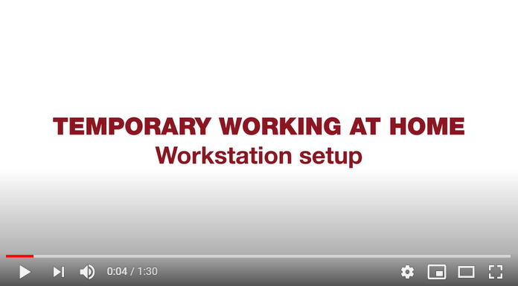
Risk Assessments
Working From Home – Governor Service
Display Screen – Council equipment only
Recommended HSE video viewing
www.youtube.com/watch?v=Af7q5j14muc#action

Slide 12
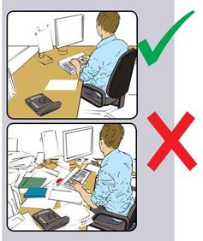
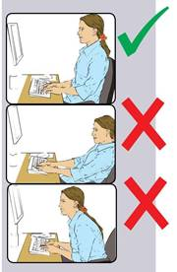
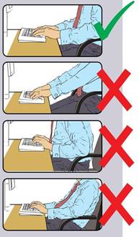
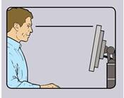
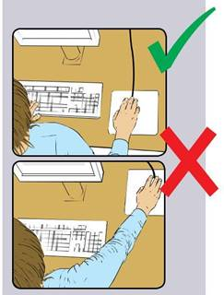
Advice for better positions when working on your computer

Slide 13
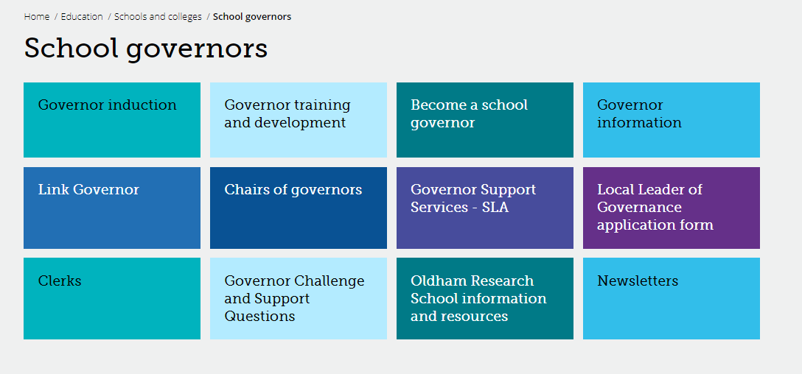
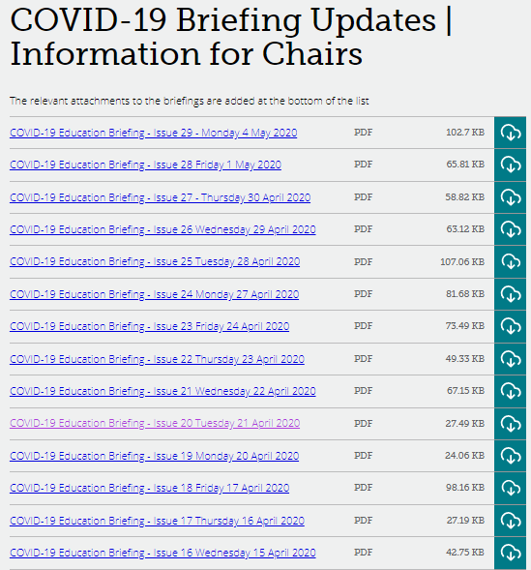
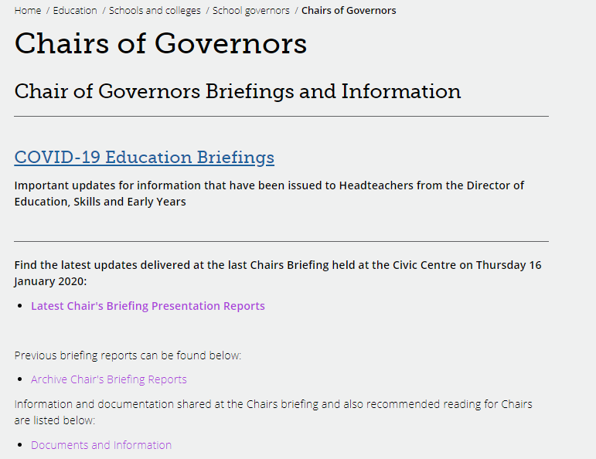
COVID-19 Education Briefings – Sent to schools
www.oldham.gov.uk/chairsofgovernors
Password protected - Oldham

Slide 14
Governor Webpage www.oldham.gov.uk/governors
Password protected - Oldham

Slide 15
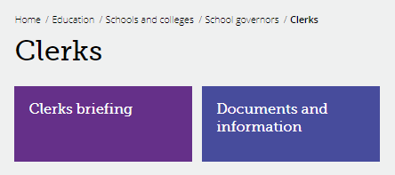
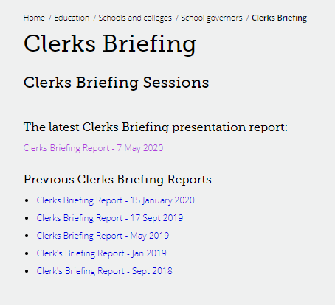
Clerks Briefing Uploaded www.oldham.gov.uk/clerk
Password protected - Oldham

Slide 16

Meeting Arrangements – GSS Only
Schools must contact the Governor Support Service with all meeting arrangements.
If the school contact you directly as a Clerk or in another role please re-direct the request to Governor Support Service.
Any dates and charges for meetings will be discussed by Governor Support Service staff.

Slide 17
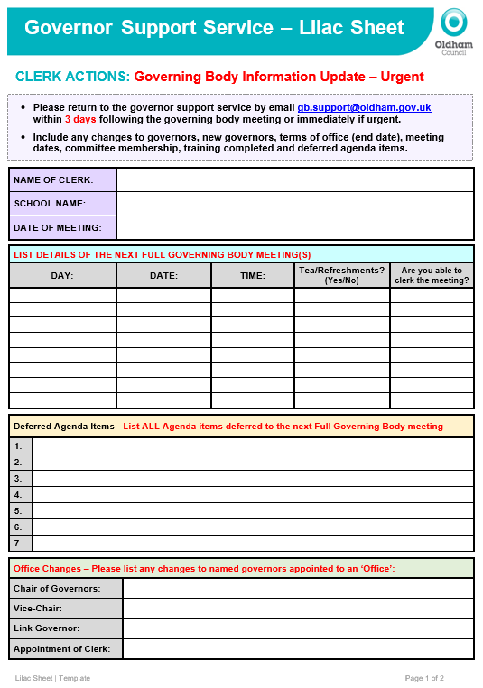
Lilac Sheet - returned within 3 days or sooner
Important Clerk Information
Update with key actions and information regarding:
New governors
All meeting dates (check diary)
Change of email address
Change of meeting dates
Governor leaving dates
Deferred agenda items
Things we need to know and to be action quickly
If you remember that you have missed something off then please let us know straightaway

Slide 18

Consequences of not returning the Lilac Sheet within 3 days or sooner…
Lilac Sheet - Important
Important/urgent/confidential information has NOT gone to a governor as they have changed or closed email addresses.
Confidential information is shared with a Governor who has left/resigned (data breach) or passed away.
Dates of meetings to be arranged and changes on committees.
New governor details - appointments regarding co-opted govs/observers etc
Thank you letters not sent to a long serving Governor that has resigned (doesn't look good on Governor Services).
New Chairs & Vice-Chairs not being invited to meetings with the Director. Chairs & Vice-Chairs not being sent important information that is shared with them throughout the week.

Slide 19

Consequences of not returning the Lilac Sheet within 3 days or sooner
Lilac Sheet - Important
New Governors missing out on training invites.
Non-compliance to the requirements of the Clerking Role and in turn the SLA committed by the Governor Support Service.
Any urgent issues raised in the meeting that needs dealing with by the LA, (complaints or such like for example), cant wait until the minutes come in.
Notice to issue election papers for staff and parents governors with in term time…If they are delayed it could cause a problem with school holidays.
External training is not recorded - also Clerks to know the difference between 'in house' and 'external'

Slide 20

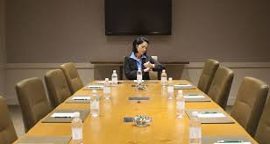







Consequences of not returning the Lilac Sheet within 3 days or sooner

Slide 21
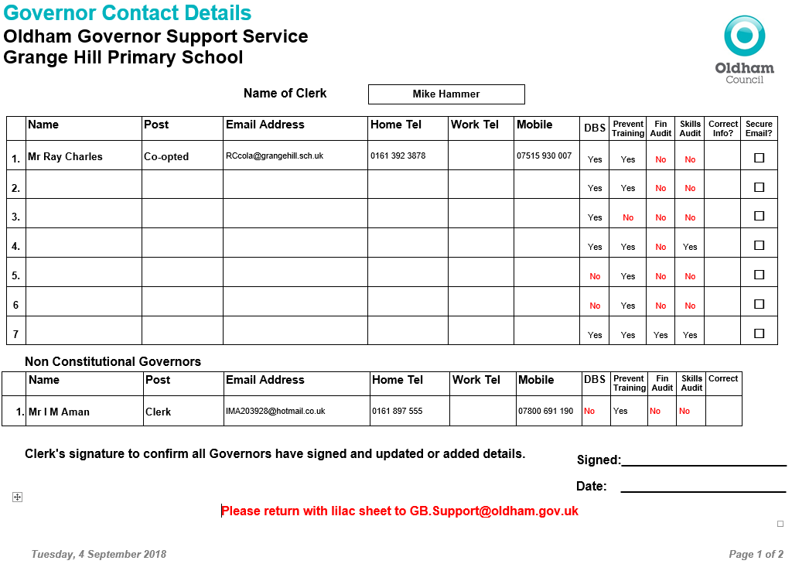
Updated Governor Contact Details Form
Prevent Required by all Governors
Required by all on Finance Committee. Good practice for all Governors
Individual skills matrix completed by all governors and returned to the Chairs to Collate
DBS forms must be completed with governors at school within 21 days
New

Slide 22
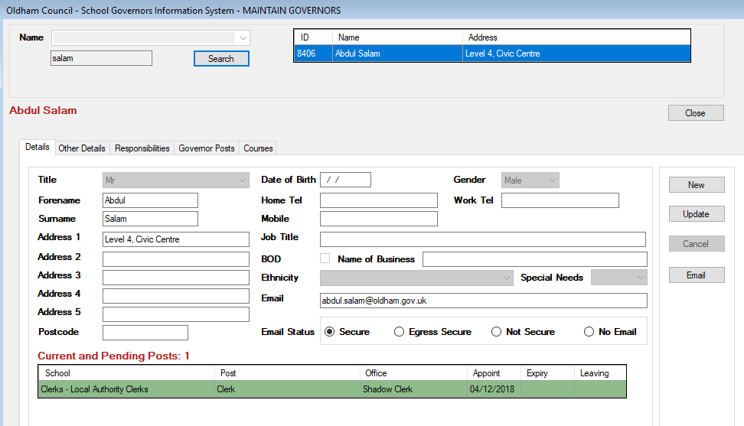
Data Cleanse and Database Update
Updating Governor Details
Correcting information where there is a spelling mistake.
It’s important to check and double check

Slide 23
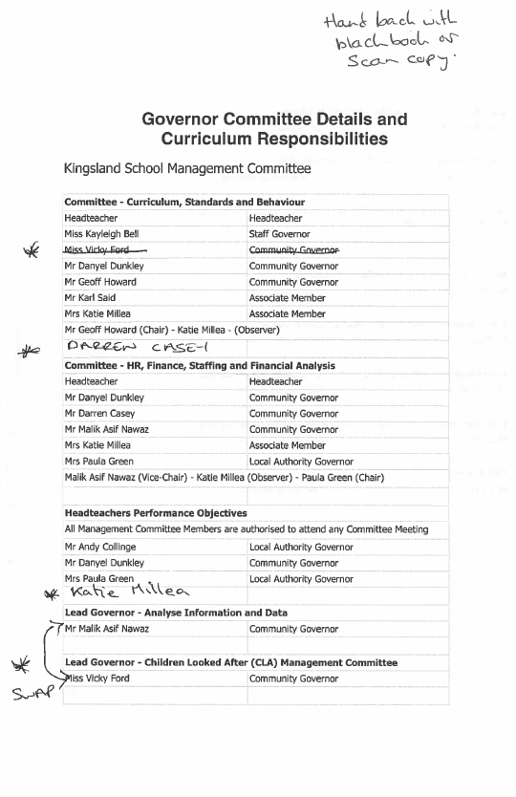

Committee Membership and Governor Responsibilities
It is imperative that you use this document
Update the committee membership and new governor responsibilities
Add changes to the Lilac Sheet gb.support@oldham.gov.uk
You must also update on the minutes

Slide 24
Responsibilities Standardisation – Gov Database
Committee | Committee xxxxxx
Year Link Governor | Year Link Governor - Year X
Subject Link Governor | Subject Link Governor - Mathematics & Numeracy
Headteacher Performance | Headteacher (Exec HT/Head of School) Performance Management Objectives
Link Governor | Link Governor – Governor Induction, Training and Mentoring
Lead Governor | Lead Governor - Safeguarding /Children Looked After/Prevent Duty Lead Governor - Financial Health and Efficiency Lead Governor - Special Educational Needs & Disabilities (SEND) Lead Governor - Analyse Information and data Lead Governor - Health and Safety in Education Lead Governor - Closing the Gap for EAL Learners Lead Governor – Human Resources (HR) Education Policy Lead Governor - Emotional Health and Wellbeing (EHW) Lead Governor – Curriculum and Standards Lead Governor – Attendance
Competency Framework for Governance - www.gov.uk/government/publications/governance-handbook

Slide 25
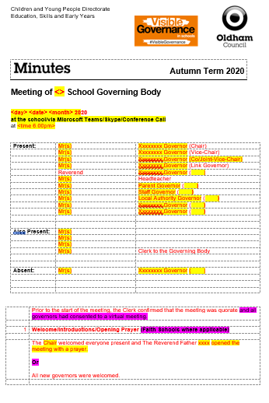
Minute template
Delete PREVIOUS versions of the template.
Check the minute text “fits” and that the tense is correct (past, present etc.)
RED text is standard on the template which signifies that no changes have been made.
BLACK text is what you have typed in i.e. your minutes, changes, amendments etc.
Yellow highlighted text will always need changing or deleting.
Delete Magenta highlighted text.

Slide 26
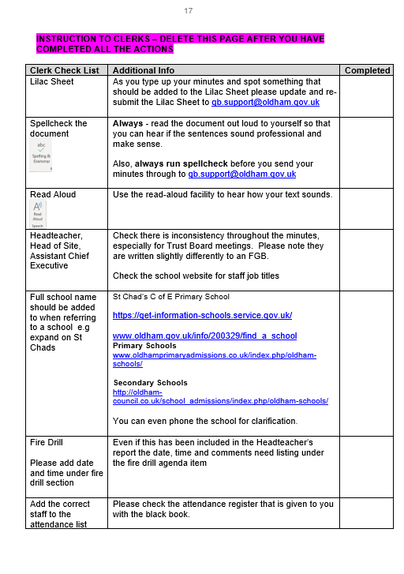
Minute template QA
A self QA check list has been updated at the back of the minute template and must be used.
Please work through this check list, then delete it before you issue your final minutes to: gb.support@oldham.gov.uk
The minutes should be a final version ready to send to the Chair & HT for factual checking (not proof reading and correcting typo’s)

Slide 27

Quality Assurance - Check your minutes
Tick list added to the back of the minute template.
Please ensure that your minutes are:
Spell checked
Double-checked
Grammar is checked
Look at formatting
The numbers are inline with the agenda
Are they good enough to publish on a website?
Buddy up with another Clerk to check your minutes
This is important!

Slide 28
Q - Minutes signed by the Chair
We are still looking for a long solution for this….
Please ask the Chair to reply as below by replying to the email sent to them with the agenda and minutes. This is their email signature
To: gb.support@Oldham.gov.uk
Re: School Minutes Chairs Signature
I can confirm that the minutes of the meeting held on day date year have been approved as a correct record.
Chair of Governors
Email signature

Slide 29
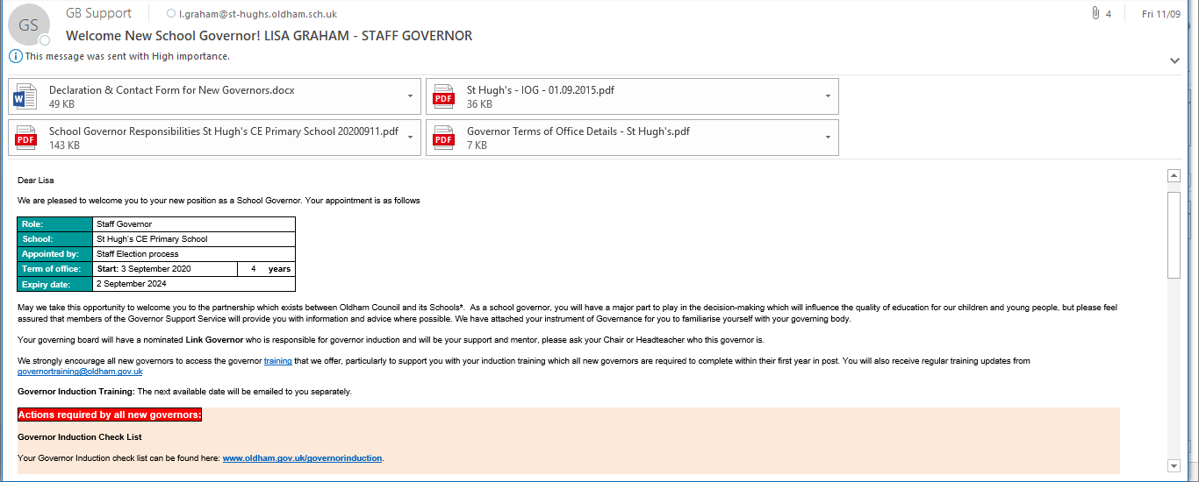
Welcome email to governors
The welcome email has been updated and re-issued to ALL governors on 4 Sept 2020 for information and so they can see what information is going to new governors.

Slide 30

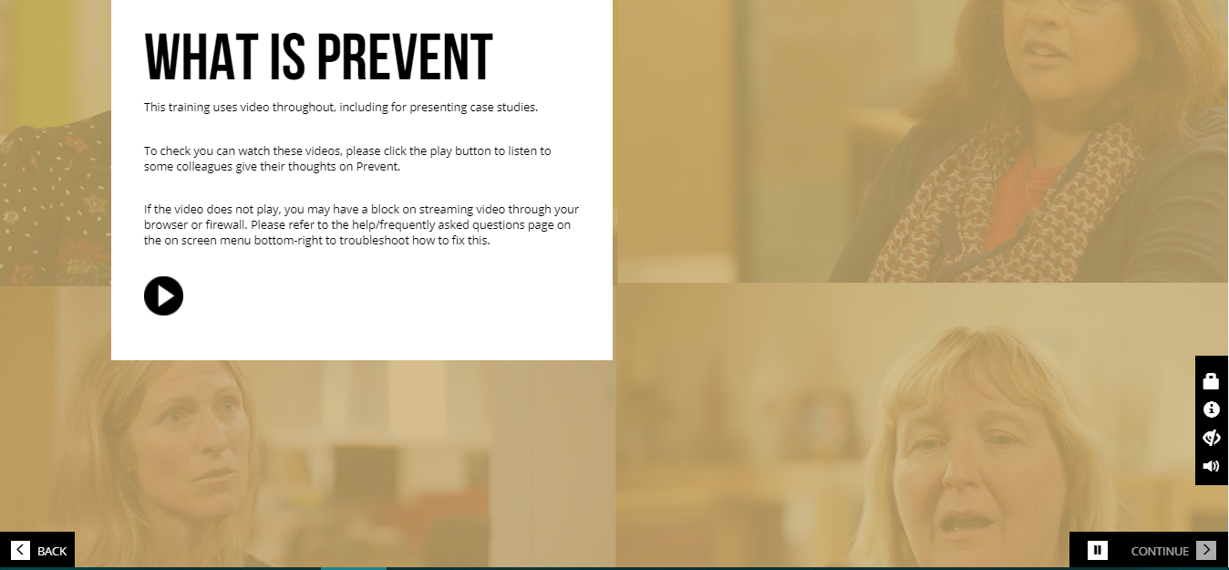

PREVENT Online Training
All Clerks and Governors must complete the prevent training.
Certificates can be printed or saved after completion.
www.elearning.prevent.homeoffice.gov.uk

Slide 31





Governor Training and Development
Encourage all governors to access the e-learning that has been sent to them from governortraining@Oldham.gov.uk
Also on the governor website:
www.oldham.gov.uk/governortraining
www.oldham.gov.uk/governortrainingprogramme

Slide 32

Automated reminder emails to Governors Please remind new governors
Governors with missing DBS Checks
15th day of month
Governors with missing Prevent Training
20th day of month
www.oldham.gov.uk/onlineprevent

Slide 33
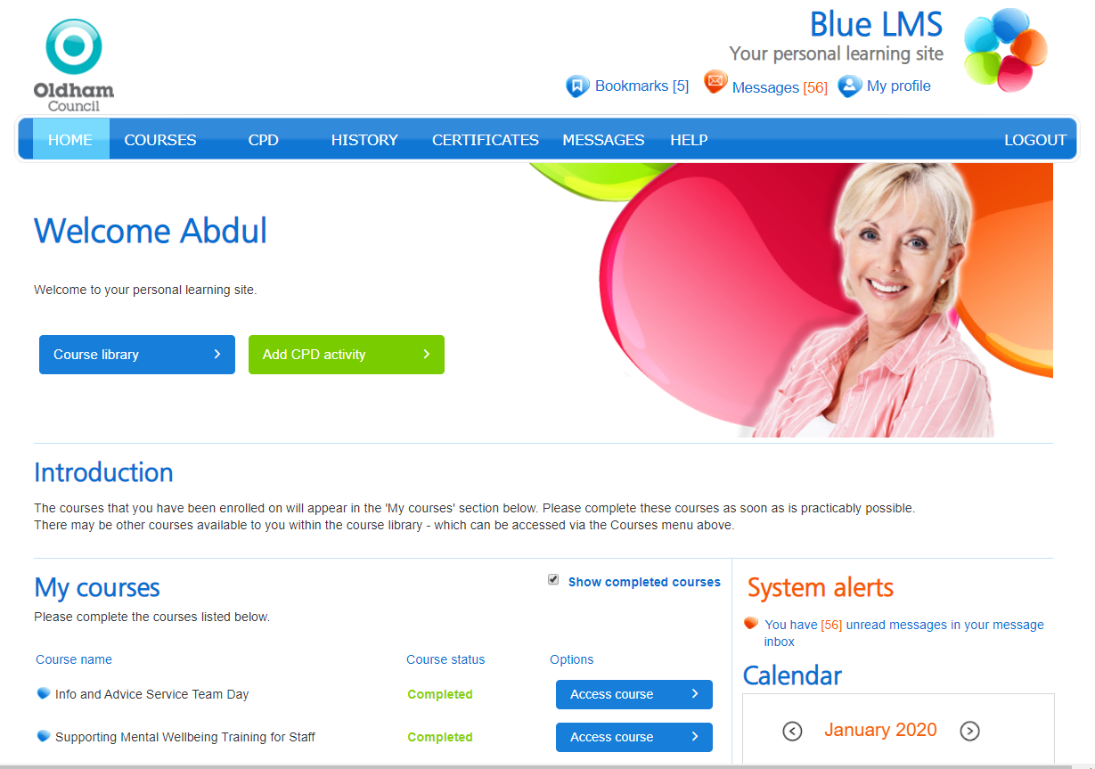
Me Learning – Clerks Training Log @ Development Academy
https://oldham.melearning.university
All Clerks not employed by Oldham Council have been emailed their password
Confirm if you have accessed this platform

Slide 34
Induction Programme | Me Learning
Weekly reminder emails will be sent to you until you have completed your Mandatory Modules i.e. GDPR, Data Protection, Cybersecurity, Health and Safety at Work, Manual Handling etc.
Fast FORWARD – Induction for new and existing staff
New 45 minutes online course.
You can also access other free Online training – Microsoft Office i.e. Excel, Word, PowerPoint etc.
If you have any queries or problems with your ‘Me Learning’ account or training, then contact Debbie Duffy at the Development Academy on
0161 770 8700 or dabs@oldham.gov.uk

Slide 35
First-Class Email Accounts
Any governors experiencing issues with their First-Class email address must speak to their school’s own IT administrator for support.
First-Class schools supported by the Oldham Council’s Unity Partnership
Passwords - automatically reset every 90 days (3 Months), council policy.
Passwords - 8 characters (numerals, uppercase and lowercase letters).
Unity Partnership ICT Support team offer support.
Tel: 0161 770 1000 option 2* | Mon–Thurs 8am to 5:30pm & Friday 8am to 5pm
*Please note voicemail or call-back facility are not available
Training – ICT are looking to offer training to support governors accessing and using their First Class account - more information to follow…

Slide 36
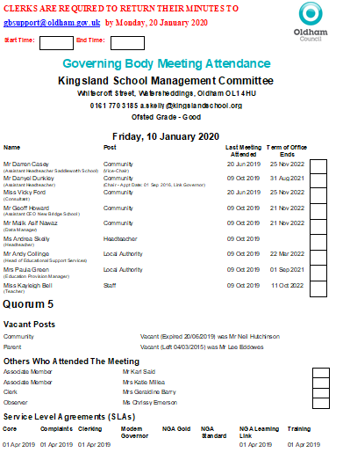
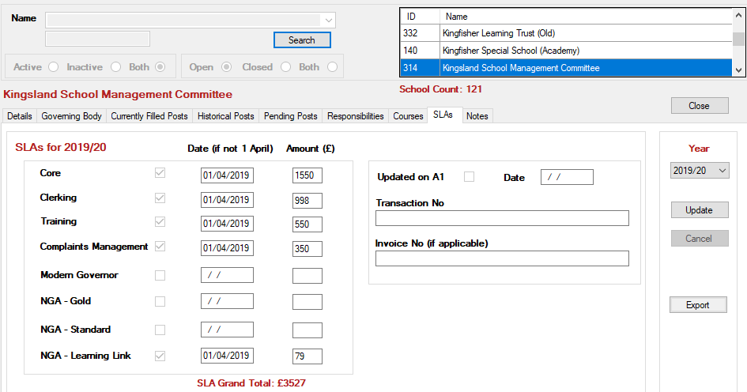
Service Level Agreement SLA 2020/21
Who buys back what?
Information about the SLA is here: https://oldhamservices.co.uk/governor-support

Slide 37
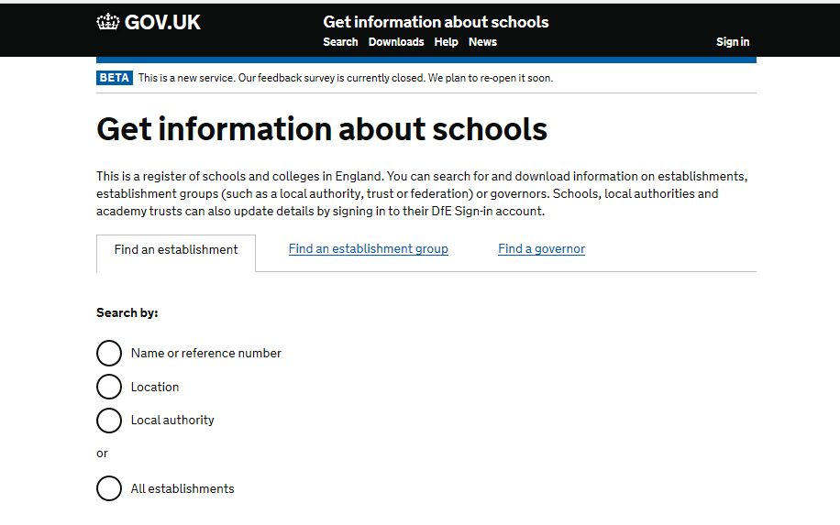
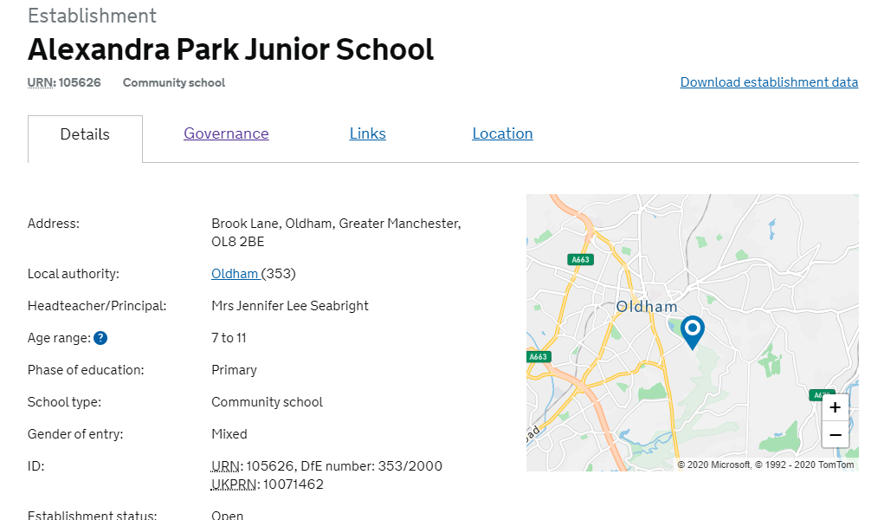
Get Information about Schools – GIAS
https://get-information-schools.service.gov.uk
Only schools can log in and update this information

Slide 38
Autumn Term 2020 - Local Authority Agenda Item for Action
There must be an action in the minutes!
Remind the Chair if the governors skip over it!!!

Slide 39
Local Authority Agenda Item for Action
Item 16.1 - School Admissions Arrangements
Governors are reminded that: Admission Authorities Admission Authorities must set (‘determine’) admission arrangements annually. Where changes are proposed to admission arrangements, the Admission Authority must first publicly consult on those arrangements. If no changes are made to admission arrangements, then they must be consulted on at least once every 7 years. Consultation must be for a minimum of 6 weeks and must take place between 1 October and 31 January. Admission Authorities must determine their admissions policy and admission arrangements for entry in September by 28 February in the determination year. The school website must also be updated. Local Authority Admission Authority Schools for which the Local Authority (LA) is the admissions authority do not need to act on the above process, but they must ensure that their school website carries the most up to date LA admissions policy.

Slide 40
Local Authority Agenda Item for Information
Item 17.1 - Schools Forum
Governors are asked to receive and note the summary papers outlining discussions held at the meetings of the Schools Forum held during last term on 1 July 2020.Link to the document: www.oldham.gov.uk/schoolsforum
Item 17.2 - New Schools HR and Payroll System – MyHR
Governors are to be aware that the new HR and Payrolls system is now known as MyHR and will be available for schools and academies. There is an anticipated go-live date during the autumn months after October 2020. The system will deliver a more responsive service, a smoother user experience, improved self-service access and greatly enhanced management information and reporting facility. If schools require any more information, they can contact peopleprogramme@unitypartnership.com

Slide 41
Clerk Update as an Agenda item
Clerks must share any new updates that occur during the term e.g. Appointment of a new Director of Education and Early Years etc.
LOOK OUT for an email ‘Clerk Update 1’ or ‘Clerk Update 2’ etc.
Drop in text from email ensuring that the information is written in it’s correct ‘tense’ – i.e. something that happened or is going to happen etc.
This is important!

Slide 42
Clerks Update 1 – Included on the agenda
Appointment of Director of Education, Skills and Early Years
Richard Lynch has been appointed to the post of Director of Education, Skills and Early Years. He joins Oldham Council from Barnsley Council at a date still to be confirmed.
Coronavirus - COVID-19
The Oldham Council website will be updated with any key developments in the local situation. Governors, clerks staff and parents can sign up for weekly for email alerts here: sign up to email alerts
The Chairs of Governor section on the governor webpage will be updated with weekly updates issued to schools www.oldham.gov.uk/chairsofgovernors
Get Information About Schools
Governors, observers and clerks who are not receiving monthly DfE updates can email request that their email is added to the mailing list here: schoolgovernance.update@education.gov.uk

Slide 43
Governor Vacancies Recruitment – Update vacancies are displayed here:
Governor Type | Process for filling vacancy | Current vacancies Sept 2020
Co-opted | Selected and approved by the Governing Body (agenda item) | 21
Parent | Election in School - welcome at FGB meeting | 31
Staff | Election in School - welcome at FGB meeting | 5
Local Authority | Approved by the Lead and Shadow Cabinet members - before approved at the GB meeting (agenda item) | 9
Foundation / Ex Officio | Appointed by the Diocese – welcome at FGB meeting | 17
Foundation PCC | Appointed by the Parish Council - welcome at FGB meeting | 15
Foundation Trustee | Appointed by the Trust – welcome at FGB meeting | 5

Slide 44
Who is the employer in a school?
School Type | Employer
Community Schools | Local Authority (LA)
Community Special Schools
Maintained Nursery
Pupil Rereferral Unit (PRU)
Voluntary Controlled (VC)
Foundation Schools & Foundation Special | The Governing Body
Voluntary Aided Schools (VA)
Academies & Free Schools | The Academy Trust
Independent Schools | The Governing Body of the Proprietor

Slide 45

Governor Elections MUST TAKE PLACE!
Governor elections must take place for ALL
Staff Governors where terms of office are coming to an end
Parent Governors where terms of office are coming to an end
Existing people in these posts can/must re-apply
They cannot automatically be extended an election must take place.

Slide 46

Staff Governors – ONE THIRD maximum
It is important when governing bodies are appointing school staff into various governor posts they must be aware that No more than a third of the governing body can be staff members at the school
1/3

Slide 47
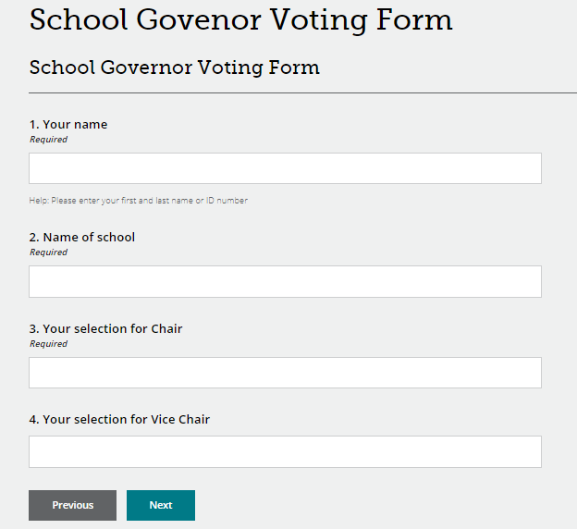
Online Voting for Chair & Vice-Chair
We can provide an online voting facility for the Chair & Vice-Chair
Let Governor Support Services know well in advance in order to collate any nominations.
There must be enough time to carry out the vote.
The Clerk will be given the result just before the GB meeting

Slide 48
MyHR – New HR & Payroll System
Email addresses have been added to personal details on A1 in preparation for the launch of MyHR.
Changes to the way Clerks are paid.
In 2013 the JE team looked at session rate for clerk and it was agreed that the 11 hours covers:
Preparation;
Attendance at training – 1 hour (including termly Clerks Briefing Meeting);
Attendance at the FGM meeting;
Travel time to collect and return any key documents (inc. lilac sheet and governor responsibilities),
finding information, research and following up actions;
Contact with the Chair;
Checking, typing up, proof reading and correcting minutes for final submission.

Slide 49
Casual Clerk Timesheets & A1 Changes
Timesheets must be submitted ONLY when you submit your final set of minutes.
Timesheets must be sent in a separate email to gb.support@oldham.gov.uk
Cost of living rise now applies
HT ratification meetings or one item agenda short meetings the claim is 2 hours. If there are issues talk to your manager

Slide 50


Governor Hub – Update
https://governorhub.com

Slide 51

Staff benefits – Company Shop
The Company Shop have temporarily opened up their membership criteria to a number of sectors and groups including council employees, social care workers and teachers (Local Authority, Trusts, Private and Academies).
Company Shop Group (membership-only) the largest commercial redistributor of surplus food and household products in the UK – the nearest store being located in Manchester at Stakehill Industrial Estate, Middleton.
Company Shop website
You can register for membership online at: Registration form
You will receive an email once approved
You will need to provide proof of ID and a copy of your latest payslip when collecting a membership card in store.

Slide 52
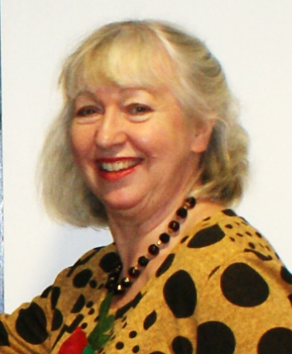


Allocation of school Governing Body/IEB meeting and cover arrangements
Kim
from the Governor Support Service will be in touch if or when a school governing body meeting needs a Clerk.

Slide 53

Any other business

Slide 54
Good Practice for Clerks
Avoid using governors names in minutes.
The do not’s …
Do not write back office/admin issues into the governing body minutes.
Do not agree to use different templates/colours or adding in additional action lists. The school will have to do this.
If they have gone paperless they cannot go back to paper - the school will need to come up with a solution e.g. Folder in school, online web folder with password for governors.
Do not write pass words or key instructions in the minutes
Do not go into detail about staffing issues, personal issues or complaints – think about how your text would look on the front page of the press or how people would feel if they read it!

Slide 55
Minute Template Training
Book yourself a session with Abdul for support on how to:
Insert rows
Adding in sections
Adding in text
Merging and splitting cells
Table/column alignment
Font size/format
Page break/columns
Contact Abdul (abdul.salam@oldham.gov.uk) to arrange a support session via Teams.

Slide 56
Ideas for Council Savings
Share your views – how can we reduce costs?
We want to hear your thoughts and ideas on how we can make up the funding gap left by Coronavirus spending.
Do you have suggestions on how the council can save money both in the short and long term?
We welcome all ideas and appreciate everyone working so hard to get us through this difficult time.
Have your say and share your ideas by emailing:
teamoldham@oldham.gov.uk

