Slide 1
Clerks to school governing bodies – Quality assurance & Support Information
Governor Support Service
May 2020

Slide 2
School Support Services - Staff Structure
May 2020
ANDY WOOD
Education Provision Manager
RITA ARYA
Senior Admissions & Place Planning Officer
JENNY MELIA RAY WHARMBY
Admissions & Appeals Officer
ANN HARVEY/VACANT
School Admissions Support Officer
VACANT
Transfers Officer
ANDY COLLINGE
Head of School Support Services
VACANT
Quality Assurance Officer
GERRI BARRY
Information & Advice Service Manager
JEAN REID
SEND, Governance & FIS Coordinator
ABDUL SALAM
Education Support Services Officer
CLERK TO THE GOVERNING BODY x 26
VACANT
Trainee – SEND Communication, Info & Advice
SUE CARROLL (0.6)
KIM HARTLEY SAMUEL LEES
Governor Support Officers
NABIHA SHAKEEL
Apprentice Communication Info & Advice
GOW – Work Experience Placements

Slide 3
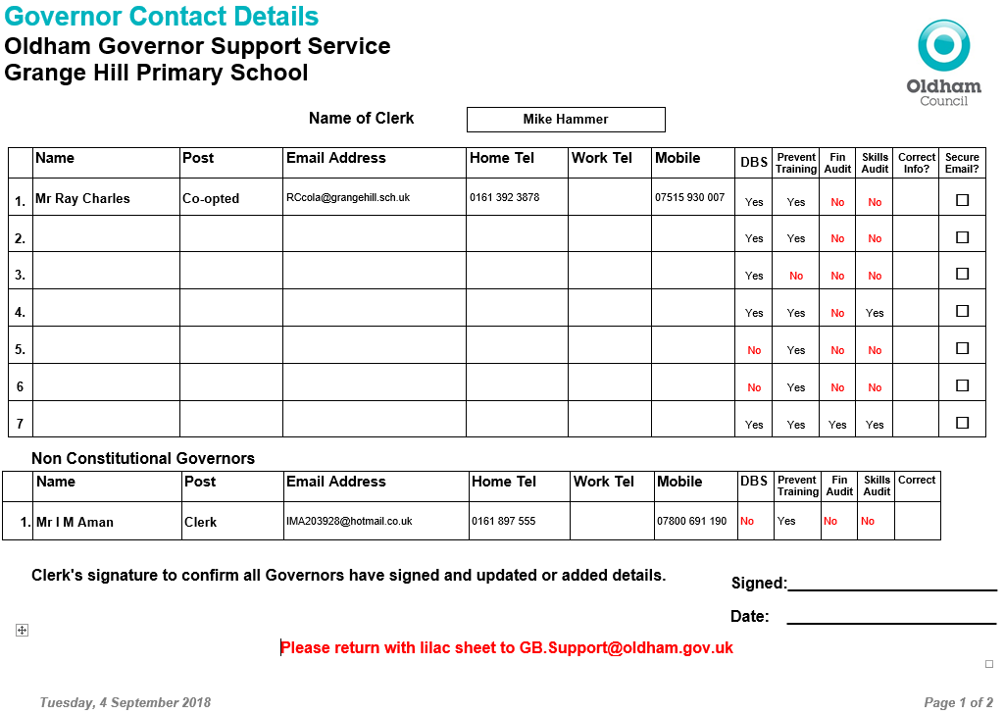
Updated Governor Contact Details Form
Prevent Required by all Governors
Required by all on Finance Committee. Good practice for all Governors
Individual skills matrix completed by all governors and returned to the Chairs to Collate
DBS forms must be completed with governors at school within 21 days
New

Slide 4


Microsoft Teams – Preferred Platform
Join a meeting using the app which you can download onto any laptop, tablet or smartphone.
Join a meeting without the Teams app, just click on your email calendar invite and choose to join using your internet browser instead of the app – click here for more info.
This is Oldham Council’s default video conference app.
Video Tutorials are available to watch on how to use features on Microsoft Teams as an account holder.

Slide 5

Zoom – Join a meeting
Join a meeting using the Zoom app which you can download onto any laptop (tablets/smartphone via App Store).
Join a meeting without the Zoom app, just choose to use Zoom using your internet browser instead of the app.
Some schools are using this platform however, the council recommends Teams as the Zoom sessions only last 40 minutes at a time - re-joining to a new meeting is required.
A useful Video Tutorial (69 secs) to watch about how to join a meeting including screenshots.

Slide 6
Email Accounts
gbsupport@oldham.gov.uk
  All general communications
governortraining@oldham.gov.uk
  All information about governor and clerk training and personal development
  E-learning alerts

Slide 7
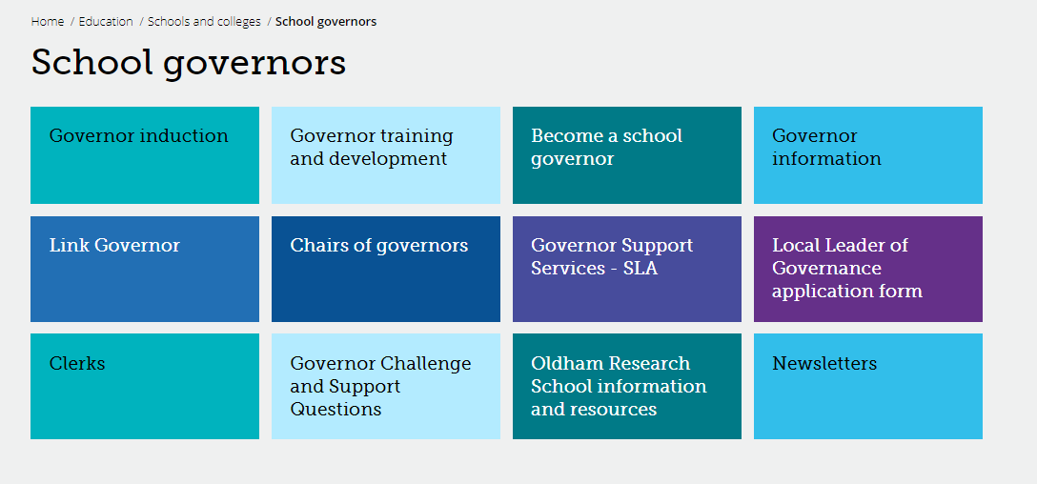
Governor Webpage www.oldham.gov.uk/governors
Password protected - Oldham

Slide 8
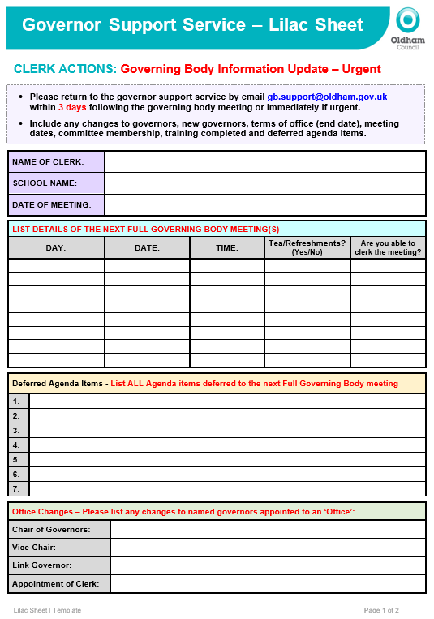
Lilac Sheet - returned within 3 days or sooner
Important
Update with key actions and information regarding:
  New governors
  All meeting dates (check diary)
  Change of email address
  Change of meeting dates
  Governor leaving dates
  Deferred agenda items
  Things we need to know and to be action quickly
  If you remember that you have missed something off then please let us know straightaway

Slide 9
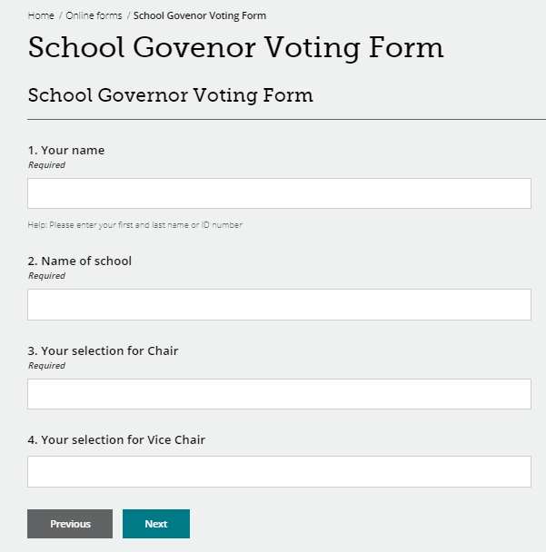
Online Voting – New!
An online voting facility is now in place so that governors can vote for:
  Chair
  Vice-Chair
Please encourage the Chair to consider using this process.
Beal Vale have been the first school to trial this.

Slide 10
Updated Governor Contact Details Form
Prevent Required by all Governors
Required by all on Finance Committee. Good practice for all Governors
Individual skills matrix completed by all governors and returned to the Chairs to Collate
DBS forms must be completed with governors at school within 21 days
New

Slide 11
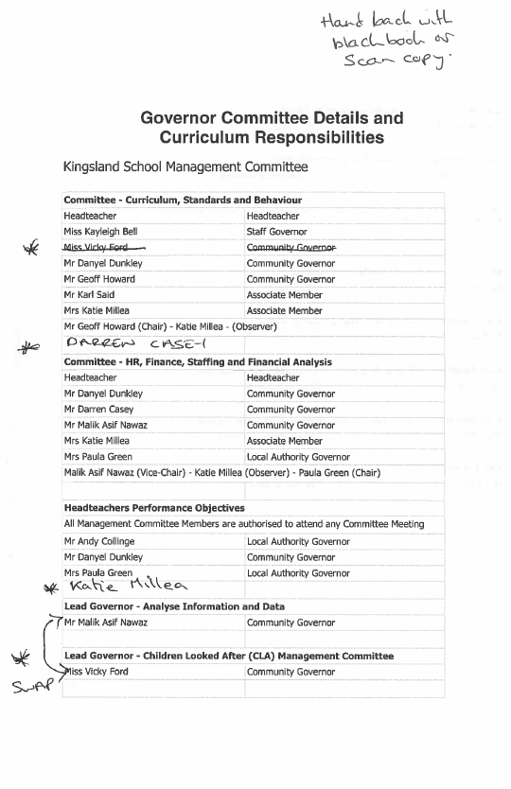

Committee Membership and Governor Responsibilities
It is imperative that you use this document
Update the committee membership and new governor responsibilities
Add changes to the Lilac Sheet gb.support@oldham.gov.uk
You must also update on the minutes

Slide 12
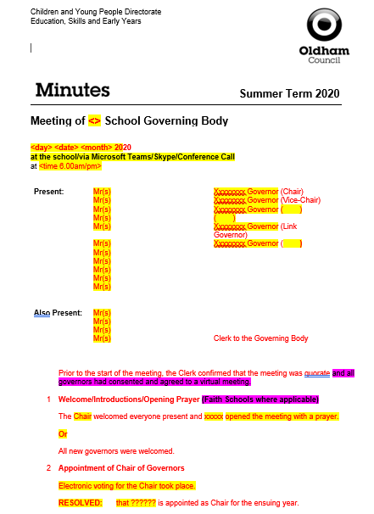
Minute template
Do not use a PREVIOUS template
Check the minute text “fits” and that the tense is correct (past, present etc.)
RED text is standard on the template which signifies that no changes have been made.
BLACK text is what you have typed in i.e. your minutes, changes, amendments etc.
Yellow highlighted text will always need changing or deleting.
Delete Magenta highlighted text.

Slide 13
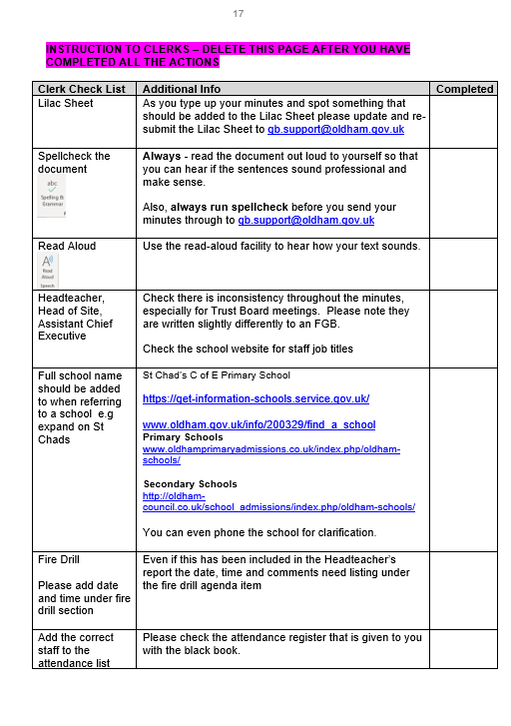
Minute template
A Check list has been updated at the back of the minute template and must be used.
Please work through this check list and then delete it before you issue your minutes to: gb.support@oldham.gov.uk
The minutes should be a final version ready to send to the Chair & HT for factual checking (not proof reading)

Slide 14

Quality Assurance - Check your minutes
Tick list added to the back of the minute template.
Please ensure that your minutes are:
  Spell checked
  Double-checked
  Grammar is checked
  Look at formatting
  The numbers are inline with the agenda
  Are they good enough to publish on a website?
Buddy up with another Clerk to check your minutes
This is important!

Slide 15
Minute Template Training
Book yourself a session with the Governor Support Staff to support you with how to:
  Insert rows
  Adding in sections
  Adding in text
  Merging and splitting cells
  Table/column alignment
  Font size/format
  Page break/columns
    Contact Abdul Abdul.salam@Oldham.gov.uk to arrange a support session

Slide 16


Slide 17

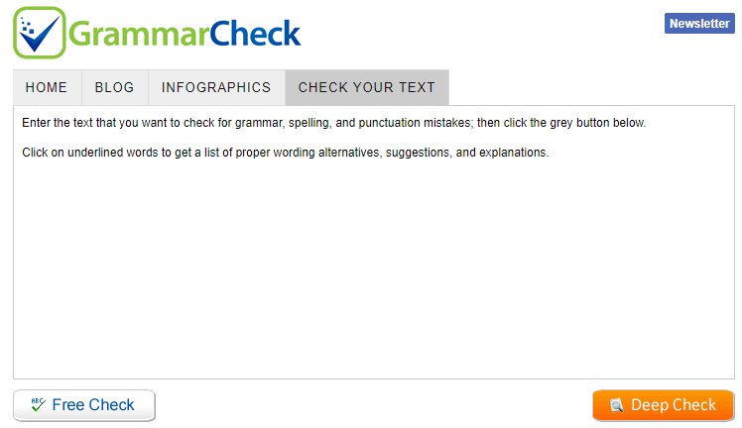
Check your Grammar - IMPORTANT
You can use free online resources
www.grammarly.com
  Add to your chrome web browser free
Grammar check.net/editor
  www.grammarcheck.net/editor
Also look at previous sets of minutes

Slide 18

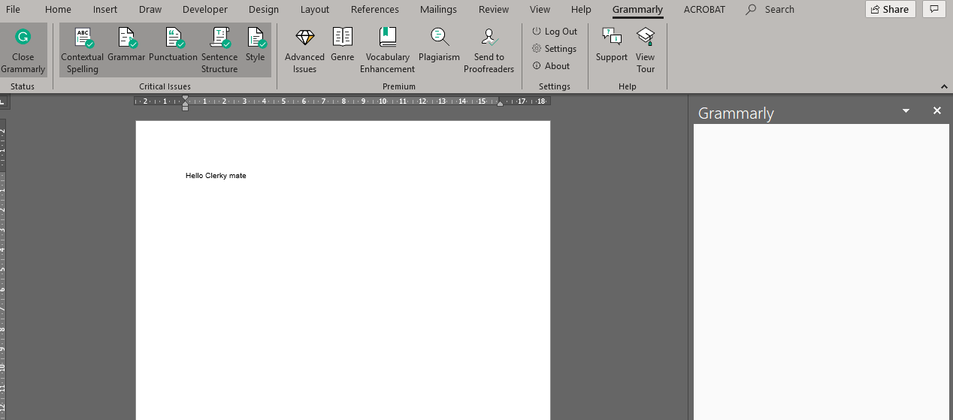
Get Grammarly for Word
www.grammarly.com/office-addin/windows
  You must have Microsoft word/office already installed for the plug-in to work
Once installed, a separate Grammarly tab appears
To use - You have to create and login to a free account
Default US version can be changed to UK in settings
Advanced features only on premium paid versions

Slide 19
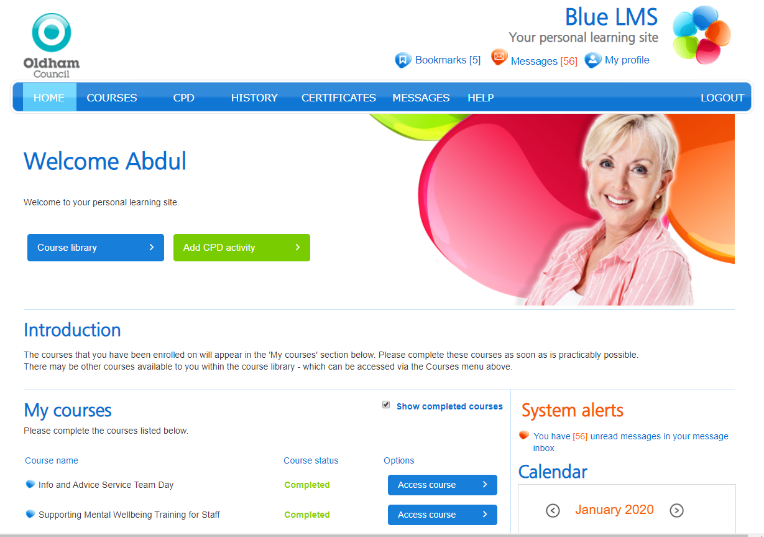
Me Learning – Clerks Training Log @ Development Academy
https://oldham.melearning.university
All Clerks not employed by Oldham Council have been emailed their password
Confirm if you have accessed this platform

Slide 20
Induction Programme | Me Learning
Weekly reminder emails will be sent to you until you have completed your Mandatory Modules i.e. GDPR, Data Protection, Cybersecurity, Health and Safety at Work etc.
Fast FORWARD – Induction for new and existing staff (half day classroom attendance).
You can also access other free Online training – Microsoft Office i.e. Excel, Word, PowerPoint etc.
If you have any queries or problems with your ‘Me Learning’ account or training, then contact Debbie Duffy at the Development Academy on
0161 770 8700 or dabs@oldham.gov.uk

Slide 21






Governor & Clerk Training and Development
Encourage all governors to access the e-learning that has been sent to them from governortraining@Oldham.gov.uk
Also on the governor website:
  www.oldham.gov.uk/governortraining
  www.oldham.gov.uk/governortrainingprogramme

Slide 22

Automated reminder emails to Governors
Governors with missing DBS Checks
  15th day of month
Governors with missing Prevent Training
  20th day of month
  www.oldham.gov.uk/onlineprevent

Slide 23
First-Class Email Accounts
First-Class email any governors with issues then they must speak to their school’s administrator for support.
First-Class schools supported by the Oldham Council’s Unity Partnership
Passwords - automatically reset every 90 days (3 Months), council policy.
Passwords - 8 characters (numerals, uppercase and lowercase letters).
Unity Partnership ICT Support team offer support.
  Tel: 0161 770 1000 option 2* | Mon–Thurs 8am to 5:30pm & Friday 8am to 5pm
  *Please note voicemail or call-back facility are not available
Training – ICT are looking to offer training to support governors accessing and using their First Class account - more information to follow…

Slide 24
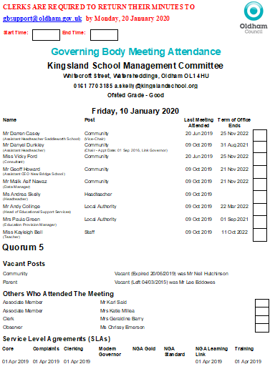
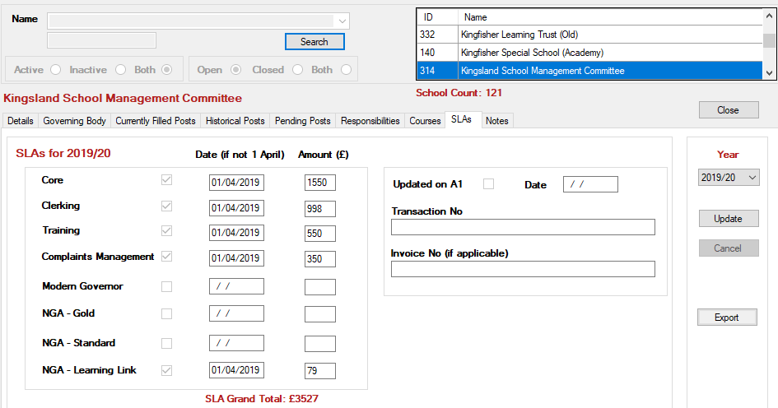
Service Level Agreement
SLA 2020/21
Who buys back what?
Information about the SLA is here: https://oldhamservices.co.uk/governor-support

Slide 25
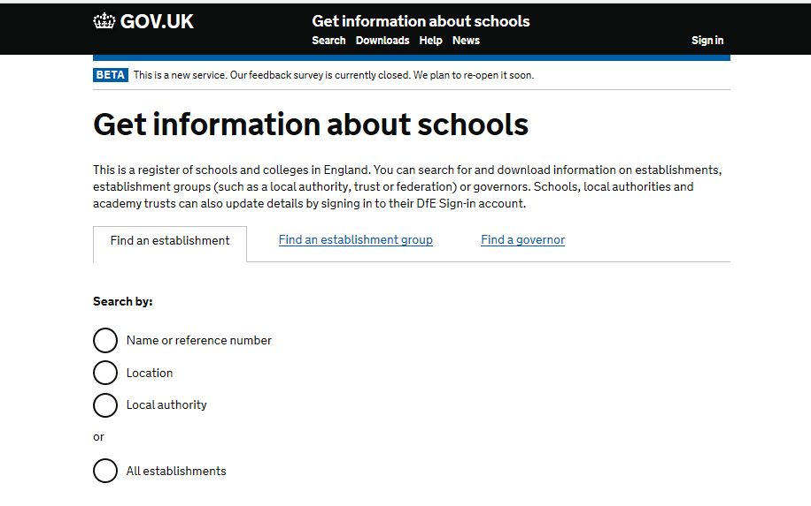
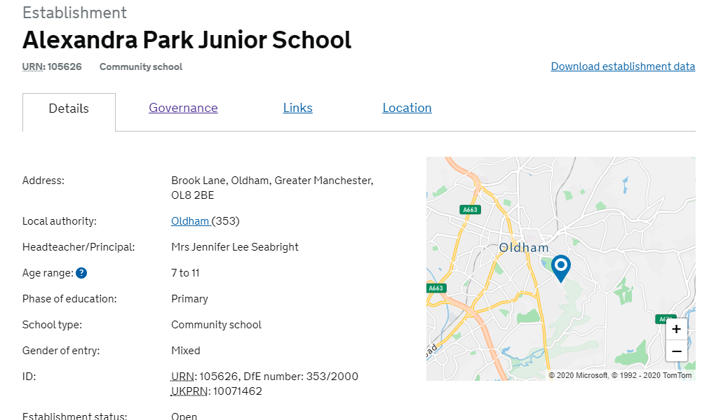
Get Information about Schools – GIAS
https://get-information-schools.service.gov.uk
Only schools can log in and update this information

Slide 26
Clerk Update as an Agenda item
  Clerks must share any new updates that occur during the term e.g. Appointment of a new Director of Education and Early Years etc.
  LOOK OUT for an email ‘Clerk Update 1’ or ‘Clerk Update 2’ etc.
    Drop in text from email ensuring that the information is written in it’s correct ‘tense’ – i.e. something that happened or is going to happen etc.
This is important!

Slide 27

New Governors & Clerks Induction Sessions – Clerks
New Clerks to sign up to attend the ‘Induction for New Governors’ course in 2020.
Next Sessions in (3 session training attendance to complete course) | Induction for New Governors / Refresher Course | 2.30-5pm | The Honeywell Centre
 |  | OR
 |  | 6-8.30pm | The Honeywell Centre
If you’ve missed a previous session due to unforeseen circumstances then you must contact Sue and book on the missed sessions.

Slide 28
Good Practice for Clerks
Avoid using governors names in minutes.
The do not’s …
  Do not write back office/admin issues into the governing body minutes.
  Do not agree to use different templates/colours or adding in additional action lists. The school will have to do this.
  If they have gone paperless they cannot go back to paper - the school will need to come up with a solution e.g. Folder in school, online web folder with password for governors.
  Do not write pass words or key instructions in the minutes
  Do not go into detail about staffing issues, personal issues or complaints – think about how your text would look on the front page of the press or how people would feel if they read it!

Slide 29
New Additions – Tell us if we can add to these
Jargon Buster
www.oldham.gov.uk/jargonbuster
Job Titles Explained
www.oldham.gov.uk/jobtitlesexplained

Slide 30
Governor Training and Development
Encourage all governors to access the governor training here:
  www.oldham.gov.uk/governortraining
They must cancel their place on the training if they cannot attend so that the place can be offered to another person
1/3 of governors booked on do not turn up and do not send apologies
www.oldham.gov.uk/governortrainingprogramme

Slide 31
Local Authority Agenda Item for Action
There must be an action in the minutes!
Remind the Chair if the governors skip over it!!!

Slide 32
Governor Vacancies Recruitment – Update
Governor Type | Process for filling vacancy | Current vacancies May 2020
Co-opted | Selected and approved by the Governing Body (agenda item) | 17
Parent | Election in School - welcome at FGB meeting | 22
Staff | Election in School - welcome at FGB meeting | 6
Local Authority | Approved by the Lead and Shadow Cabinet members - before the GB meeting (agenda item) | 7
Foundation / Ex Officio | Appointed by the Diocese – welcome at FGB meeting | 16
Foundation PCC | Appointed by the Parish Council - welcome at FGB meeting | 12
Foundation Trustee | Appointed by the Trust – welcome at FGB meeting | 5

Slide 33
Clerk Timesheets
Timesheets must be submitted when you submit your final set of minutes.
Send in a separate email to gb.support@oldham.gov.uk
New HR & Payroll system is being introduced across the council soon - We will keep you posted when this happens

Slide 34
Good Practice for Clerks to Support Chairs
Meeting dates - remind Chairs and Headteachers there should be no meetings within the first FOUR weeks of term.
Encourage governors to access training
Let them know the governors who are missing their DBS and Prevent information
Remind governors of the password to access the governor database - Oldham
First-class email passwords are reset

Slide 35
A Competency Framework for Governance
The list below are Lead governors in specific areas:
Lead Governor
Special Educational Needs and Disabilities (SEND)
Safeguarding of children including Prevent Duty
Health and safety in education
Analyse information and data
Financial health and efficiency compared to organisations locally and nationally
Human Resource Education Policy
Closing the gap for EAL Learners (English as an Additional Language)
Emotional Health and Wellbeing (New)
www.gov.uk/government/publications/governance-handbook

Slide 36



Prevent Awareness Online Training
All new Governors and Clerks must do this!
You can access the e-learning by clicking on the website below
www.elearning.prevent.homeoffice.gov.uk
Link also available on www.oldham.gov.uk/governortraining

Slide 37

Staff Governors – ONE THIRD maximum
It is important when governing bodies are appointing school staff into various governor posts they must be aware that No more than a third of the governing body can be staff members at the school
1/3

Slide 38

Know a fantastic governor?
Then log on to the ‘Governors do the honours!’ webpage.
This gives you the 'tools' to nominate someone you know for a Queen’s national honour.
Contact: Govgongs@outlook.com or Martin Matthews @mm684

Slide 39
Clerk Timesheets
Timesheets must be submitted when you submit your final set of minutes.
Send in a separate email to gb.support@oldham.gov.uk
New HR & Payroll system is being introduced across the council soon - We will keep you posted when this happens - iTrent

Slide 40
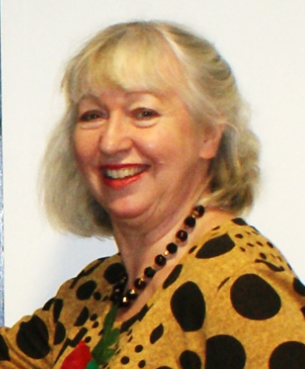


Allocation of school Governing Body/IEB meeting and cover arrangements
Kim from the Governor Support Service will be in touch if or when a school governing body meeting needs a Clerk.

