Slide 1


Clerks and Governor Support Service Briefing Session
Gerri Barry
Information and Advice Service Manager
Thursday 7 May 2020

Slide 2
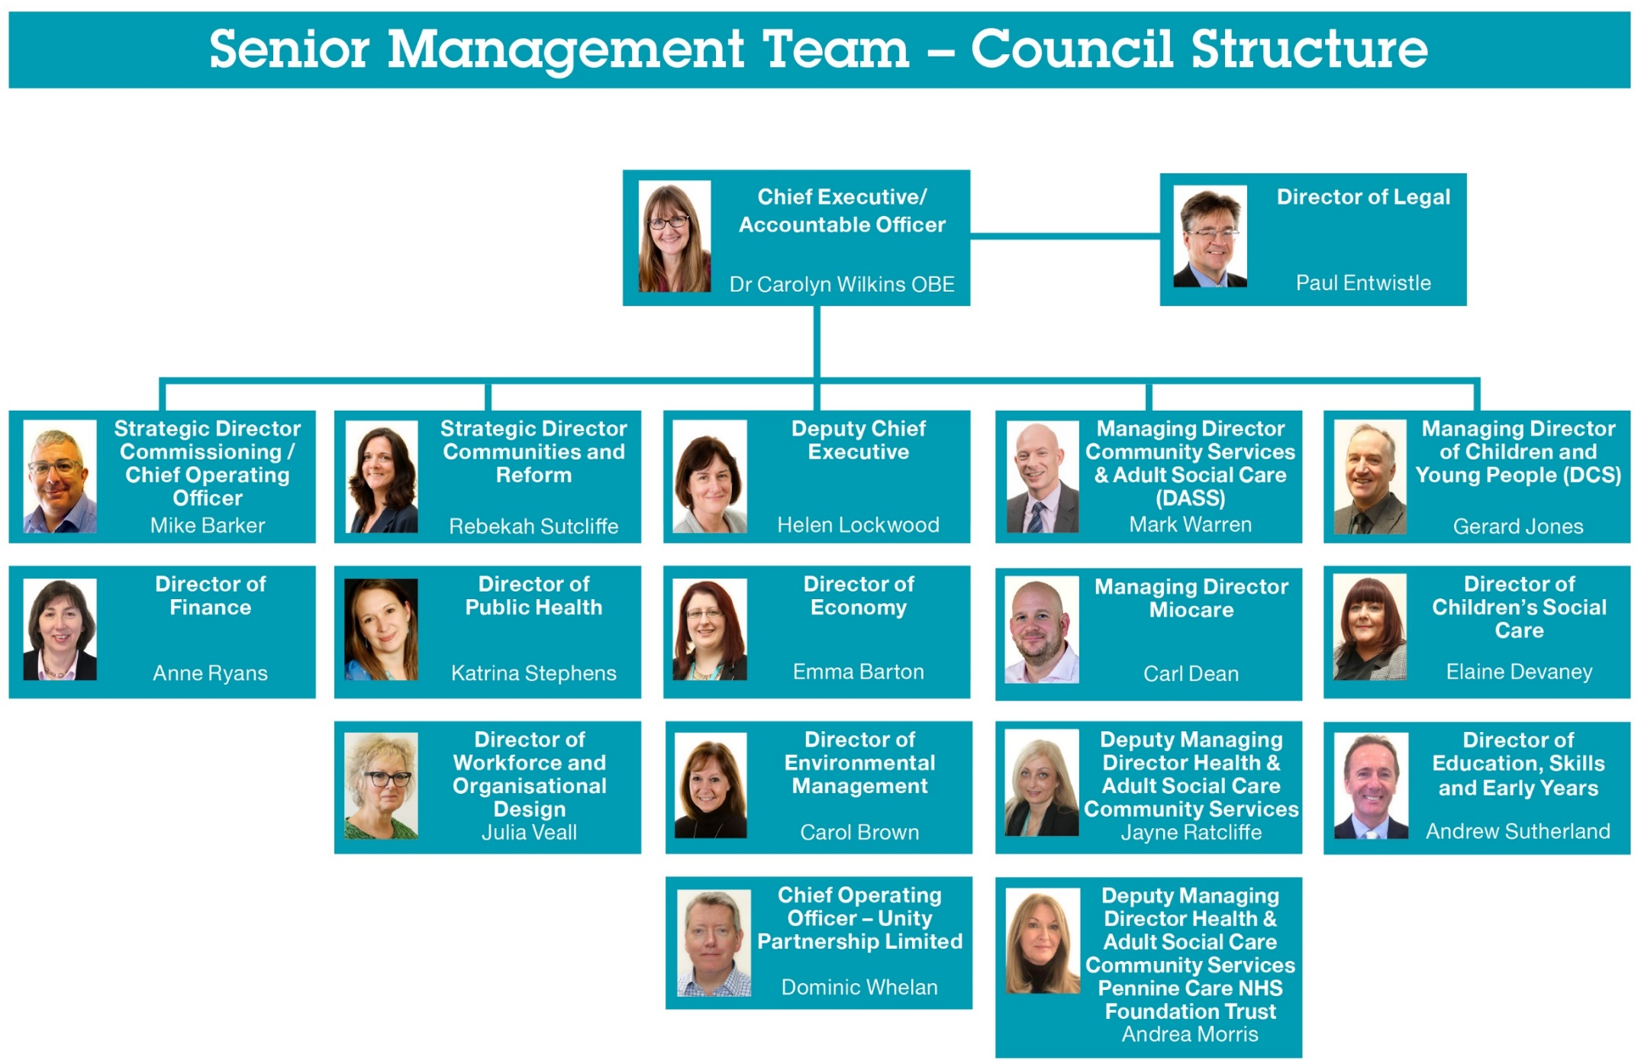
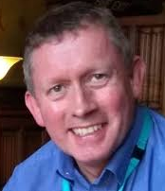
Tony Shepherd
Matt Bulmer

Slide 3

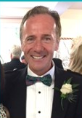
Andrew Sutherland bid us farewell – ‘Guidbye for noo’ (April 2020)

Slide 4
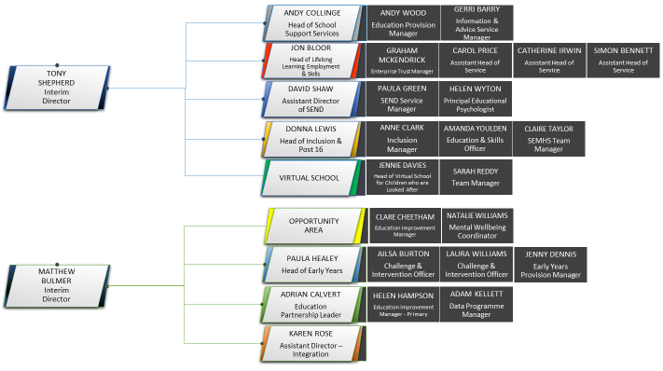
Education, Skills and Early Years Staff Structure
May 2020

Slide 5
School Support Services - Staff Structure May 2020
ANDY WOOD
Education Provision Manager
RITA ARYA
Senior Admissions & Place Planning Officer
JENNY MELIA RAY WHARMBY
Admissions & Appeals Officer
ANN HARVEY/VACANT
School Admissions Support Officer
VACANT
Transfers Officer
ANDY COLLINGE
Head of School Support Services
VACANT
Quality Assurance Officer
GERRI BARRY
Information & Advice Service Manager
JEAN REID
SEND, Governance & FIS Coordinator
ABDUL SALAM
Education Support Services Officer
CLERK TO THE GOVERNING BODY x 26
VACANT
Trainee – SEND Communication, Info & Advice
SUE CARROLL (0.6)
KIM HARTLEY SAMUEL LEES
Governor Support Officers
NABIHA SHAKEEL
Apprentice Communication Info & Advice
GOW – Work Experience Placements

Slide 6


Microsoft Teams – Preferred Platform
Join a meeting using the app which you can download onto any laptop, tablet or smartphone.
Join a meeting without the Teams app, just click on your email calendar invite and choose to join using your internet browser instead of the app – click here for more info.
This is Oldham Council’s default video conference app.
Video Tutorials are available to watch on how to use features on Microsoft Teams as an account holder.

Slide 7

Zoom – Join a meeting
Join a meeting using the Zoom app which you can download onto any laptop (tablets/smartphone via App Store).
Join a meeting without the Zoom app, just choose to use Zoom using your internet browser instead of the app.
Some schools are using this platform however, the council recommends Teams as the Zoom sessions only last 40 minutes at a time - re-joining to a new meeting is required.
A useful Video Tutorial (69 secs) to watch about how to join a meeting including screenshots.

Slide 8
Email Accounts
gbsupport@oldham.gov.uk
All general communications
governortraining@oldham.gov.uk
All information about governor and clerk training and personal development
E-learning alerts

Slide 9
Oldham Council and COVID-19 Updates
Council updates will be shared with all clerks
Staff already employed by the council – usual way
Staff clerk only - communications will be shared via gb.support@oldham.gov.uk
Information on COVID-19 updates are available here: www.oldham.gov.uk
Consultations and surveys – ‘Have your Say’ will also be shared e.g.
Transport survey - The closing date is Friday 8 May 2020.
NGA Survey HERE Closing date Tuesday 26 May 2020.

Slide 10
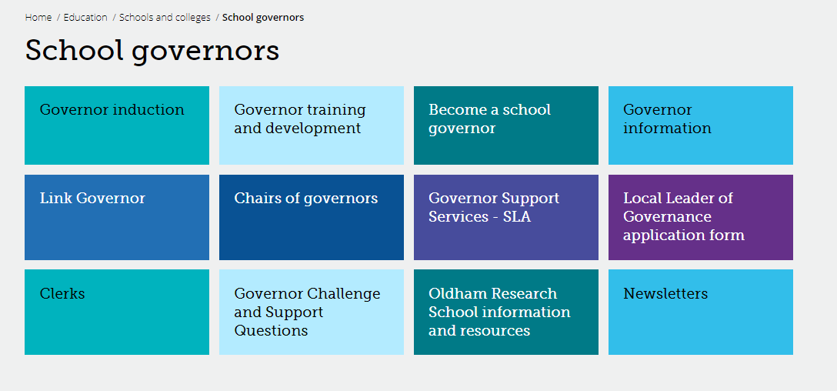
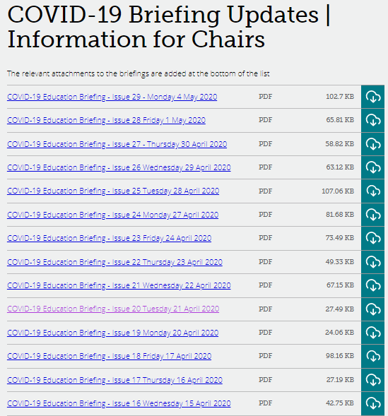
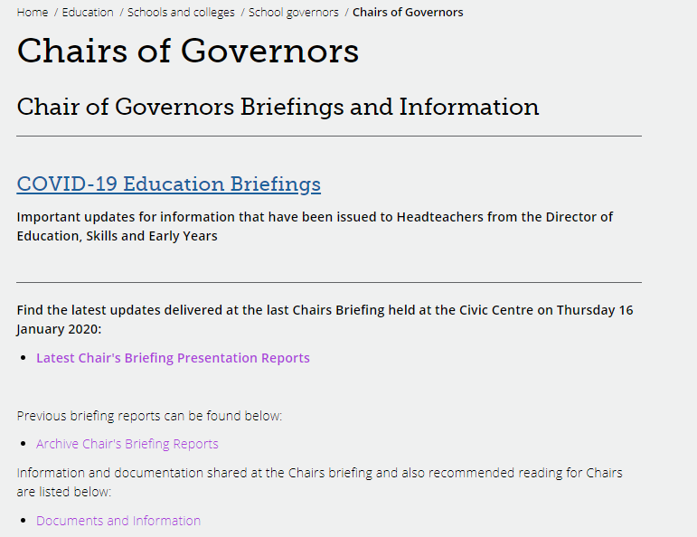
COVID-19 Education Briefings – Sent to schools
www.oldham.gov.uk/chairsofgovernors
Password protected - Oldham

Slide 11
Governor Webpage www.oldham.gov.uk/governors
Password protected - Oldham

Slide 12
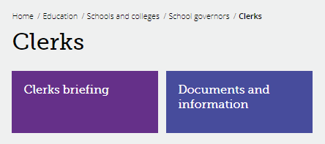
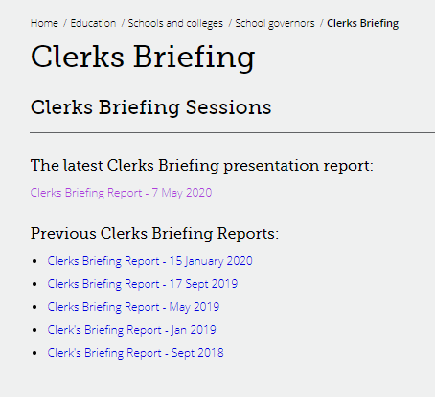
Clerks Briefing Uploaded www.oldham.gov.uk/clerk
Password protected - Oldham

Slide 13
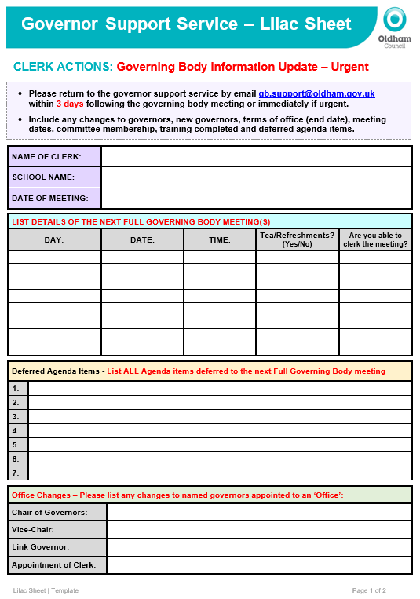
Lilac Sheet - returned within 3 days or sooner
Important
Update with key actions and information regarding:
New governors
All meeting dates (check diary)
Change of email address
Change of meeting dates
Governor leaving dates
Deferred agenda items
Things we need to know and to be action quickly
If you remember that you have missed something off then please let us know straightaway

Slide 14
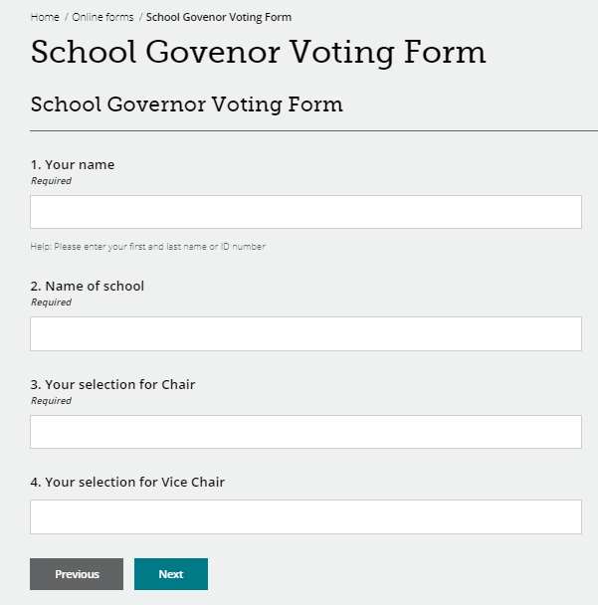
Online Voting – New!
An online voting facility is now in place so that governors can vote for:
Chair
Vice-Chair
Please encourage the Chair to consider using this process.
Beal Vale have been the first school to trial this.

Slide 15
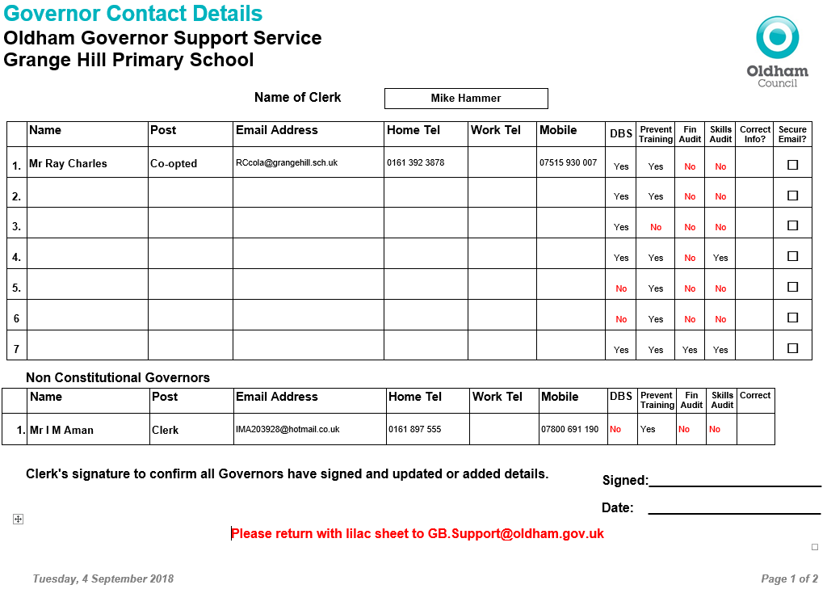
Updated Governor Contact Details Form
Prevent Required by all Governors
Required by all on Finance Committee. Good practice for all Governors
Individual skills matrix completed by all governors and returned to the Chairs to Collate
DBS forms must be completed with governors at school within 21 days
New

Slide 16
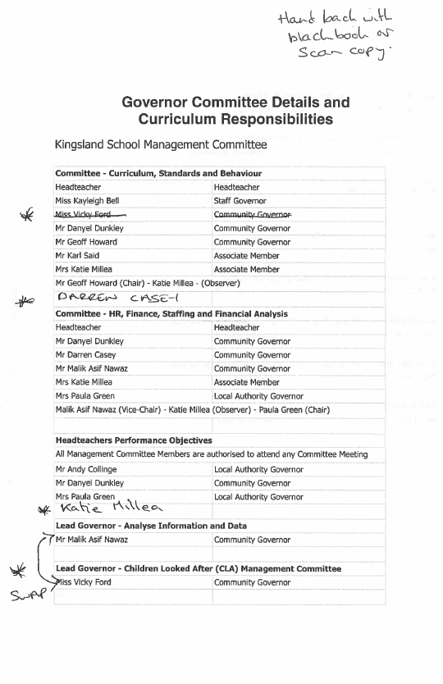

Committee Membership and Governor Responsibilities
It is imperative that you use this document
Update the committee membership and new governor responsibilities
Add changes to the Lilac Sheet gb.support@oldham.gov.uk
You must also update on the minutes

Slide 17
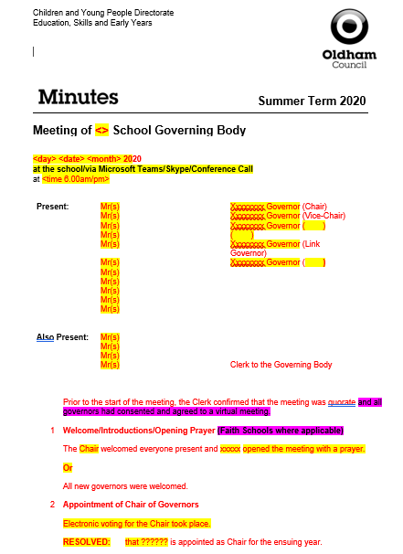
Minute template
Do not use a PREVIOUS template
Check the minute text “fits” and that the tense is correct (past, present etc.)
RED text is standard on the template which signifies that no changes have been made.
BLACK text is what you have typed in i.e. your minutes, changes, amendments etc.
Yellow highlighted text will always need changing or deleting.
Delete Magenta highlighted text.

Slide 18
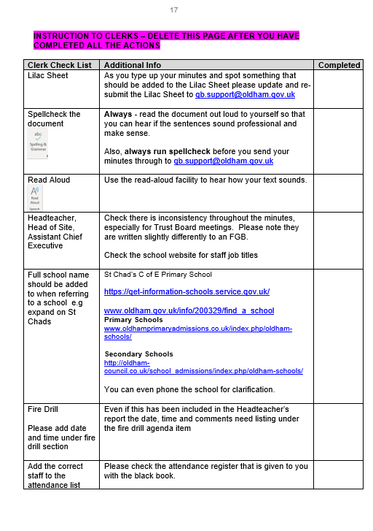
Minute template
A Check list has been updated at the back of the minute template and must be used.
Please work through this check list and then delete it before you issue your minutes to: gb.support@oldham.gov.uk
The minutes should be a final version ready to send to the Chair & HT for factual checking (not proof reading)

Slide 19

Quality Assurance - Check your minutes
Tick list added to the back of the minute template.
Please ensure that your minutes are:
Spell checked
Double-checked
Grammar is checked
Look at formatting
The numbers are inline with the agenda
Are they good enough to publish on a website?
Buddy up with another Clerk to check your minutes
This is important!

Slide 20
Minute Template Training
Book yourself a session with the Governor Support Staff to support you with how to:
Insert rows
Adding in sections
Adding in text
Merging and splitting cells
Table/column alignment
Font size/format
Page break/columns
Contact Abdul Abdul.salam@Oldham.gov.uk to arrange a support session

Slide 21
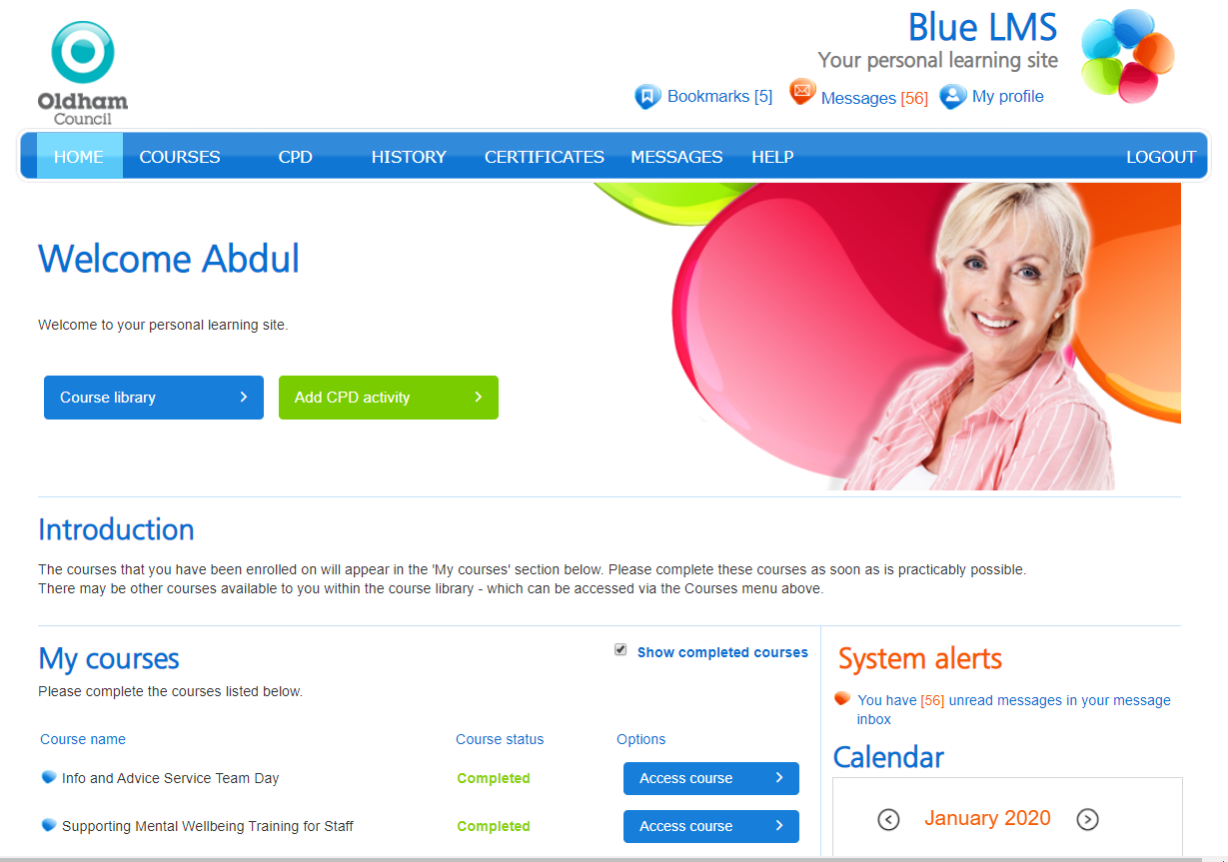
Me Learning – Clerks Training Log @ Development Academy
https://oldham.melearning.university
All Clerks not employed by Oldham Council have been emailed their password
Confirm if you have accessed this platform

Slide 22
Induction Programme | Me Learning
Weekly reminder emails will be sent to you until you have completed your Mandatory Modules i.e. GDPR, Data Protection, Cybersecurity, Health and Safety at Work etc.
Fast FORWARD – Induction for new and existing staff (half day classroom attendance).
You can also access other free Online training – Microsoft Office i.e. Excel, Word, PowerPoint etc.
If you have any queries or problems with your ‘Me Learning’ account or training, then contact Debbie Duffy at the Development Academy on
0161 770 8700 or dabs@oldham.gov.uk

Slide 23






Governor Training and Development
Encourage all governors to access the e-learning that has been sent to them from governortraining@Oldham.gov.uk
Also on the governor website:
www.oldham.gov.uk/governortraining
www.oldham.gov.uk/governortrainingprogramme

Slide 24

Automated reminder emails to Governors
Governors with missing DBS Checks
15th day of month
Governors with missing Prevent Training
20th day of month
www.oldham.gov.uk/onlineprevent

Slide 25
First-Class Email Accounts
First-Class email any governors with issues then they must speak to their school’s administrator for support.
First-Class schools supported by the Oldham Council’s Unity Partnership
Passwords - automatically reset every 90 days (3 Months), council policy.
Passwords - 8 characters (numerals, uppercase and lowercase letters).
Unity Partnership ICT Support team offer support.
Tel: 0161 770 1000 option 2* | Mon–Thurs 8am to 5:30pm & Friday 8am to 5pm
*Please note voicemail or call-back facility are not available
Training – ICT are looking to offer training to support governors accessing and using their First Class account - more information to follow…

Slide 26
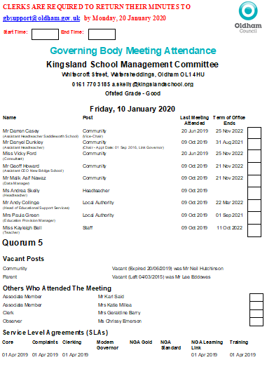
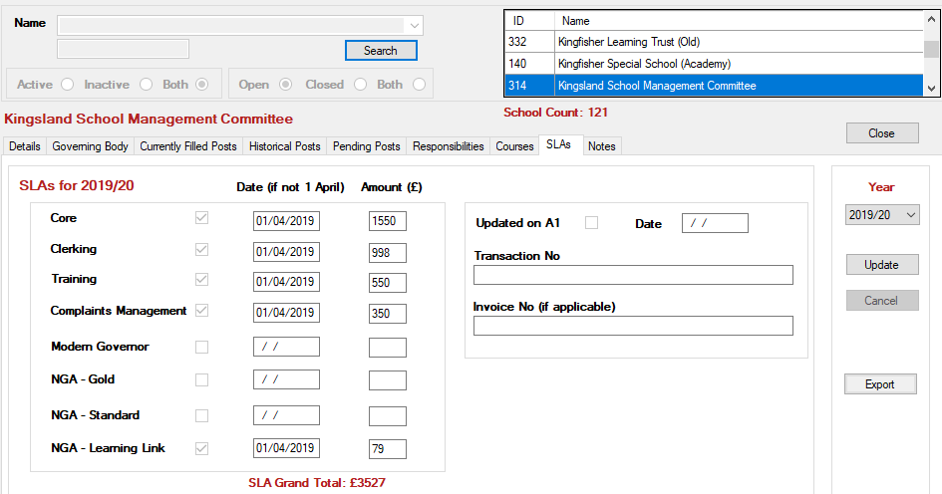
Service Level Agreement SLA 2020/21
Who buys back what?
Information about the SLA is here: https://oldhamservices.co.uk/governor-support

Slide 27
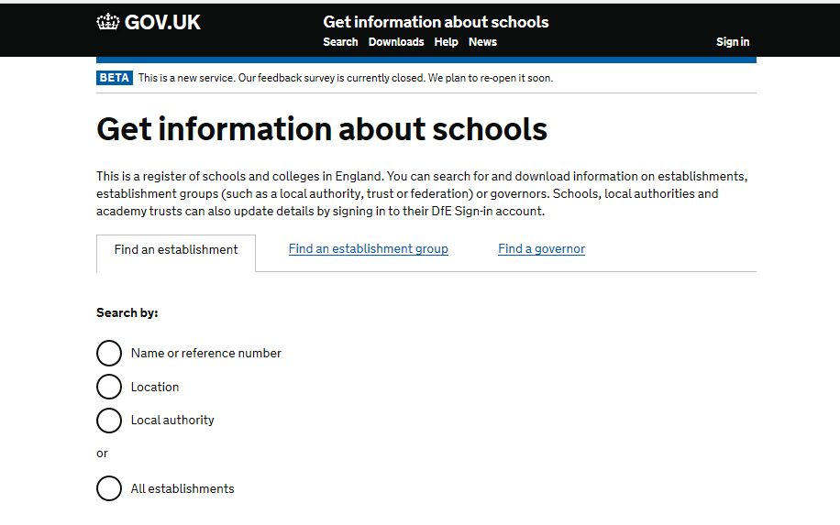
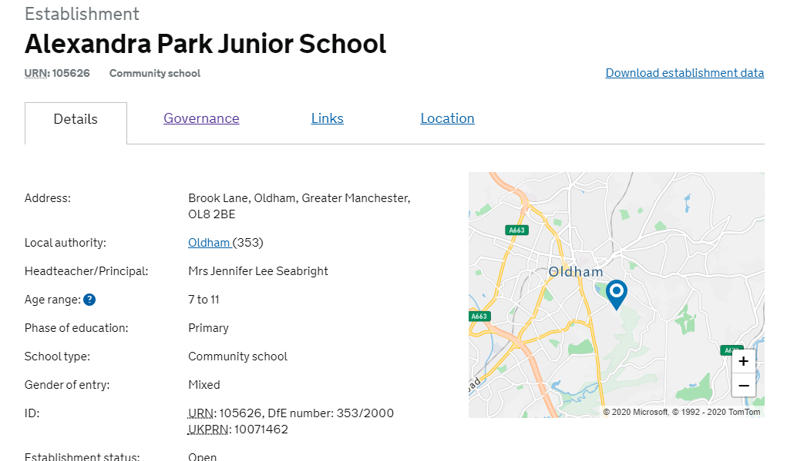
Get Information about Schools – GIAS
https://get-information-schools.service.gov.uk
Only schools can log in and update this information

Slide 28
Summer Term 2020 - Local Authority Agenda Item for Action
There must be an action in the minutes!
Remind the Chair if the governors skip over it!!!

Slide 29
Covid-19 – Replacement Agenda Items
School Business Critical Decisions or Headteacher’s Report
Monitoring of Care for Children
School Building Issues and Remote Working
Home Learning Support for Parents and Carers
Monitoring of Wellbeing
School Website Compliance
Chairs of Governors Briefing – Teams Meeting on Tuesday 19 May 2020 | 6 – 7.30pm

Slide 30
Local Authority Agenda Item for Action
None for Summer 2020

Slide 31
Local Authority Agenda Item for Information
Item 17.1 - Schools Forum
Governors are asked to receive and note the summary papers outlining discussions held at the meetings of the Schools Forum held during last term on 15 January 2020.
Link to the document: www.oldham.gov.uk/schoolsforum
Item 17.2 - School Admissions 2021/22
Governors are asked to ensure that where applicable under the Own Admissions Authority that their school has determined their 2021/22 admissions policy (and supplementary form if applicable) by 28 February 2020 and has published the policy by 15 March 2020.

Slide 32
Clerk Update as an Agenda item
Clerks must share any new updates that occur during the term e.g. Appointment of a new Director of Education and Early Years etc.
LOOK OUT for an email ‘Clerk Update 1’ or ‘Clerk Update 2’ etc.
Drop in text from email ensuring that the information is written in it’s correct ‘tense’ – i.e. something that happened or is going to happen etc.
This is important!

Slide 33
Clerks Update 1 – sent to Clerks on 20/4/2020
Staffing and Post Changes in Oldham Council’s Children Services Directorate
Andrew Sutherland Director of Education, Skills and Early Years left the Local Authority on 24 April 2020. In the interim, Tony Shepherd (Head of Schools and Learning) and Matt Bulmer (Programme Director- Opportunity Area) will act up in the Director role.
David Shaw joined Oldham Council in April 2020 in the post of Assistant Director of Education (SEND).
Coronavirus - COVID-19
Updates from Oldham Council are regularly shared with governors.
The Oldham Council website is updated with any key developments in the local situation. www.oldham.gov.uk/coronavirus
Oldham Learning Festival 2020
Oldham Learning Festival 2020 scheduled to take place in June 2020 has been postponed. www.oldham.gov.uk/olf

Slide 34
Good Practice for Clerks
Avoid using governors names in minutes.
The do not’s …
Do not write back office/admin issues into the governing body minutes.
Do not agree to use different templates/colours or adding in additional action lists. The school will have to do this.
If they have gone paperless they cannot go back to paper - the school will need to come up with a solution e.g. Folder in school, online web folder with password for governors.
Do not write pass words or key instructions in the minutes
Do not go into detail about staffing issues, personal issues or complaints – think about how your text would look on the front page of the press or how people would feel if they read it!

Slide 35
Governor Vacancies Recruitment – Update
Governor Type | Process for filling vacancy | Current vacancies May 2020
Co-opted | Selected and approved by the Governing Body (agenda item) | 17
Parent | Election in School - welcome at FGB meeting | 22
Staff | Election in School - welcome at FGB meeting | 6
Local Authority | Approved by the Lead and Shadow Cabinet members - before the GB meeting (agenda item) | 7
Foundation / Ex Officio | Appointed by the Diocese – welcome at FGB meeting | 16
Foundation PCC | Appointed by the Parish Council - welcome at FGB meeting | 12
Foundation Trustee | Appointed by the Trust – welcome at FGB meeting | 5

Slide 36

Governor Elections MUST TAKE PLACE!
Governor elections must take place for ALL
Staff Governors where terms of office are coming to an end
Parent Governors where terms of office are coming to an end
Existing people in these posts can/must re-apply
They cannot automatically be extended an election must take place.

Slide 37
A Competency Framework for Governance
The list below are Lead governors in specific areas:
Lead Governor
Special Educational Needs and Disabilities (SEND)
Safeguarding of children including Prevent Duty
Health and safety in education
Analyse information and data
Financial health and efficiency compared to organisations locally and nationally
Human Resource Education Policy
Closing the gap for EAL Learners (English as an Additional Language)
Emotional Health and Wellbeing (New)
www.gov.uk/government/publications/governance-handbook

Slide 38

Staff Governors – ONE THIRD maximum
It is important when governing bodies are appointing school staff into various governor posts they must be aware that No more than a third of the governing body can be staff members at the school
1/3

Slide 39
Clerk Timesheets
Timesheets must be submitted when you submit your final set of minutes.
Send in a separate email to gb.support@oldham.gov.uk
New HR & Payroll system is being introduced across the council soon - We will keep you posted when this happens - iTrent

Slide 40
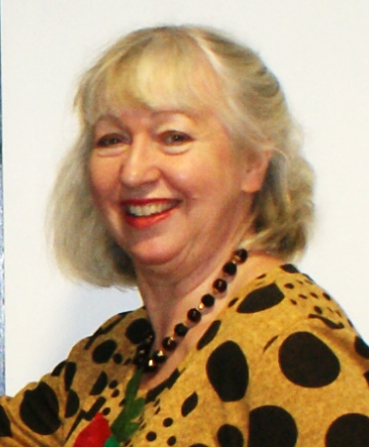


Allocation of school Governing Body/IEB meeting and cover arrangements
Kim
from the Governor Support Service will be in touch if or when a school governing body meeting needs a Clerk.

Slide 41

Any other business

Slide 42
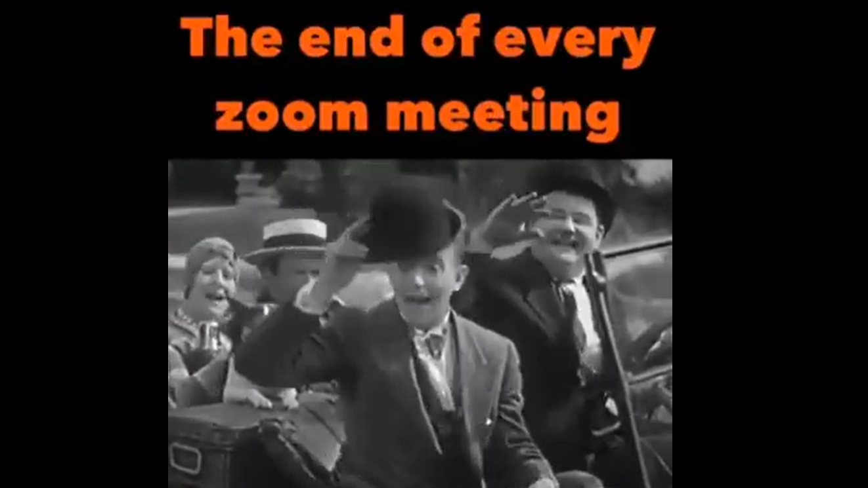
…and TEAMS!
www.youtube.com/watch?v=2R5jOVZJCK4

