Slide 1
Preparing for your Ofsted Inspection under the New Framework
Governor Training Session
Julie Stevens
Support and Challenge Officer
Oldham Council
Monday 24 February 2020

Slide 2
Areas to be covered
Brief overview of the framework
Core functions of Governance and the new education inspection framework (EIF)
Intelligence from regional inspections –to include timescales, deep dives, areas of focus
How the local authority (LA) help to support the school prior to inspection
Preparing for the practicalities of an inspection
Questions and closing

Slide 3
Brief overview of the Ofsted framework
Brief overview of the framework including:
  Intelligence from local inspections
  The difference between a Section 5 and a Section 8
  Possible outcomes from each
  Self-assessment and limiting factors
  What each part of the inspection process looks like in practice
  The prominence of reading in the inspection

Slide 4

The previous framework…

Slide 5


Slide 6
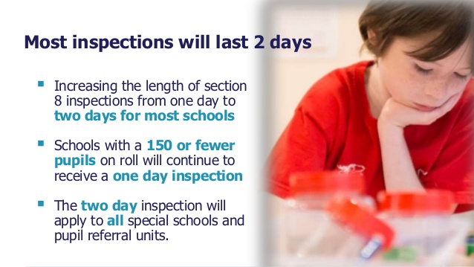

Slide 7


Slide 8
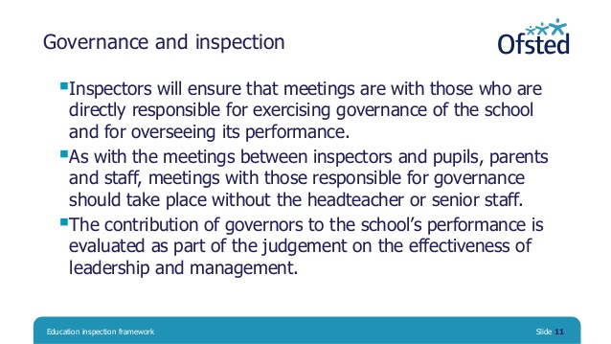

Slide 9
Intelligence from local inspections
We have had 17 Primary inspections in Oldham since September 2019
The gap between inspections has been between:
  43 and 59 months for good schools and
  26 and 35 months for RI schools.
We have had 28 different inspectors (a handful have completed a couple of inspections) but have intelligence on others
Nationally the percentage of primary schools being graded as outstanding is now only 2% (inspections since September 2019)

Slide 10

Further intelligence from local inspections
* In Oldham - All English or Reading and Maths
10 History
7 Science
3 Geography
2 MFL
1 ICT; 2 DT; 1 Sports / P.E.; 2 Art
If you have a team leading a subject then they can meet inspectors together. If the leader is new - need to show how Senior Leadership Team (SLT) have supported them.
Trainees should not receive a lesson visit but will be asked about how they have been supported and the CPD (Continuous they have received.

Slide 11
How the LA support the school
* Has the same intelligence as Ofsted plus we can liaise with other LA teams/SIP(School Improvement Partner)
Review of SEF (School Evaluation Form) / SDP (School Development Plan) / Website
School visit – question preps, view of school, evidence gathering to support judgement, identify gaps
Support specific leaders/governors as necessary
Interview
Support during the inspection as needed
Meet with the inspector as the LA representative
Question sets – SLT, subject leads, SENCO, governors, assessment leads, safeguarding leads.

Slide 12
Types of Inspection
Section 8 and Section 5

Slide 13
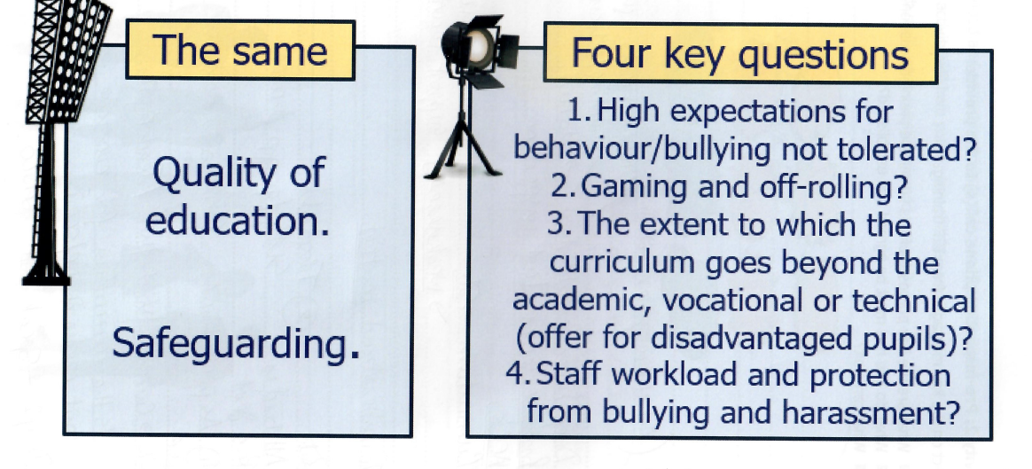
Section 8 Inspection
The focus is on………………..
This is a 2 day inspection with one inspector - for the majority of primary schools
Notes:
No judgement made under other headings but Inspectors consider:
Whether school has high expectations of behaviour, whether this is reflected in pupil conduct and outcomes – observable practice, taking to pupils, bullying logs
Whether leaders, staff and pupils create an environment in which bullying is not tolerated – staff and pupil surveys/ parentview
Inspectors will consider the extent to which the curriculum goes beyond theacademic, vocational or technical, whether the school provides effectively forpupils’ broader development and whether the school’s work to enhance pupils’spiritual, moral, social and cultural development is of a high quality. – website, work scrutiny, conferencing, SL discussions, SLT
Inspectors will consider the extent to which leaders engage with staff and areaware and take account of the main pressures on them, engaging with themrealistically and constructively. They will consider the extent to which staff arefree from bullying and harassment. Inspectors will also consider whetherleaders and staff understand the limitations of assessment and use it in a waythat will avoid creating unnecessary burdens. Staff survey/ work scrutiny
64.If these issues are not being managed well, this could be considered asevidence that the school would no longer receive a ‘good’ judgement if itreceived a section 5 inspection. Where the lead inspector has serious concernsabout workload or the bullying or harassment of staff, the inspection will beconverted to a section 5 inspection.
All schools should have a good culture of safeguarding. This means that theyshould have effective arrangements to:
◼always act in the best interests of pupils to protect them online and offline;
◼identify pupils who may need early help and those who are at risk ofharm or have been harmed. This harm can include, but is not limited to,
neglect, abuse (including by their peers, in school or outside school), grooming or exploitation
◼ secure the help that pupils need, and, if required, refer pupils in a timely way to those who have the expertise to help
◼ manage safe recruitment and allegations about adults who may be a risk to children, pupils, students and vulnerable adults.

Slide 14


Slide 15

A Section 8 inspection – p14 November 2019
Inspectors will focus primarily on the ‘quality of education’ during a section 8 inspection of a good or non-exempt outstanding school.
Inspectors will form a secure view of whether the quality of education as defined in the ‘school inspection handbook’ remains good at this school.
Notes:
Most inspections are Section 8 – good / outstanding schools who after Ofsteds risk assessment are still likely to be good

Slide 16
A Section 8 inspection – p14 November 2019
Continued…
In order to do this, inspectors will focus on key aspects of the school’s provision. They will:
  always consider and evaluate all aspects of the aims of the school’s curriculum, including the degree to which the school’s overall curriculum is coherently sequenced and structured (intent).
  consider the extent to which teachers have good knowledge of the subjects they teach, present subject matter clearly, check pupils’ understanding systematically, identify misconceptions accurately and provide clear, direct feedback to pupils (implementation).
Notes:
Brief discussion about how this is done – reiterate we will look at question sets later.

Slide 17
A Section 8 inspection – p14 November 2019
Continued…
  consider the extent to which pupils develop detailed knowledge and skills across the curriculum and, as a result, achieve well and are ready for the next stage of education, employment or training (impact).
  always consider whether there is any evidence that the school’s curriculum has been narrowed inappropriately (gaming).
  observe, where it exists, provision for 2 and 3 year-olds, and assess whether staff are knowledgeable about the typical development and characteristics of 2 and 3 year-olds, are focused on teaching children through the three prime areas of learning and are attentive to children’s needs (EYFS).

Slide 18
A Section 8 inspection – p14 November 2019
Continued…
  consider how well reading and early mathematics are taught in early years foundation stage (EYFS) and Key Stage 1 as part of a wide-ranging curriculum that prepares children well for the next stage in their education. As in section 5 inspections, inspectors will always carry out a deep dive in reading; they may choose to carry out a deep dive in mathematics but this is at the lead inspector’s discretion.
  in primary schools, explore how well a broad range of subjects(exemplified by the national curriculum) is taught in key stage 2.
  Inspectors will focus first and foremost on the teaching of reading, particularly on how children gain access to the whole of the national curriculum through learning to read fluently and with comprehension.

Slide 19
Subjects for deep dives on section 8 inspection…
Reading (definitely) – for primaries
Maths (probably) unless writing is cause for concern and becomes a focus
One or two other subjects (likely to be one of the ‘academic’ subjects…history, geography, science) chosen in discussion with HT.
The subject must be being taught during the first day but schools do not have to adjust their timetables.
Notes:
After Day 1, the Inspector will come up with a hypothesis to check on Day 2 – this may involve looking at a second subject or a further dive into one already covered, dependent on what is found.

Slide 20
Quality of Education – ‘Deep Dives’
Inspectors identify the focus for deep dives from initial conversation with SLT and information on website
Curriculum conversation with SLT
Curriculum conversation with subject leader
‘Lessons visits’ - ideally, visits to all key stages
Follow up conversation with teacher after lesson
Work scrutiny and conversation with teacher/subject lead
Pupil conversation – with subject book, on focus of deep dive
Look at sequence of lessons in the subject
Joined up evidence – what is it saying about the Quality of Education?
Notes:
The report will be written under ‘Spotlights’ – word counted, written for parents etc

Slide 21
Outcomes of a Section 8
Outcome 1 – the school continues to be a good/outstanding school. This is the most common outcome
Outcome 2 – the school remains good and there is sufficient evidence of improved performance to suggest that the school might be judged outstanding if it received a section 5 inspection at the time of the section 8 inspection.
Outcome 3 – the lead inspector is not satisfied that the school would receive at least its current grade if a section 5 inspection were carried out at the time of the section 8 inspection.
Outcome 4 – the lead inspector has gathered evidence that suggests that the school may be inadequate in one or more of the graded judgements under section 5 inspection, and there are serious concerns about the quality of education, pupils’ behaviour or safeguarding.
Notes:
Outcome 2 - The school will be informed that its next inspection will be a section 5 inspection, which will typically take place within one to two years of the publication of the section 8 inspection report
Outcome 3 - The school will be informed that itsnext inspection will be a section 5 inspection within the statutorytimeframe, which will typically take place within one to two years of thepublication of the section 8 inspection report
Outcome 4 -
For outstandingnon-exempt schools, there are concerns that the performance of theschool could be declining to ‘requires improvement’.20 The section 8inspection will be converted to a section 5 inspection, usually within 48hours.
Inspectors will always report on whether safeguarding is effective. If there is evidence that safeguarding is ineffective, the inspection will convert to a section 5 within 48 hours.
Outcome 4 would be evidenced by gaming or off rolling, serious safeguarding concerns, inadequate quality of education, or there are serious concerns about behaviour and attitudes.

Slide 22
‘Good’ or ‘Outstanding’ schools who trigger a Section 5
Ofsted’s Risk Assessment (page 6-7 Handbook)
Some triggers include:
  Data shows standards may be declining over time
  Safeguarding issue
  Qualifying complaint to Ofsted
  Pupil mobility
  Outcomes of any survey inspections carried out since last inspection.
  Time since last inspection for exempt schools.
Notes:
Pupil mobility This measures the amount of pupils leaving the school before the normal leaving age, or joining after the normal joining age, for that school.

Slide 23
Section 5 Inspection
Under Section 5 – every judgement is available
Reporting under all areas in feedback
  Quality of education
  Behaviour & attitudes
  Personal development
  Leadership & management
  Early years
Lead Inspector plus 1 (or 2) others dependent on size of school.
Deep dives into R,W,M and at least two foundation subjects.
Section 5 inspections – Q of E is a limiting factor.

Slide 24
Exempt Schools
Primary and secondary schools and academies that were judged to be outstanding in their overall effectiveness at their most recent section 5 inspection are exempt from routine inspections under section 5.
BUT…
Exempt schools are subject to risk assessment.
  If the risk assessment process raises concerns about the performance of an exempt school, we may inspect it under section 8 of the Act at any time after the risk assessment.
Notes:
This exemption also applies to academy converter schools when the overall effectiveness of the predecessor school was outstanding at its most recent section 5 inspection.

Slide 25
Exempt Schools
If a risk assessment identifies sufficient concerns about a decline in the performance of pupils’ academic/vocational/technical achievement and an overall decline in performance, these outstanding schools will receive a section 8 ‘no formal designation’ inspection
If, during the course of the inspection, the lead inspector finds that the school’s overall effectiveness may be lower than outstanding, then the lead inspector may deem the section 8 inspection as a section 5 inspection.
All outstanding schools under new proposals will be inspected in the next 4-5 years.

Slide 26

Any questions so far?

Slide 27
So how is the inspection structured?
10 days before – Inspector finds out which school they will be inspecting
They will look at the key development points from the last inspection, examine the school IDSR (Inspection Data Summary Report) and look closely at the school website
The school website will be viewed to ensure everything that is statutory is present and to explore the quality of curriculum offer for all pupils.
These three things will offer up lines of discussion for the 90 minute conversation.

Slide 28
Before the 90 minute conversation…
The HT will receive a call from Ofsted saying that school will be inspected over the following two days, what type of inspection it will be and the name of the inspector/s.
They will be able to negotiate the time of the conversation, which gives them time to gather up who they need to and be ready with their evidence (p56 - you can have other leaders present).
They will receive a call from the LA representative at which point we will give them some background on their inspector/s.

Slide 29
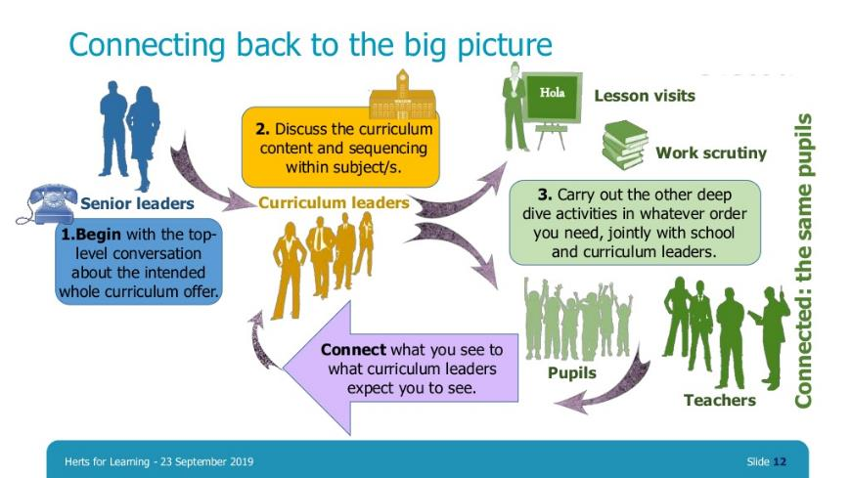
Notes:
In both inspections, this process will be followed. If you know to expect it, it’s easy to be prepared for it. The focus is most definitely now on leaders at all levels – subject leaders would do well to ensure they know and understand the rationale for the curriculum choices made, why their subject is structured in the way it is, how it links to other subjects and to have evidence ready to demonstrate coherence, sequence and progression in their subject from pupil work scrutiny and conferencing which exemplifies what SLT and they are saying. This is part of subject leadership and should not involve extra workload.

Slide 30
The 90 minute conversation – Top Level View (page 17, Handbook)
May be one or two conversations – the HT/SLT decide.
Two purposes –
  A reflective conversation about the school’s progress since the last inspection, to include the curriculum offer.
  A shorter inspection planning conversation focussing on practical and logistical issues such as timetabling

Slide 31
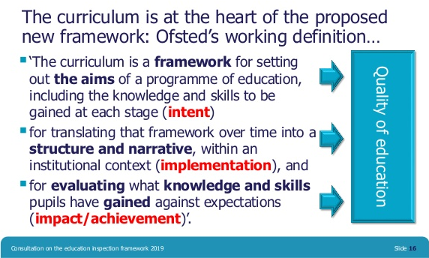
Intent, Implementation and Impact
Notes:
Now we are a little further down the line of seeing how the new framework is being implemented, we know what scrutiny of these three areas looks like in practice.
Intent is not merely a vision, neither is it a mission statement, a set of values or faith statement. Intent is a full understanding by a school of context and content – what you want children to know, why you want children to know it and how you are organising it in your school. It is a sequenced, progressive and coherent plan of what will be taught in each subject and when. It is everything up to the point of being taught. This will be viewed on your website, discussed in your 90 minute conversation and unpicked with subject and middle leaders.
Implementation is all about how this content will be taught and is definitely the biggest part of the judgement. Here, inspetcors will consider what leaders have said about their intent ( including subject leaders) and check whether this intent is being implemented in classrooms in terms of pedagogy, addressing misconceptions and building on prior knowledge, delivered over time in book scrutinies and understood by children, gauged in pupil discussions. We will discuss a little later what this looks like in practice during an inspection.
Impact is a clear evaluation of what pupils have learnt – have pupils achieved what we set out for them to achieve? Again, this will come through book scrutiny and pupil conversation but also in middle leaders discussions about what they know about the strengths and areas for development in their subject and hat they are doing to address any gaps in practice. How do leaders know what pupils have learnt over time?
So before we unpick fully what this looks like during an inspection, let’s look at what Ofsted said in their Curriculum Roadshow in January…

Slide 32
The 90 minute conversation for leaders
Be clear - what you are asked will also be asked of middle leadership and governors and will inform your deep dives
Be honest – discuss strengths against the handbook statements, give exemplars, including the progress of PP (Pupil Premium) and SEND pupils. Other leaders may be best placed to do this – draw on team strength. Discuss SEF/SDP
Be prepared – the more you and your team understand why you are being asked the questions you are being asked, the simpler the discussion is.
Make links – you will be asked about your curriculum offer on your website and your journey in producing it.
Be sure – during the deep dives the quality of curriculum thinking will be explored with subject leads and triangulated with evidence. Once brought together, hypothesis are created for Day 2 around the quality of education.
Notes:
Knowing why you are being asked what you are being asked is key. Using the Ofsted statements and language and providing the evidence against them makes the process simpler for all.
All inspectors are quality assured , as are their reports. Howevr, different inspector will obviously have diffetent styles of approaching the inspection. Some will be more conversational in style, which will probably put you at ease. Others may be more direct and explicit. Either way, Inspectors will use your answers to hypothesise and create key questions, that they will also ask of middle leaders and governors, and cross check against pedgagogy, learning over tme and pupil voice. And they are ALL trying to evidence against the handbook statements.

Slide 33

Link to Governor interview

Slide 34
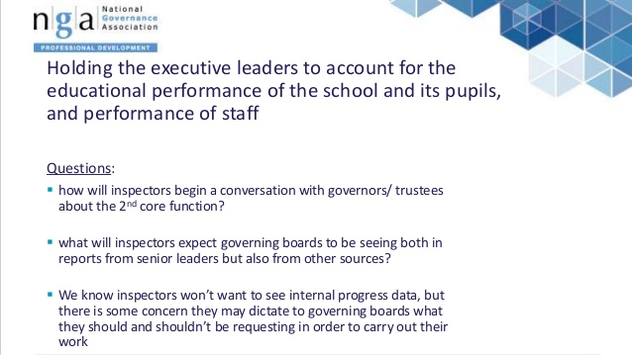

Slide 35
Key questions
Do you know what the key areas of development were from your last inspection and what progress has been made against them?
Is your website statutory? Whose responsibility is it to make sure that it is?
www.gov.uk/guidance/what-maintained-schools-must-publish-online - 2018 update
What does your school data tell you about the progress of pupils? What are the strengths/areas for development? How do you hold leaders to account for their actions against these priorities? Do you access your SIP report?

Slide 36
Key questions
Have you discussed with your SLT these key questions so that your statements ‘match’ theirs?
For timetabling purposes, does your school leadership know who they can rely on to attend the Governors interview? ( usually on Day 2?)
Who are the best people to be interviewed? What are their responsibilities? Are they up to date on knowledge and intelligence on the school? Do they attend training? What is the impact of that training?
Can Governors describe an area of challenge which has impacted on pupil outcomes?
Up to date on KCSIE (Keeping Children Safe in Education) 2019 updates – crucial.

Slide 37
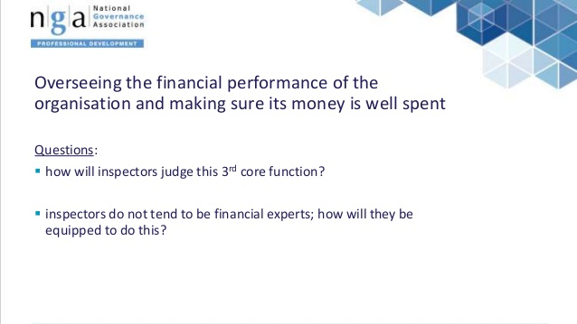

Slide 38


Slide 39
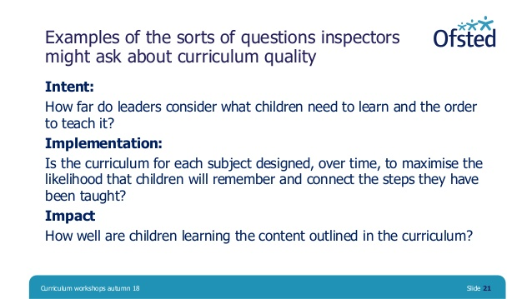

Slide 40
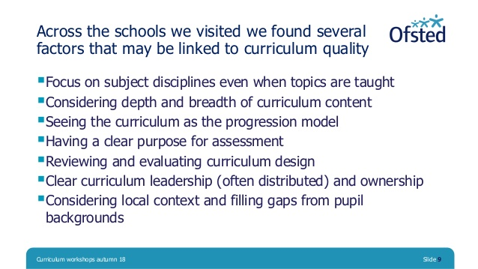

Slide 41
Key questions
Do you know what the barriers for children are in your context and how your curriculum offer intends to close the gap?
What are your schools current strengths in this area and what are the areas for development? How do you know? (Governing body meetings, work scrutiny, subject leader conversations) In short, whose responsibility is it in your Governing Body to know this?
How are staff new to role supported? (mentors/CPD)

Slide 42
Assessment
Good schools praised for quality of assessment
Teachers use assessment information well
Teachers using skilled subject knowledge to iron out misconceptions and fill gaps in pupil knowledge
Skilful questioning to ensure they are finding out what pupils know and remember and where there are struggling to catch up and keep up, planning rapid interventions to ensure the gap does not widen
Notes:
Interestingly no mention of assessment in RI schools explicitly and definitely no mention of quantity or frequency of marking

Slide 43

The importance of vocabulary acquisition
‘There is a clear link between vocabulary and social class – and potential educational outcomes are set in motion well before a child starts school.’
Notes:
There is a wide variation in young children’s exposure to vocabulary. Evidence from cognitive psychology – direct correlation between a higher acquisition of vocabulary and a higher level of knowledge and consequently better qualifications and employment in later life

Slide 44


Slide 45
Key question
What does your school do to close the vocabulary gap? How is this visible in practice?
  Learning environments
  Knowledge organisers
  Pedagogy ( teaching and learning)
  Interventions/support
  Work with external agencies

Slide 46
Takeaway points – key summary
Why is your curriculum designed the way it is? Content and context, essential knowledge, golden threads, links between subjects. Sequence, progression, coherence.
How is it fulfilling the needs of ALL pupils – is the adaptation right and is it leading that pupil to suitably ambitious end points?
Vocabulary acquisition is key – how are you addressing the deficit and expanding vocab through your curriculum?
Learning is a change in long term memory – how do you know this is happening for your pupils?
Progress is knowing more and remembering more.

Slide 47
Short reflection time (10 minutes)
From our discussions thus far, what are the key strengths of your school? Areas of development?
What questions do you need to ask when you go back to school?
What do you know and what do you need to find out?

Slide 48
Notes:
In both inspections, this process will be followed. If you know to expect it, it’s easy to be prepared for it. The focus is most definitely now on leaders at all levels – subject leaders would do well to ensure they know and understand the rationale for the curriculum choices made, why their subject is structured in the way it is, how it links to other subjects and to have evidence ready to demonstrate coherence, sequence and progression in their subject from pupil work scrutiny and conferencing which exemplifies what SLT and they are saying. This is part of subject leadership and should not involve extra workload.

Slide 49
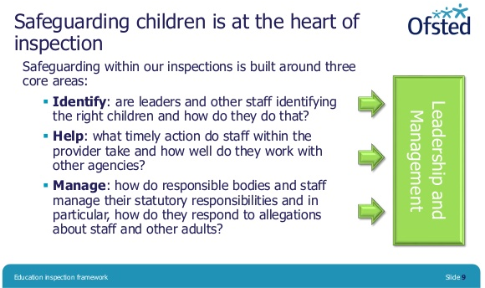
Safeguarding

Slide 50

Safeguarding

Slide 51
Staff workload and protection from bullying and harassment
With reference to assessment and the data collection, input and analysis it involves, Ofsted now suggest that leaders ‘do not use it in a way that creates unnecessary burdens for staff or learners’.
The framework and handbooks also contain more general outlines for leaders saying that they should be aware of the main pressures that are on staff and take account of them, be realistic and constructive in the way they manage their staff (including their workload), and that any workload issues are consistently dealt with appropriately and quickly.

Slide 52
Staff workload and protection from bullying and harassment
It’s not just workload that leaders need to protect their staff from, the framework also states that leaders should ‘protect their staff from bullying and harassment.’ The criteria for outstanding leadership also include the statement: ‘Staff consistently report high levels of support for well-being issues.’
In order to lead on improvements to workload problems, Ofsted also point out that:
  Teachers should not be selecting resources and materials which create unnecessary workload;
  That teaching should not be unnecessarily elaborate;
  That differentiated approaches that require a great deal of planning time aren’t necessary.

Slide 53
Staff workload and protection from bullying and harassment
Staff will be asked…
  Q. What is it like to work here?
  Q. How do leaders support you with a work-life balance?
  Q. How are you supported in dealing with ‘difficult’ parents?
  SLT not to attend meetings with staff
  Inspectors to ask staff individually i.e. at a subject leader meeting
  Discussion with leaders – how do you support staff workload?
  How well do leaders deal with workload issues when they are identified?
  Discussion with governors – How do you know if staff are happy?
  Staff questionnaire

Slide 54
Key questions
When was the last time school carried out a staff wellbeing questionnaire?
What were the results of it and was anything changed as a result?
______________________________________________
How do Governors ensure the wellbeing of the Headteacher?
Does your Head take their allocated release time?

Slide 55
Any questions?

Slide 56
Notes:
In both inspections, this process will be followed. If you know to expect it, it’s easy to be prepared for it. The focus is most definitely now on leaders at all levels – subject leaders would do well to ensure they know and understand the rationale for the curriculum choices made, why their subject is structured in the way it is, how it links to other subjects and to have evidence ready to demonstrate coherence, sequence and progression in their subject from pupil work scrutiny and conferencing which exemplifies what SLT and they are saying. This is part of subject leadership and should not involve extra workload.

Slide 57

Reading – the non-negotiable

Slide 58
Effective Schools
Make sure reading is right EARLY
Importance is raised from EYFS to KS1
Leaders place a strong focus on reading and high quality CPD – everyone in school is an expert
Systematic phonics is taught well
High expectations and no excuses
Teachers and children demonstrate a genuine love of reading – story time is a valuable part of the school day
Reading is embedded across the curriculum
Effective links with parents
Right level of support for those who are making slower progress or arrive in school later.
Notes:
Assessing children on onset to the setting and getting the basics right is crucial. Masetring phonics in high quality consistent practice, where teacher and TA knowledge is strong is key. Adults exposing young children to a wide vocabulary through first hand experiences and reading to them is key.
Quality practice ensures that by the end of Y2, children are confidently decoding a range of age appropriate texts. In cross curricular texts, they underatand the knowledge behind the text that enables them to comprehend what they are reading.

Slide 59
Inspecting reading… p87 of handbook
Website/ data
SLT 90 minute conversation
Phonics and reading lead interview
Observation of the teaching of phonics and in KS2 the teaching of reading
Listening to the bottom 20% read – particular focus on Y2/3 and Y5/6. Fluency and accuracy
How does school support parents in helping their children to read? Home readers being decodable at KS1
How is reading embedded in other areas of the curriculum?
Learning environments – books matching pupil ability
Pupil discussion – enjoyment, authors
EYFS/KS1 staff all experts in early reading – plans being followed, leaders aware when they are not and actions to rectify
Interventions – how quickly do pupils catch up and keep up?
Notes:
So we know Ofsted will look at the curriculum offer and how reading is prioritised.
They will speak to the phonics lead about intent and ask how phonics is implemented in the setting and what the setting does to ensure those who are making slower progress catch up and keep up

Slide 60
Systematic v Typical
When making a judgement of the quality of education, inspectors will question whether the intent and implementation are a systemic strength or if there are areas of weakness. These may form a hypothesis in Day 2.
The findings will then be part of feedback or action points to improve.
Transition arrangements are only valid for intent.
As long as Reading, Writing, Maths and Science plus a couple of foundation subjects are ‘sound’, 198 is triggered and your action point will be to give other areas more time or bring other subjects up to the same standard.
Not used in outstanding schools or on a section 8.

Slide 61
Final note
Reports
These are brief and for the benefit of parents – what is it like to be a child in this school?
There is a format and word count inspectors have to stick to
Feedback is detailed (to HT/SLT first) so advise someone to take detailed notes
You can tell staff the outcome straight away

