Slide 1
Clerks Information and Briefing
Gerri Barry
Information and Advice Service Manager
Governor Support Service
Wednesday 15 January 2020

Slide 2
Governor Recruitment Event Invitation
Governors for Schools information session
This is a joint event with Manchester University and Manchester Metropolitan University staff and alumni
Date: Wednesday 26 February 2020
Time: 5.00 to 7.30pm
(sessions held at 5pm and 6.30pm)
Venue: Oldham Sixth Form College, Union Street West,
Oldham, OL8 1XU
RSVP: www.oldhamschoolgovernorevent.eventbrite.co.uk
Email: Emma.harris@governorsforschools.org.uk

Slide 3
Housekeeping

Slide 5
Governor Webpage www.oldham.gov.uk/governors
New
Password protected

Slide 6
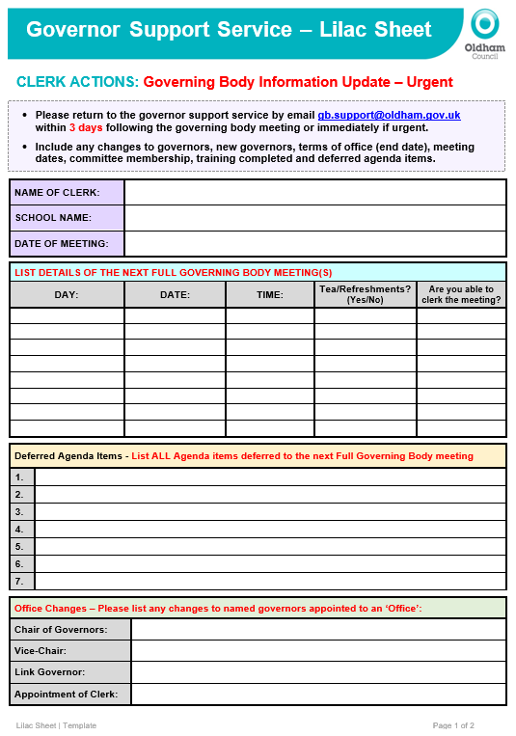
Lilac Sheet – New improved format
Update with key actions and return within 3 days
New governors
New meeting dates
Change of meeting dates
Governor leaving dates
Deferred agenda items
Things we need to know and action quickly
If you spot that you have missed something off then please let us know straight away

Slide 7
Updated Governor Contact Details Form
Prevent Required by all Governors
Required by all on Finance Committee. Good practice for all Governors
Individual skills matrix completed by all governors and returned to the Chairs to Collate
DBS forms must be completed with governors at school within 21 days
New

Slide 8
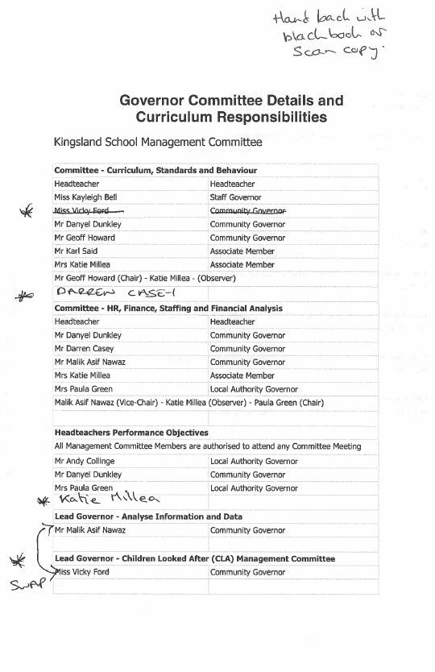
Committee Membership and Governor Responsibilities
It is imperative that you use this document
Clearly write on and cross out changes made to committee details and governor responsibilities
Return hard copy or scan back to gb.support@oldham.gov.uk
You can also update on Lilac Sheet and minutes

Slide 9
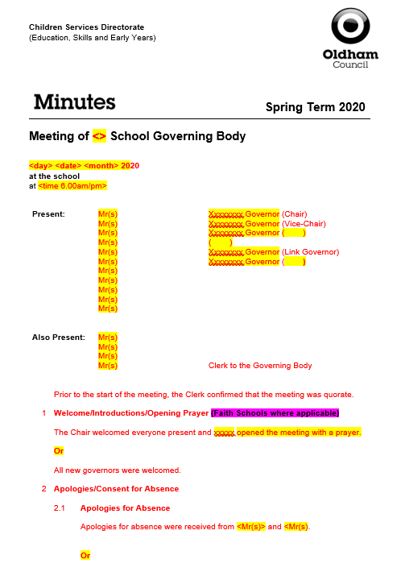
Minute template
Do not use a PREVIOUS template
Check the minute “fits” and that the tense is correct (past, present etc.)
RED text is standard on the template which signifies that no changes have been made.
BLACK text is what you have typed in i.e. your minutes, changes, amendments etc.
Yellow highlighted text will always need changing or deleting.
Delete Magenta highlighted text.

Slide 10
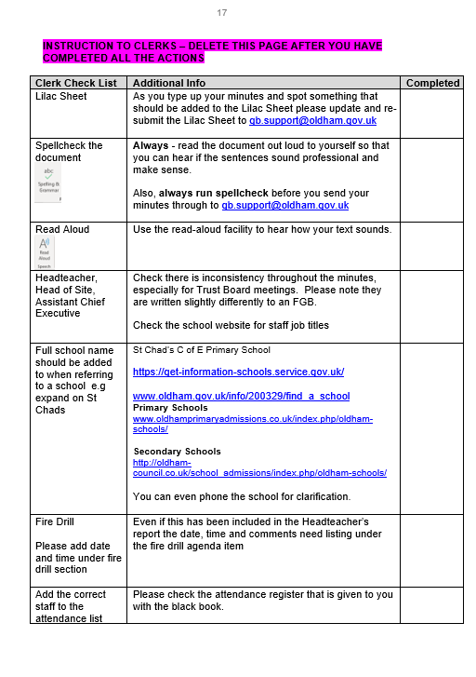
Minute template
A Check list has been updated at the back of the minute template and must be used.
Please work through this check list and then delete before you issue your minutes to: gb.support@oldham.gov.uk

Slide 11
Quality Assurance - Check your minutes
Tick list added to the back of the minute template. Please work through it and then delete the list before sending in the minutes
Please ensure that your minutes are:
Spell checked
Double-checked
Grammar is checked
Look at formatting
Are they good enough to publish on a website?
Buddy up with another Clerk to check your minutes
This is important!

Slide 13
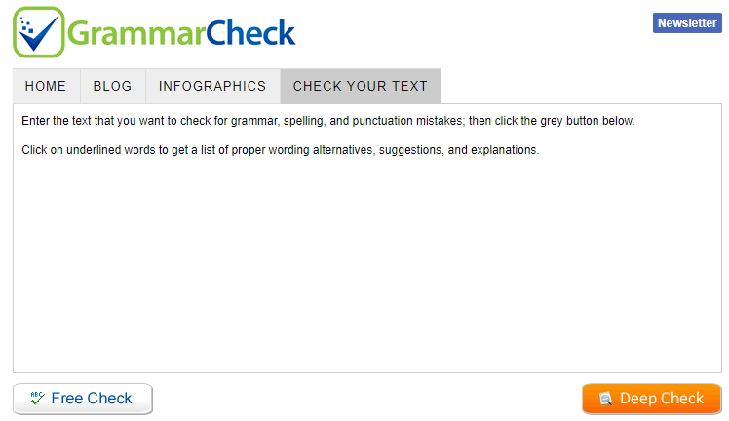
Check your Grammar - IMPORTANT
You can use free online resources
www.grammarly.com
Add to your chrome web browser free
Grammar check.net/editor
www.grammarcheck.net/editor
Also look at previous sets of minutes

Slide 14
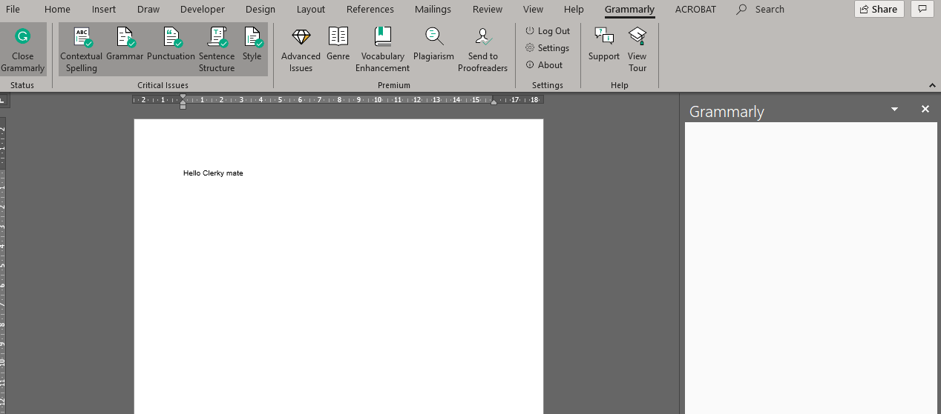
Get Grammarly for Word
www.grammarly.com/office-addin/windows
You must have Microsoft word/office already installed for the plug-in to work
Once installed, a separate Grammarly tab appears
To use - You have to create and login to a free account
Default US version can be changed to UK in settings
Advanced features only on premium paid versions

Slide 15
Minute Template Training
Book yourself a session with the Governor Support Staff to support you with how to:
Insert rows
Adding in sections
Copy and pasting into the template correctly
Merging and splitting cells
Table/column alignment
Font size/format
Page break/columns
Contact 0161 770 3640 to arrange a mini support session

Slide 16
Me Learning Learning and Development Online Platform
Debbie Duffy
Learning & Development Specialist
Development Academy

Slide 17
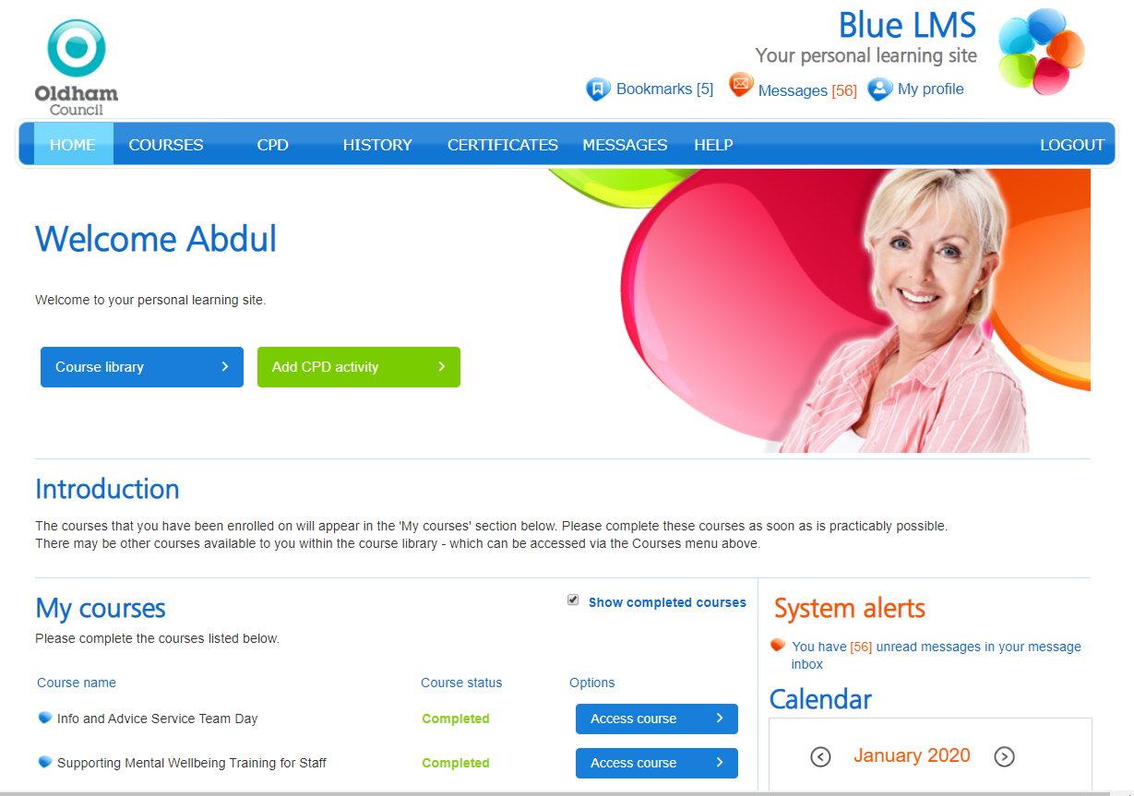
Me Learning – Clerks Training Log @ Development Academy
https://oldham.melearning.university
All Clerks not employed by Oldham Council have been emailed their password
Confirm if you have accessed this platform

Slide 18
Induction Programme | Me Learning Debbie Duffy - Learning & Development Specialist
Mandatory Modules i.e. GDPR, Data Protection, Cybersecurity, Health and Safety at Work etc.
Fast FORWARD – Induction for new and existing staff (half day classroom attendance).
Classroom Training – Microsoft Office i.e. Excel, Word etc.
If you have any queries or problems with your ‘Me Learning’ account or training, then contact the Development Academy on 0161 770 8700 or dabs@oldham.gov.uk

Slide 19
Induction Programme | Me Learning Debbie Duffy - Learning & Development Specialist
Clerks who do NOT have an @oldham.gov.uk email address i.e. Hotmail, Gmail etc. will have a password reset sent to them.
Mandatory courses will be listed along with any all other courses you may manually add on.
Clerks will get an email sent to them every Friday to remind them to complete any outstanding course (displayed as ‘not started’).
If you have any queries or problems with your ‘Me Learning’ account or training, then contact the Development Academy on 0161 770 8700 or dabs@oldham.gov.uk

Slide 20
Induction Programme | Me Learning Debbie Duffy - Learning & Development Specialist
Thank you
If you have any queries or problems with your ‘Me Learning’ account or training, then contact the Development Academy on 0161 770 8700 or dabs@oldham.gov.uk

Slide 21
New Governors Induction Sessions – Clerks
New Clerks to sign up to attend the ‘Induction for New Governors’ course in 2020.
Next Sessions in Jan/Feb 2020 Tuesdays 28 January, 4 & 11 February (3 session training for complete course) | Induction for New Governors / Refresher Course | 2.30-5pm | The Honeywell Centre
 |  | OR
 |  | 6-8.30pm | The Honeywell Centre
If you’ve missed a previous session due to unforeseen circumstances then you must contact Sue and book on the missed sessions.

Slide 22
Governor’s Digitisation project
We are seeking to improve the way we share and communicate information with school governors to:
Ensure ease of access to relevant school documents (including historical documents)
Timely and up to date information (national and local) policies related to governors
Self Service Portal (update details online)

Slide 23
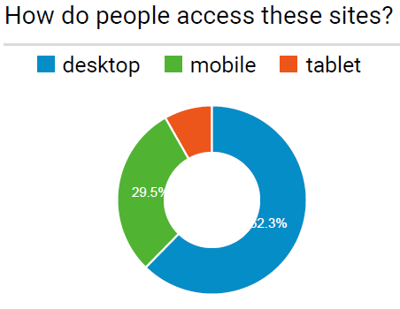
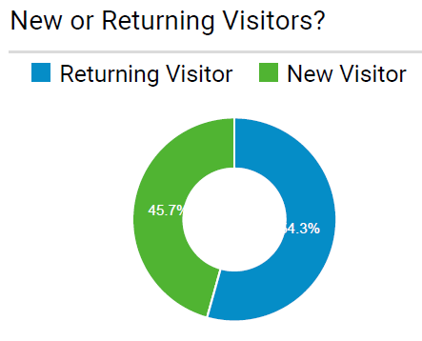
Digital Platform Solution
Business request for a digital online solution.
It will be independently led
Volunteers to provide a ‘user story’
What is your current experience?
What would you like your experience to be?

Slide 24
Usability – What is Usability?
The formal definition of usability from the ISO 9241- 11 standards is: “The extent to which a product can be used by specified users to achieve specified goals with effectiveness, efficiency, and satisfaction in a specified context of use”.
The 5 ‘E’s otherwise known as the five characteristics which must be met for the users! (Whitney Quesenbery, 2004)

Slide 25
Prioritising User Requirements
User requirements will be prioritised based on the MOSCOW Methodology following this session

Slide 26
Challenges
Data Protection - secure transfer of sensitive information
Environmental - increase in printing (and postage)
Removal of printing facilities
Increasing traffic of emails
Administrative capacity
Access at any time – 24/7
Supporting new and existing governors (historical context)

Slide 27
User Feedback
As a Clerk/School Governor
I would Like……..
Because ……….

Slide 28
Group Session
User Type | I would Like… | Because….
School governor | View historical documents relating to my school | I can better understand the context of current meetings
School governor | Check my personal details are correct and up to date | School and LA are able to contact me with ease
Chair of Governors | Up to date information on training records of all my school governors | Identify if I have any gaps in training/skills set in my governing body
Clerk | Receive notification when a training opportunity becomes available | I am able to book on at the earliest opportunity

Slide 29
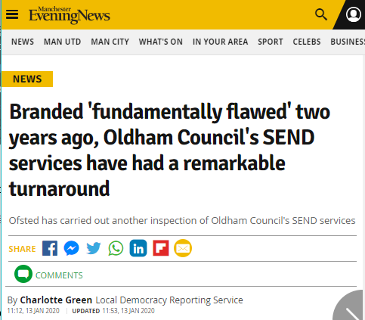
SEND Re-visit September 2019
This re-visit took place in September 2019. The outcome letter has been published and information will be shared with Chairs at their briefing.
www.manchestereveningnews.co.uk/news/greater-manchester-news/branded-fundamentally-flawed-two-years-17557642
As SEND Local Offer Champions, please continue to signpost our families, residents and colleagues to the Local Offer – www.oldham.gov.uk/localoffer

Slide 30
New Additions – Tell us if we can add to these
Jargon Buster
www.oldham.gov.uk/jargonbuster
Job Titles Explained
www.oldham.gov.uk/jobtitlesexplained

Slide 31
Governor Training and Development
Encourage all governors to access the governor training here:
www.oldham.gov.uk/governortraining
They must cancel their place on the training if they cannot attend so that the place can be offered to another person
1/3 of governors booked on do not turn up and do not send apologies
www.oldham.gov.uk/governortrainingprogramme

Slide 32
New Governors Induction Sessions
Sign up ALL new governors (within the last 24 months) on to the ‘Induction for New Governors’ course
Next Sessions in Jan/Feb 2020 Tuesdays 28 January, 4 & 11 February (3 session training for complete course) | Induction for New Governors / Refresher Course | 2.30-5pm | The Honeywell Centre
 |  | OR
 |  | 6-8.30pm | The Honeywell Centre
There are currently 108 new governors in the last two years who have not completed this important training.
This course is also a refresher course for longer serving governors.

Slide 33
NGA Development Programmes www.nga.org.uk/LeadingGovernance
Worth £1000
2 members each from a governing body

Slide 34
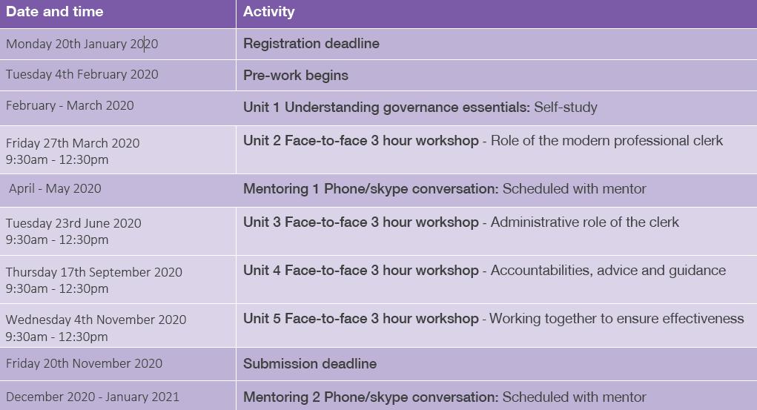

Slide 35
Automated Emails to Governors
Governors Missing DBS Checks
15th day of month
Governors Missing Prevent Training
15th…TBC
Plus more…

Slide 36
First-Class Email Accounts
Key updates and information for your meetings are emailed to you on a regular basis.
School First-Class email account, please remember to routinely log into your account to access your emails – we advise you to do this on a weekly basis.
If you have any problems accessing your First-Class email then please speak to your school’s administrator for support.
First Class supported by the Oldham Council’s Unity Partnership
Passwords - Your password is automatically reset every 90 days (3 Months), this is in line with the council policy.
Passwords must contain more than 8 characters mixed between numerals, uppercase and lowercase letters.
You can call the Unity Partnership ICT Support team for support if you wish (details below).
Tel: 0161 770 1000 option 2* | Mon–Thurs 8am to 5:30pm & Friday 8am to 5pm
*Please note that due to a high level of calls there may occasionally be a waiting period (there will not be any voicemail or call-back facility)
Training – ICT are looking to offer training in the new year to support governors accessing and using their First Class account - more information to follow…

Slide 37
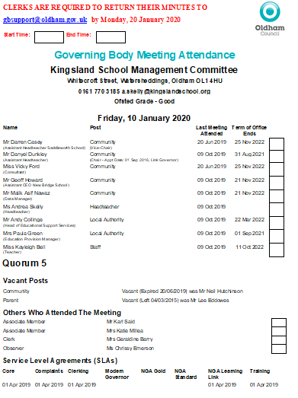
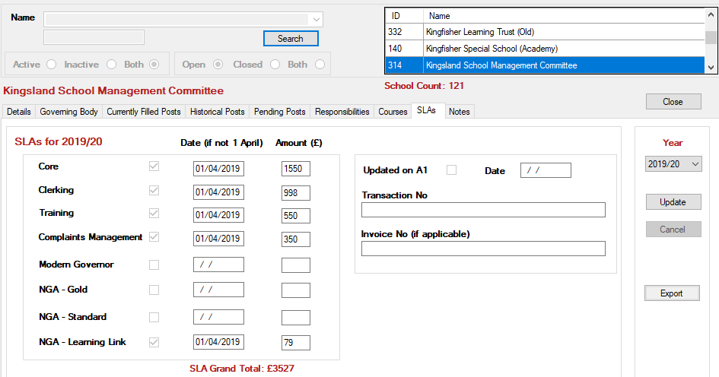
SLA 2020/21
SLA buy-back documents issued to schools this week.

Slide 38
Spring Term Agenda 2020 Gerri Barry Information and Advice Service Manager

Slide 39
Local Authority Agenda Item for Action
There must be an action in the minutes!
Remind the Chair if the governors skip over it!!!

Slide 40
Local Authority Agenda Item for Action
Item 13.1
Keeping Children Safe in Education (KCSIE) 2019 - Updated Guidance
Governors are asked to be aware of updated guidance and to ensure that the school’s safeguarding policies are up-to-date and published on the school website. www.oldham.gov.uk/keepingchildrensafe

Slide 41
Local Authority Agenda Item for Action
Item 13.2 - Section 128 Checks for School Governors
Section 128 Checks – ‘barred list’
From September 2019, Ofsted Inspectors are now checking that Section 128 checks for ALL school governors (and managers of academy schools, Trust members and Trustees) have been completed and recorded on your school's single central record (SCR).
Guidance on how to do list has been issued to schools.

Slide 42
Local Authority Agenda Item for Information
Item 14.1 - Schools Forum
Governors are asked to access and note the summary papers outlining discussions held at the meetings of the Schools Forum during the autumn term on 10 September 2019 and 27 November 2019.
Link to the document: www.oldham.gov.uk/schoolsforum

Slide 43
Clerk Update as an Agenda item
Clerks must share any new updates that occur during the term e.g. Appointment of a new Director of Education and Early Years etc.
LOOK OUT for an email ‘Clerk Update 1’ or ‘Clerk Update 2’ etc.
Drop in text from email ensuring that the information is written in it’s correct ‘tense’ – i.e. something that happened or is going to happen etc.
This is important!

Slide 44
Good Practice for Clerks
Avoid using governors names in minutes.
The do not’s …
Do not write back office/admin issues into the governing body minutes.
Do not agree to any more different templates or using different colours or adding in additional action lists. The school will have to do this.
If they have gone paperless they cannot go back to paper - the school will need to come up with a solution e.g. Folder in school, web folder with password for governors.
Do not write pass words or key instructions in the minutes
Do not go into detail about staffing issues or complaints – think about how that would look on the front page of the press!

Slide 45
Good Practice for Clerks to Support Chairs
Meeting dates - remind Chairs and Headteachers there should be no meetings within the first FOUR weeks of term.
Encourage governors to access training
Let them know the governors who are missing their DBS and Prevent information
Remind governors of the password to access the governor database - Oldham
First-class email passwords are reset

Slide 46
Governor Vacancies Recruitment – Update
Governor Type | Process for filling vacancy | Current vacancies January 2020
Co-opted | Selected and approved by the Governing Body (agenda item) | 22
Parent | Election in School - welcome at FGB meeting | 21
Staff | Election in School - welcome at FGB meeting | 7
Local Authority | Approved by the Lead and Shadow Cabinet members - before the GB meeting (agenda item) | 8
Foundation / Ex Officio | Appointed by the Diocese | 15
Foundation PCC | Appointed by the Parish Council | 12
Foundation Trustee | Appointed by the Trust | 3

Slide 47
Governor Elections MUST TAKE PLACE!
Governor elections must take place for ALL
Staff Governors where terms of office are coming to an end
Parent Governors where terms of office are coming to an end
Existing people in these posts can/must re-apply
They can not automatically be extended an election must take place.

Slide 48
A Competency Framework for Governance
The list below are Lead governors in specific areas:
Lead Governor
Special Educational Needs and Disabilities (SEND)
Safeguarding of children including Prevent Duty
Health and safety in education
Analyse information and data
Financial health and efficiency compared to organisations locally and nationally
Human Resource Education Policy
Closing the gap for EAL Learners (English as an Additional Language)
Emotional Health and Wellbeing (New)
www.gov.uk/government/publications/governance-handbook

Slide 49
Prevent Awareness Online Training
All new Governors and Clerks must do this!
You can access the e-learning by clicking on the website below
www.elearning.prevent.homeoffice.gov.uk
Link also available on www.oldham.gov.uk/governortraining

Slide 50
Staff Governors – ONE THIRD maximum
It is important when governing bodies are appointing school staff into various governor posts they must be aware that No more than a third of the governing body can be staff members at the school
1/3

Slide 51
Know a fantastic governor?
Then log on to the ‘Governors do the honours!’ webpage.
This gives you the 'tools' to nominate someone you know for a Queen’s national honour.
Contact: Govgongs@outlook.com or Martin Matthews @mm684

Slide 52
Top Awards 2019 Nominations Shortlist Friday 7 February 2020
The shortlisted nominees are:
Team of the Year:
Get Oldham Working
SEND Team
Oldham Adult Learning Disability Service
Lifelong Learning Support Team
Leader of the Year
Irfan Rasul – Children’s Services IT
Andrea Dickinson – Organisational Development Team
Jennie Davies – Head of Virtual School

Slide 53
Top Awards 2019 Nominations Shortlist Friday 7 February 2020
The shortlisted nominees are:
Fit for Oldham award
Elisabetta Coccia – People Services
Sam Samuel – Unity IT
Muzamil Khan – Environmental Services
Community Contribution Award
Jean Reid – Family Information Service
Sadrul Alam - Finance
Failsworth and Hollinwood District Team

Slide 54
Top Awards 2019 Nominations Shortlist Friday 7 February 2020
The shortlisted nominees are:
Young employee of the Year
Clinton Reading – Unity Benefits Service
Jessica Price – Get Oldham Working
Jack Armstrong – Get Oldham Working
Front line service award
Nazet Yaqub – Library Service
Tia Boucher – Library Service
Jean Reid – Family Information Service

Slide 55
Top Awards 2019 Nominations Shortlist Friday 7 February 2020
The shortlisted nominees are:
Employee of the Year
Jean Reid – Family Information Service
Eve Edwards – Community Cohesion Team
Joanne Blair – Development Control

Slide 56
Top Awards 2019 Nominees Friday 7 February 2020
Those nominated but may not have been shortlisted are listed below:
Adrian Morris
Adult Social Care Quality Team
Amie Witherspoon
Amy Crompton
Ann Fitzpatrick
Applications team
Beckie Wylie Rothwell
Carl Newton
Carol Thompson
Clare Bamforth
Collette Donnolly
Complex Care Team
Connor Moss
Daniel Smith
Depaul Team
Education Improvement Team (Early Years)
Elizabeth Stanford
Enablement Team
Euey Madden
Executive Support Team
Fay Hough
Fitton Hill Library Team
Focus Trust
Gary Flanagan
Gerri Barry
Glen Yarr
Glenn Freer
Gordon Lee
Helen Chambers
Honeywell Centre
Irene Shepherd
James Postle
Jane Steeple
Janet Wray
Jessica Price
Jillian Milner
Joanne Blair
Joanne Jones
John McAuley
Joseph Shaw
Kadie Ratchford
Karen Seth
Karen Walsh
Kenneth Lees
Keryn Green
Kirsten Linaker
Kirsty Dowden
Kolsuma Kamali
Langham House reception & admin team
Leah Lewis
Lesley Hayes
Linda Lucas
Lisa Bibby
Littletown Family Medical Practice
Local Children’s Safeguarding Partnership Team
Makhols Mayhenyengwa
Mary Walker
Mental Well-being team (Educational Psychology)
Multi-disciplinary SU team
Naaira Zaman
Natalie Moores
Radhika Aggarwal
Rebecca Addyman
Richard Leahy
Ron Rafferty
Saffron Blakeley
Samantha Muidhead
Shirley Bradsell
Shirley Woods-Gallagher
Simon Shaw
Simon Shuttleworth
South Failsworth Primary Team
Steven Wolstencroft
Stuart Brownlow
The Oldham Medical Centre Team
The Reablement Team
Thomas Rogers
Tour of Britain – events team
Waterhead Academy
Wayne Dawson
Yvonne Ashworth

Slide 57
Clerk Timesheets
Time sheets must be submitted when you submit your final set of minutes.
Send in a separate email to gb.support@Oldham.gov.uk

Slide 58
Training for Governors 2020
Preparing for Ofsted Inspection under the New Framework
Date | Time | Venue
Monday 24 February 2020 | 3 - 5pm | The Honeywell Centre
 | OR 6 - 8pm
To book a place, please visit www.oldham.gov.uk/governortrainingprogramme

Slide 59
Training for Governors 2020
Promoting the Education of Children Looked After and previously Looked After Children
To book a place, please visit www.oldham.gov.uk/governortrainingprogramme
Date | Time | Venue
Tuesday 3 March 2020 | 1pm – 3pm | The Honeywell Centre
Tuesday 23 June 2020 | 6pm – 8pm | The Honeywell Centre

Slide 60
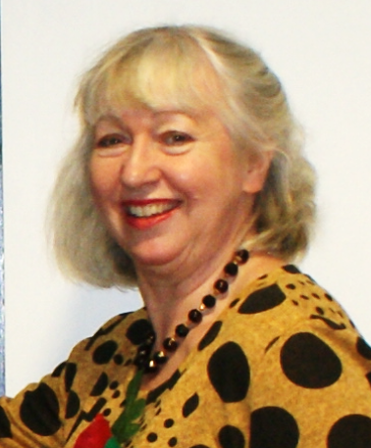
Allocation of school Governing Body/IEB meeting and cover arrangements
Kim from the Governor Support Service will be in touch if or when a school governing body meeting needs a Clerk.

Slide 61
Any other business

