Slide 1
Clerks Information and Briefing
Gerri Barry
Information and Advice Service Manager
Governor Support Service
Tuesday 17 September 2019

Slide 2
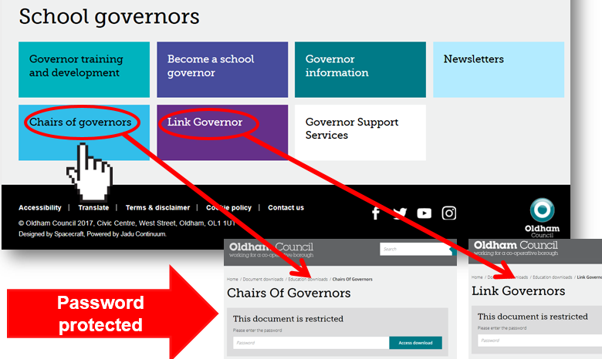
Welcome and introductions Clerks Briefing | Tuesday 17 September 2019
Gerri Barry Information and Advice Service Manager
PASSWORD PROTECTED WEBPAGES
www.oldham.gov.uk/chairsofgovernors
www.oldham.gov.uk/linkgovernor

Slide 3
Governor Webpage www.oldham.gov.uk/governors
New
Password protected

Slide 4
#OLF19
@OldhamLearnFest
#daretobewise
Notes:
Following are from the success of OLF18:
Oldham learning festival is being planned. It will run for one week, 1st July to 7th July 2019. With the main programme running Monday to Friday in and around the QE Hall in Oldham.
All schools are invited to get involved and for staff to attend.
More information will be issued when it becomes available.
Follow us on Twitter @OldhamLearnFest – Hashtag OLF19 – Hashtag Dare to be wise

Slide 5
Oldham Learning Festival Website Update www.oldham.gov.uk/olf
Media –
OLF19 Video Highlights (NEW!)
Link to a video news report on a popular UK Urdu Channel on Sky.
Keynote Speakers
Presentation and Workshop Resources
Exhibitors and Organisations at the Festival Market Place
Programme Guide
OLF18 information and Video Highlights

Slide 6
Local Leader of Governance (LLG)
Welcome to our new LLG’s:
Paul Devine
Chair of Governors, Holy Rosary RC Primary School
Christine Maymon
Chair of Corpus Christi RC Primary School

Slide 7
SEND re-visit in September
Ofsted and the Care Quality Commission (CQC) will be revisiting the borough on 23 - 27 September 2019.
The focus of the revisit is to determine whether we, as a partnership, have made sufficient progress in addressing the areas detailed in the Written Statement of Action (WSoA) since the original inspection.

Slide 8
SEND re-visit in September
This re-visit is an opportunity to showcase our improvement journey.
You may well be approached or asked to participate in order to assist the inspectors and we would be grateful for your assistance and co-operation.
As SEND Local Offer Champions, please continue to signpost our families, residents and colleagues to the Local Offer – www.oldham.gov.uk/localoffer

Slide 9
Parent Survey and Conversation with Inspectors
Online Parent/Carer Survey - from 13 September to 12 noon 20 September 2019. www.oldham.gov.uk/localoffer
Parent/Carer Meeting - Ofsted and the Care Quality Commission will be hosting their open meeting at the Parent Carer Forum (POINT offices, 451 Middleton Road, Chadderton, Oldham OL9 9LB) on
Monday 23 September 1.30 – 2.30pm where parents / carers can share their views and speak directly with the Ofsted / CQC Inspection team.

Slide 10
Me Learning – Clerks Training Log @ Development Academy
All Clerks not employed by Oldham Council have been emailed their password
Confirm if you have accessed this platform

Slide 11
Induction Programme
Mandatory Modules
Fast Forward

Slide 12
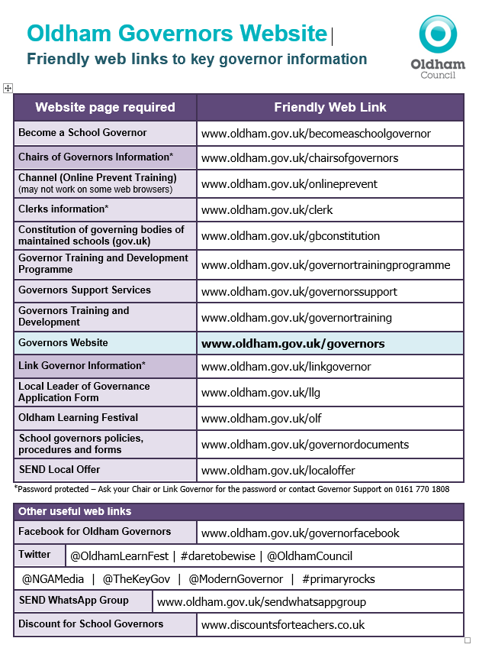
Friendly web links
The friendly web links have been recently updated
New additions include Clerks, social media and governor discounts.
www.oldham.gov.uk/ governors

Slide 13
Benefits of the programme/course
This programme aims to nurture high quality clerking through recognising professional competencies and ensuring that clerking is both effective and sustainable by:
developing the clerk’s knowledge, skills and networks
the creation of a realistic school-based project which aims to improve effectiveness in clerking practice
enhancing the clerk’s awareness of their own strengths and areas for development
creating self-supporting groups to ensure learning and support continue beyond the duration of the programme
Qualification gained:
Level 3 accreditation in Clerking of School and Academy Governing Boards

Slide 14
Cohort: Rochdale 2
Venue: The REAL Trust, Hopwood Hall College, Rochdale, OL12 6RY
Level 3 Certificate in the Clerking of School and Academy Governing Boards
The course cost is £475 (part funded by the DfE)
Remaining costs will be covered by the Governor Support Service including hours to attend the training

Slide 15
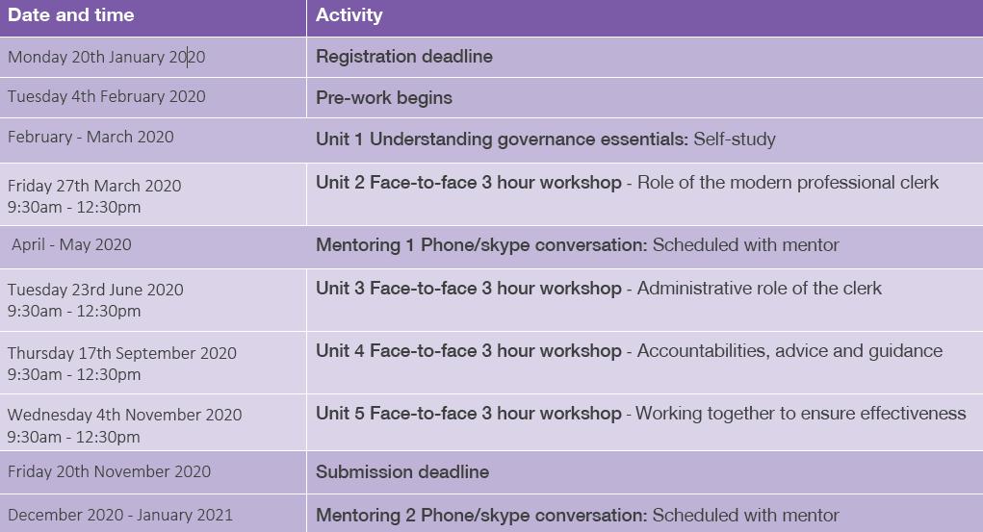

Slide 16
New Governors Induction Sessions – Clerks
New Clerks to sign up to attend the ‘Induction for New Governors’ course in 2020.
Next Sessions in Jan/Feb 2020 Tuesdays 28 January, 4 & 11 February (3 session training for complete course) | Induction for New Governors / Refresher Course | 2.30-5pm | The Honeywell Centre
 |  | OR
 |  | 6-8.30pm | The Honeywell Centre
If you missed a previous session through snow then please catch it up and attend the relevant session above.

Slide 17
New Governors Induction Sessions
Sign up ALL new governors (within the last 24 months) on to the ‘Induction for New Governors’ course
Next Sessions in Jan/Feb 2020 Tuesdays 28 January, 4 & 11 February (3 session training for complete course) | Induction for New Governors / Refresher Course | 2.30-5pm | The Honeywell Centre
 |  | OR
 |  | 6-8.30pm | The Honeywell Centre
There are 96 new governors in the last 2 years who have not completed this important training.
This course is also a refresher course for longer serving governors.

Slide 18
Governor Training and Development
Encourage all governors to access the governor training here:
www.oldham.gov.uk/governortraining
They must cancel their place on the training if they can not attend so that the place can be offered to another person
1/3 of governors booked on do not turn up and do not send apologies
www.oldham.gov.uk/governortrainingprogramme

Slide 19
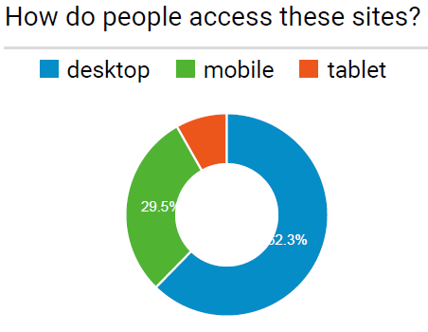
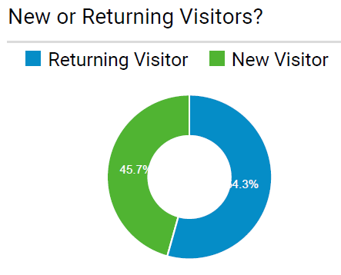
Digital Platform Solution
Business request for a digital online solution.
It will be independently led
Volunteers to provide a ‘user story’
What's your current experience?
What would you like your experience to be?

Slide 20
Updated Governor Contact Details Form
Prevent Required by all Governors
Required by all on Finance Committee. Good practice for all Governors
Individual skills matrix completed by all governors and returned to the Chairs to Collate
DBS forms must be completed with governors at school within 21 days
New

Slide 21
Summer Term Governing Body Meetings
Month | No of FGB Meetings | Committees | Cancelled | Late FGB Meetings
April | 5 | 0 | FGB Comm | 3
May | 29 | 4 | FGB 1 Comm | 4
June | 39 | 6 | FGB Comm 4 | 6
July | 25 | 1 | FGB Comm | 4 so far
Total: | 98 | 11 | FGB 1 Comm 5 | FGB
Meeting Schedule Summer 2019 Agendas

Slide 22
Clerk Update as an Agenda item
Clerks must share any new updates that occur during the term e.g. Appointment of a new Director of Education and Early Years etc.
LOOK OUT for a ‘Clerk Update’ email
Drop in text from email ensuring that the information is written in it’s correct ‘tense’ – i.e. something that happened or is going to happen etc.
Please make sure it is minuted
This is important!

Slide 23
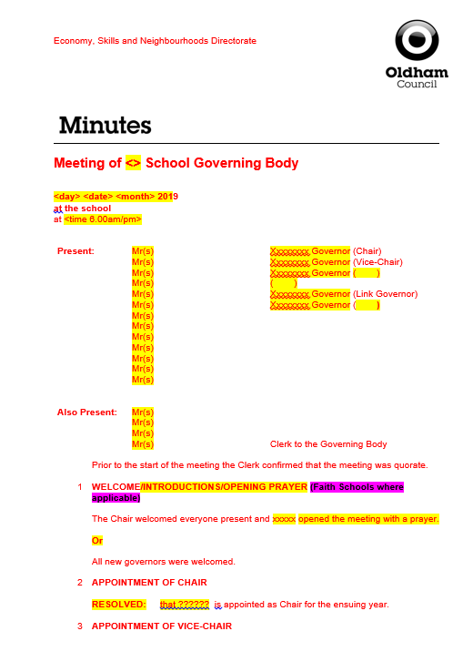
Minute template
Check the minute “fits” and that the tense is correct (past, present etc.)
RED text is standard on the template which signifies that no changes have been made.
BLACK text is what you have typed in i.e. your minutes, changes, amendments etc.
Yellow highlighted text will always need changing or deleting.
Delete Magenta highlighted text.

Slide 24
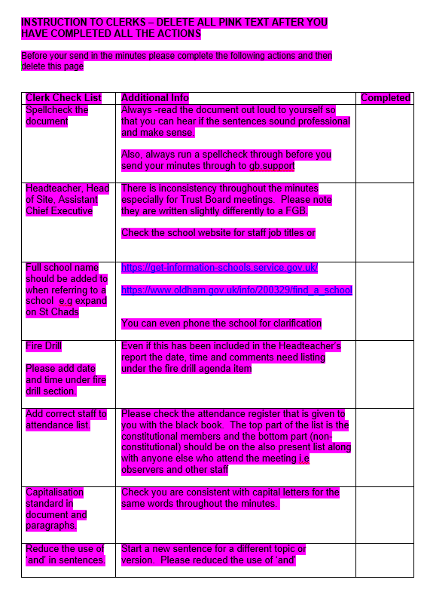
Minute template
A Check list has been added at the back of the minute template.
Please work through this check list and then delete before you issue your minutes to: gb.support@oldham.gov.uk

Slide 25
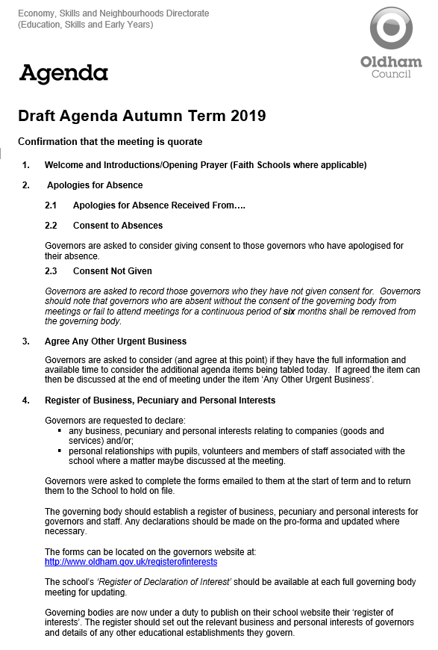
Autumn term agenda items
Autumn Term Agenda 2019

Slide 26
Local authority agenda item for action
There must be an action in the minutes!
Remind the Chair if the governors skip over it!!!

Slide 27
Local authority agenda item for action
Item 14.1 - School Admission Arrangements for Admissions in the Academic Year 2021/22
The School Admissions Code December 2014 (The Code) sets out the responsibilities of all admission authorities. The Code has the force of law and imposes a number of mandatory requirements on the Admission Authorities of Maintained Schools, Governing Bodies and Local Authorities. Academies and Free Schools are required by their funding agreements to comply with the Code.
All governing bodies are asked to note the content of the briefing paper, “School Admission Arrangements September 2020” – The document can be found at:
www.oldham.gov.uk/schooladmissionarrangements
www.oldham.gov.uk/proformaadmissionarrangements

Slide 28
Local authority agenda item for action
Cont…
Governors of schools that are their own Admissions Authority and Academies/Free Schools are asked to:
Notify the Local Authority (LA) if changes are proposed to their published admission arrangements, including any proposed change to the PAN, or to notify the LA that no changes are to be proposed.
Confirm that they will be able to notify the LA no later than 28 February 2020 of the full admission arrangements that will apply to admissions in the academic year 2020/2021.
Confirm that they will be able to notify the LA no later than 31 October 2019 if they intend to admit above their PAN in the admissions round commencing September 2020 for admission to school in September 2021.

Slide 29
Local authority agenda item for action
Cont…
Governors of schools that are their own Admissions Authority and Academies/Free Schools are asked to:
Notify the Local Authority (LA) if changes are proposed to their published admission arrangements, including any proposed change to the PAN, or to notify the LA that no changes are to be proposed.
Confirm that they will be able to notify the LA no later than 28 February 2020 of the full admission arrangements that will apply to admissions in the academic year 2020/2021.
Confirm that they will be able to notify the LA no later than 31 October 2019 if they intend to admit above their PAN in the admissions round commencing September 2020 for admission to school in September 2021.

Slide 30
Local authority agenda item for action
Item 14.2 - Prevent Self-Assessment
All schools have a duty under the Counter Terrorism and Security Act 2015 to give due regard to the need to prevent people from being drawn into terrorism in everything they do. Schools have previously completed self-assessments of their response to the Prevent Duty.
It is recommended that governors review their school’s refreshed Prevent Self-Assessment, including consideration of training needs for staff and governors. Governors also need to have an oversight of any Prevent related concerns regarding the school (for example if there have been safeguarding referrals relating to Prevent).

Slide 31
Local authority agenda item for action
Item 14.3 - NJC School Support Staff Grading Structure
Governors are to read and discuss the supporting note issued to Governing Bodies regarding the revision of the NJC School Support Staff grading structure.
The documents can be found at:
www.oldham.gov.uk/gradestructure
www.oldham.gov.uk/njcadoptionform
The Chair of governors must sign and return the NJC Adoption Form to confirm that governors have agreed to one of the following:
The governors of the school have opted to adopt the LA recommended grading structure; or
The governors of the school have not opted to adopt the LA recommended grading structure and will devise and consult on the schools own devised pay structure.

Slide 32
Local authority agenda item for information
Item 15.1 - Teachers Pay Award Update 2019/20
Governors are to be made aware that consultation on the Teachers Pay Award closed at the end of August 2019. Information will be shared once the correct approval processes has been completed.
The Governing Body will be required to record the decision and return the necessary proforma back to Governor Support Services.

Slide 33
Local authority agenda item for information
Item 15.2 - Schools Forum
Governors are asked to receive and note the summary papers outlining discussions held at the meetings of the Schools Forum held during last term on 14 May 2019 and 19 June 2019.
Link to the document: www.oldham.gov.uk/schoolsforum

Slide 34
Lilac Sheet – This is important!
Update with key actions and return with 3 to 5 days
New governors
New meeting dates
Change of meeting dates
Governors leavings
Things we need to know and action quickly
NB if you spot that you have missed something off then please let us know straight away

Slide 35
Quality Assurance - Check your Minutes
Tick list added to the back of the minute template. Please work through it and then delete the list before sending in the minutes
Please ensure that your minutes are:
Spell checked
Double-checked
Gramma is checked
Look at formatting
Are they good enough to publish on a website?
Buddy up with another Clerk to check your minutes

Slide 36
Good practice for Clerks
Meeting dates - remind Chairs and Headteachers there should be no meetings within the first 4 weeks of term.
Avoid using governors names in minutes.
The do not’s …
Do not write back office/admin issues into the governing body minutes.
Do not agree to different templates or using different colours or adding in additional action lists. The school will have to do this.
If they have gone paperless they cannot go back to paper - the school will need to come up with a solution e.g. Folder in school, web folder with password for governors.
Do not write pass words or key instructions in the minutes
Do not go into detail about staffing issues or complaints

Slide 38
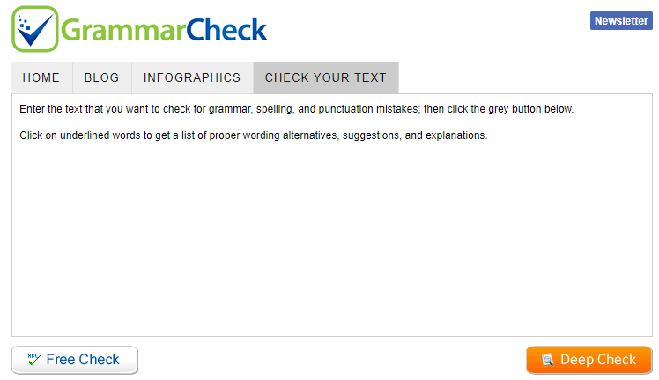
Check your Grammar - IMPORTANT
You can use free online resources
www.grammarly.com
Add to your chrome web browser free
Grammar check.net/editor
www.grammarcheck.net/editor
Also look at previous sets of minutes

Slide 39
Governor Vacancies Recruitment – Update
Governor Type | Process for filling vacancy | Current vacancies September 2019
Co-opted | Selected and approved by the Governing Body (agenda item) | 22
Parent | Election - ratified at FGB meeting | 22
Staff | Election - ratified at FGB meeting | 4
Local Authority | Approved by the Lead and Shadow Cabinet members - before the GB meeting (agenda item) | 6
Foundation / Ex Officio | Appointed by the Diocese | 16
Foundation PCC | Appointed by the Parish Council | 8

Slide 40
Governor Elections MUST TAKE PLACE!
Governor elections must take place for ALL
Staff Governors where terms of office are coming to an end
Parent Governors where terms of office are coming to an end
Existing people in these posts can/must re-apply
They can not automatically be extended an election must take place.

Slide 41
Message from the DfE
The DfE will be sending direct communications to those in school governance roles on a monthly basis from September 2019.
The first email - Thursday 19 September
Highlight various key DfE messages (created as a bespoke update for the governance sector)
Highlight other key activity, such as the new guidance collections on gov.uk
The message will be published on gov.uk, and the link will be promoted via email to all governors, trustees, chairs and clerks for whom we have up-to-date contact details on GIAS* (Get Information About Schools).
We expect to be able to reach the majority of those in governance roles in English schools and trusts.
*https://get-information-schools.service.gov.uk/

Slide 42
Prevent Awareness Online Training
All new Governors and Clerks must do this!
You can access the e-learning by clicking on the website below
www.elearning.prevent.homeoffice.gov.uk
Link also available on www.oldham.gov.uk/governortraining

Slide 43
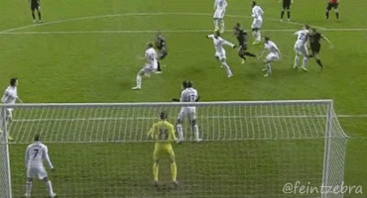
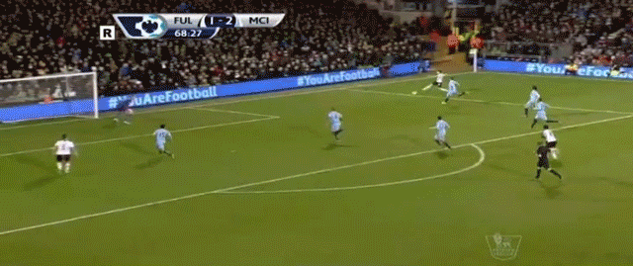
Message from National Leader in Governance !
School’s may be getting themselves in a vulnerable position when Ofsted visit by not keeping up to date with the following governing body requirements:
Prevent Awareness training and DBS checks.
Governor information not up to date on School’s Website and also ‘Get information about schools’
Lockdown drills not taking place

Slide 44
A Competency Framework for Governance
The list below are Lead governors in specific areas:
Lead Governor
Special Educational Needs and Disabilities (SEND)
Safeguarding of children including Prevent Duty
Health and safety in education
Analyse information and data
Financial health and efficiency compared to organisations locally and nationally
Human Resource Education Policy
Closing the gap for EAL Learners (English as an Additional Language)
Emotional Health and Wellbeing (New)
Vacant lead governor responsibilities must be filled this term!!

Slide 45
Staff Governors – ONE THIRD maximum
It is important when governing bodies are appointing school staff in to various governor posts that they must be aware that No more than a third of the governing body can also be staff members at the school
1/3

Slide 46
SECURE Email or Egress
All new and existing governors MUST have a secure email or register with Egress
133 governors currently DO NOT have a secure email!

Slide 47
Staff governor’s email address – MUST BE SECURE
Please ask staff governors for the following:
Work email address e.g. joe.king@clownacademy.org
Personal email addresses where a work email is unavailable e.g. hotmail, gmail etc.
Egress
Avoid obtaining the following:
Generic email addresses i.e. info@hogwarts.oldham.sch.uk
A shared email address i.e. friends, relatives or on behalf of another governors email.

Slide 48
Nominate a brilliant governor…don’t know where to start?
Contact Govgongs@outlook.com or Martin Matthews @mm684
Download the booklet: Governors, do the honours! https://ignoratus.wordpress.com/governors-do-the-honours-how-to-nominate-a-governor-forrecognition
Or simply type in google ignoratus honours.

Slide 49
Top Awards 2019
The TOP Awards 2019 nominations are still open and don’t forget there’s an exciting new category for this year. Friday 27 Sept Closing date!
For the first time ever, you can nominate colleagues for the ‘Community Contribution Award’ which recognises the excellent work that is carried out each and every day across the local communities of Oldham by our colleagues and partner organisations.
The full range of this year’s award categories include:
> Employee of the Year > Fit for Oldham Award > Front Line Services Award
> Leader of the Year > Team of the Year > Young Employee of the Year
> Community Contribution Award
You can nominate employees from Oldham Council, NHS Oldham CCG, Unity Partnership, MioCare, OCL Oldham GP Practices and Oldham Schools.
Nominations are open to staff and residents.
The nomination form as well as more information on each of the categories is available on our website by visiting www.oldham.gov.uk/TOPAwards
You have until Friday 27 September 2019 to nominate.

Slide 50
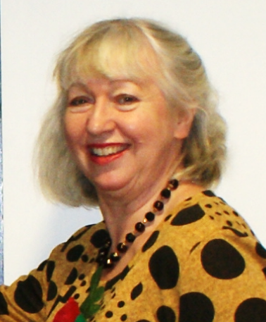
Allocation of school Governing Body/IEB meeting and cover arrangements
Kim from the Governor Support Service will be in touch if or when a school governing body meeting needs a Clerk.

Slide 51
Any other business

