Slide 1
Clerks Information and Briefing
Gerri Barry
Information and Advice Service Manager
Governor Support Service
Monday 13 May 2019
Room 4F Level 4

Slide 2
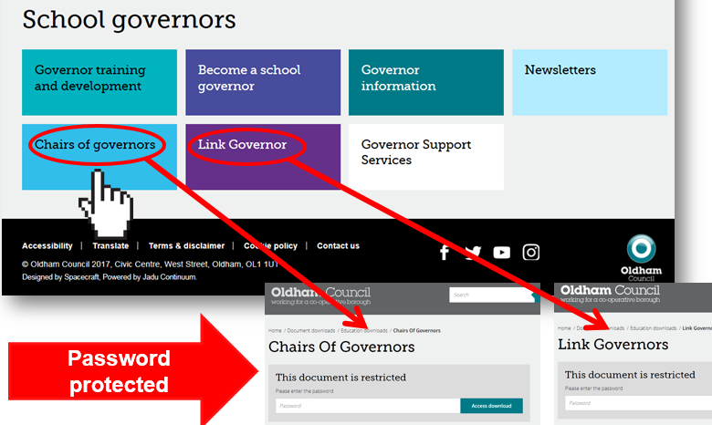
Welcome and introductions Clerks Briefing | Monday 14 May 2019
Gerri Barry Information and Advice Service Manager
PASSWORD PROTECTED WEBPAGES
www.oldham.gov.uk/chairsofgovernors
www.oldham.gov.uk/linkgovernor

Slide 3
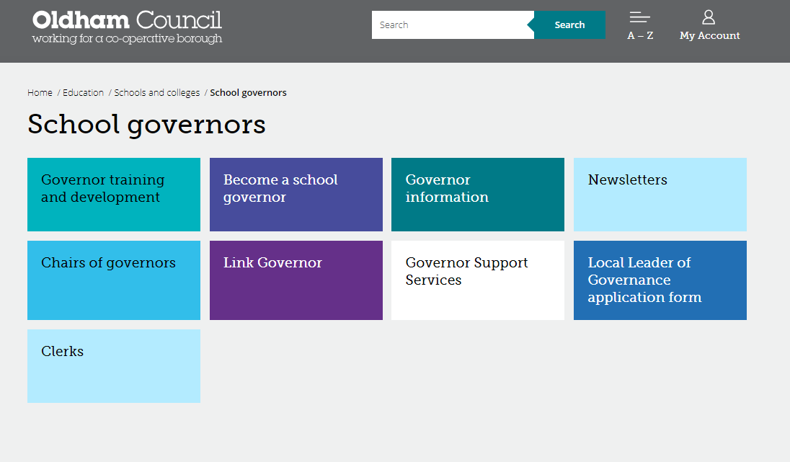
Governor Webpage www.oldham.gov.uk/governors
New
Password protected

Slide 4
Education & Early Years Service – May 2019
Economy, Skills and Neighbourhoods Directorate
Director of Education & Early Years
Andrew Sutherland
Education Partnership Leader
Adrian Calvert
Programme Director Opportunity Area
Matthew Bulmer
Head of Learning
Tony Shepherd
Head of Inclusion & Post 16
Donna Lewis
Assistant Director of Education SEND
Dr Shirley
Woods-Gallagher
Head of School Support Services (Compliance)
Andy Collinge
SEMHS Manager
Claire Taylor
Head of Virtual School for Children who are Looked After
Jennie Davies
Education Improvement Manager
Paula Healey
Inclusion Manager
Anne Clark
SEND Service Manager
Paula Green
Education Psychology
& Prevention Services
Dr Helen Wyton
Education Provision Manager
Andy Wood
Information & Advice Service Manager
Gerri Barry

Slide 5


#OLF19
@OldhamLearnFest
#daretobewise
Keep your calendar free!
Encourage your colleagues, contacts and partners to SAVE THE DATE!
Notes:
Following are from the success of OLF18:
Oldham learning festival is being planned. It will run for one week, 1st July to 7th July 2019. With the main programme running Monday to Friday in and around the QE Hall in Oldham.
All schools are invited to get involved and for staff to attend.
More information will be issued when it becomes available.
Follow us on Twitter @OldhamLearnFest – Hashtag OLF19 – Hashtag Dare to be wise

Slide 6
HR Payroll System – New Regulations April 2019
Payslips
The Employment Rights Act 1996 (Itemised Pay Statement) (Amendment) Order 2018
Payslips to state number of hours being paid and holiday pay.
It came into force on 6 April 2019.
Errors should be corrected in May pay. Please let Wendy know if there are still issues

Slide 7
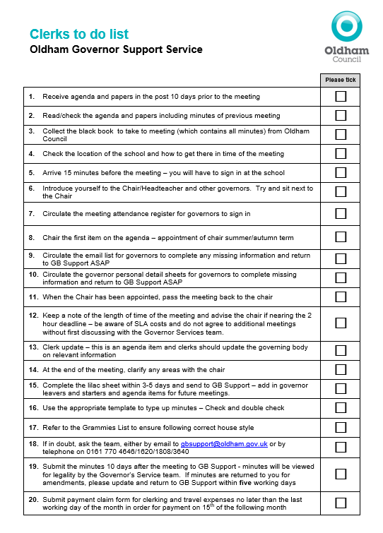
Clerks to do list
A resourceful checklist for all clerks

Slide 8
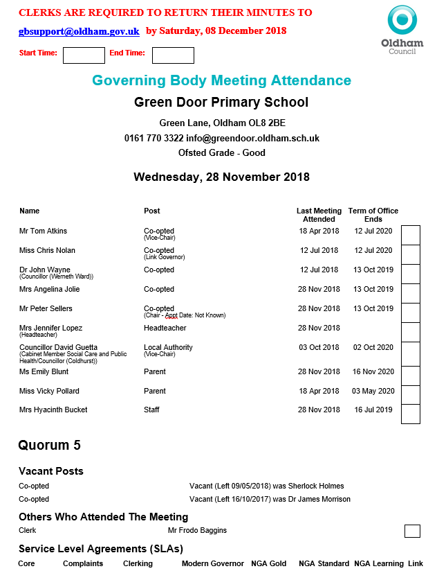
Meeting attendance register
Check with Chairs before the start of the meeting.
Highlight Missing information
Job Titles
Terms of Office coming to an end
Vacant Posts
Governors who have not attended since last year
Any other errors
New Additions
Meeting ‘start’ and ‘end’ times
Full school address
Service Level Agreement (SLA) info

Slide 9
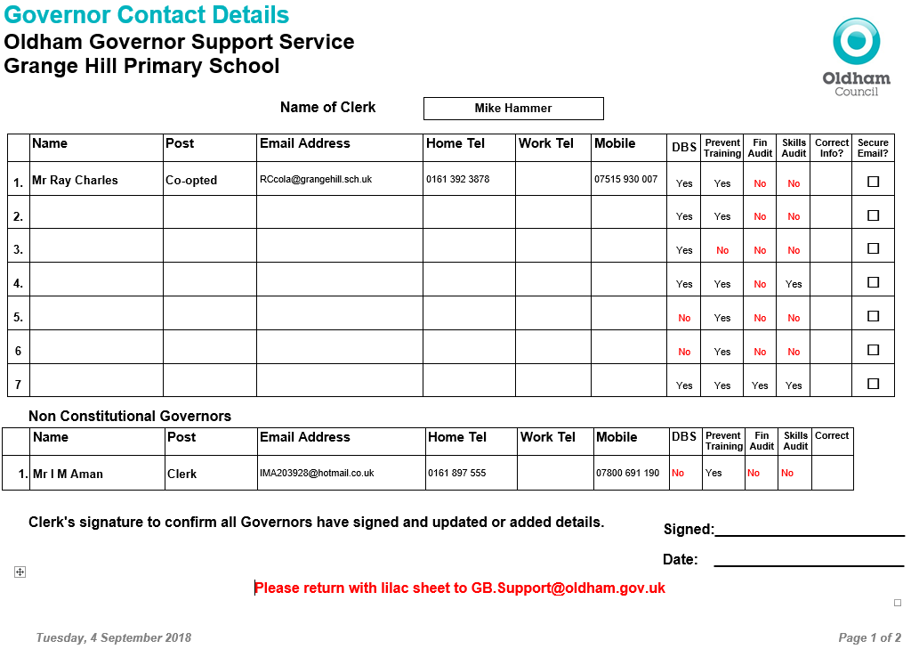
Updated Governor Contact Details Form
Prevent Required by all Governors
Required by all on Finance Committee. Good practice for all Governors
Individual skills matrix completed by all governors and returned to the Chairs to Collate
DBS forms must be completed with governors at school within 21 days
New

Slide 10

Quality Assurance - Check your Minutes
Tick list added to the back of the minute template. Please work through it and then delete the list before sending in the minutes
Please ensure that your minutes are:
Spell checked
Double-checked
Gramma is checked
Look at formatting
Are they good enough to publish on a website?
Buddy up with another Clerk to check your minutes

Slide 11


Slide 12

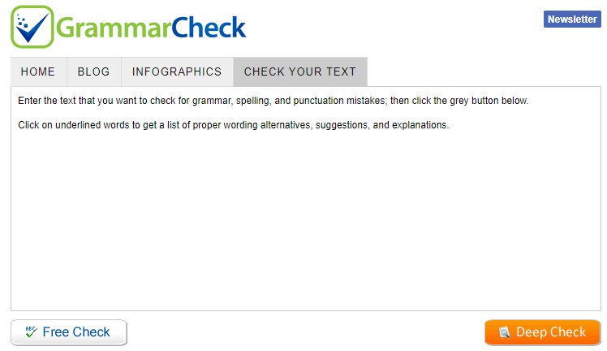
Check your Grammar - IMPORTANT
You can use free online resources
www.grammarly.com
Add to your chrome web browser free
Grammar check.net/editor
www.grammarcheck.net/editor
Also look at previous sets of minutes

Slide 13
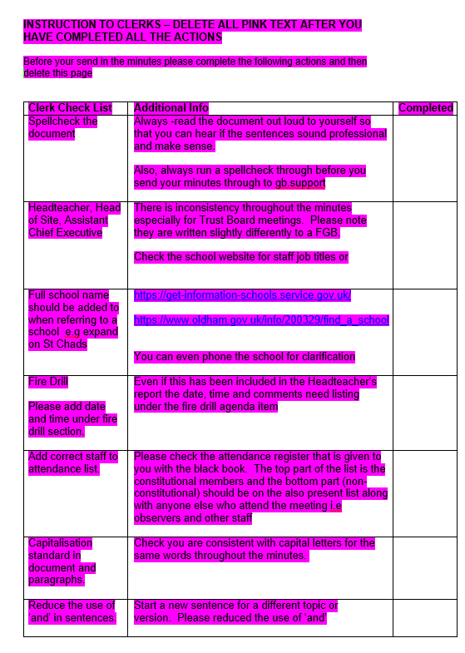
Minute template
A Check list has been added at the back of the minute template.
Please work through this check list and then delete before you issue your minutes to: gb.support@oldham.gov.uk

Slide 14
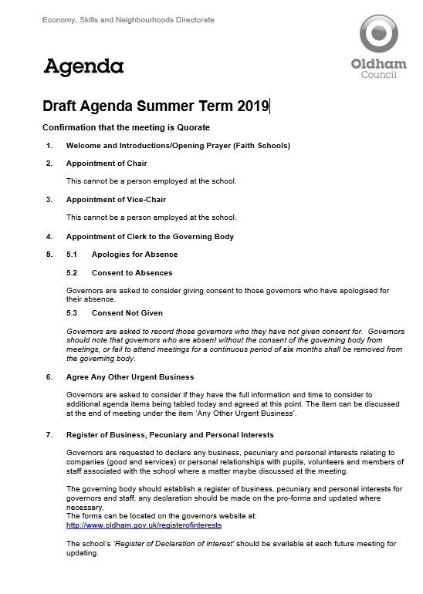
Summer term agenda items
Summer Term Agenda 2019

Slide 15
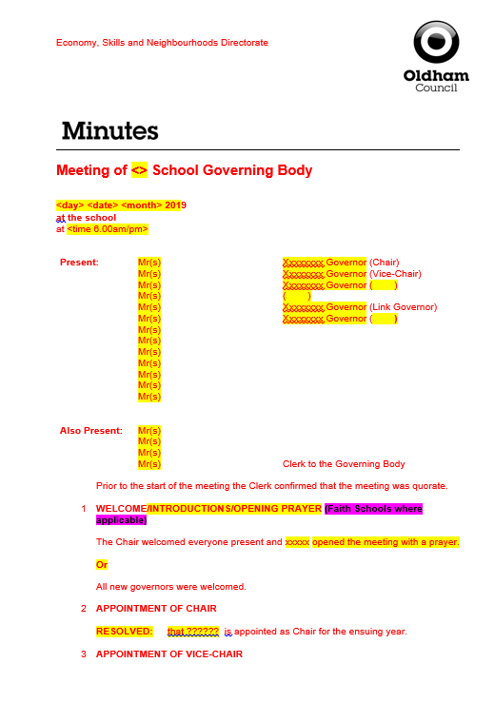
Minute template
Check the minute “fits” and that the tense is correct (past, present etc.)
RED text is standard on the template which signifies that no changes have been made.
BLACK text is what you have typed in i.e. your minutes, changes, amendments etc.
Yellow highlighted text will always need changing or deleting.
Delete Magenta highlighted text.

Slide 16
Good practice for Clerks
Meeting dates - remind Chairs and Headteachers there should be no meetings within the first 4 weeks of term.
Avoid using governors names in minutes.
The do not’s …
Do not write back office/admin issues into the governing body minutes.
Do not agree to different templates or using different colours or adding in additional action lists. The school will have to do this.
If they have gone paperless they cannot go back to paper - the school will need to come up with a solution e.g. Folder in school, web folder with password for governors.
Do not write pass words or key instructions in the minutes
Do not go into detail about staffing issues or complaints

Slide 17

New Governors Induction Sessions – Clerks
New Clerks to sign up to attend the ‘Induction for New Governors’ course
Next Sessions in June/July 2019 Wednesdays 26 June, 3 & 10 July (3 session training for complete course) | Induction for New Governors / Refresher Course | 2.30-5pm | The Honeywell Centre
 |  | OR
 |  | 6-8.30pm | The Honeywell Centre
If you missed a previous session through snow then please catch it up and attend the relevant session above.

Slide 18



SECURE Email or Egress
All new and existing governors MUST have a secure email or register with Egress
183 governors currently DO NOT have a secure email!

Slide 19
Nominating a Chair
Proposing and voting a Chair – You or the vice-chair should take this agenda item
Discrete vote
Ask the candidates to leave the room

Slide 20
Steer the Chair.
Through the Chair (sit next to the Chair) …..
Encourage governors to ask questions – especially at the Headteacher’s report. You could say something like “Chair it is good practice for governors to ask questions of the Headteacher regarding his/her report”
Remind governors that if they want to talk about a staffing issue that could go to an appeal then if it’s discussed in front of all the governors then they are ‘tarnished’ and cannot sit on an appeal panel.

Slide 21
Governor Training and Development
Encourage all governors to access the governor training here:
www.oldham.gov.uk/governortraining
They must cancel their place on the training if they can not attend so that the place can be offered to another person
1/3 of governors booked on do not turn up and do not send apologies
www.oldham.gov.uk/governortrainingprogramme

Slide 22
Local authority agenda item for action
There must be an action in the minutes!
Remind the Chair if the governors skip over it!!!

Slide 23

Local authority agenda item for action
Item 14.1 - School Complaints Procedures: Guidance for Schools
Governors are asked to be aware and ensure policies have been updated to meet the requirements to ensure that the school is statutorily compliant.
The new DfE statutory guidance is located here:
www.gov.uk/government/publications/school-complaints-procedures

Slide 24

Local authority agenda item for action
Item 14.2 - SEND Local Offer
Governors should note the link to Oldham’s SEND Local Offer www.oldham.gov.uk/localoffer
A4 Posters (PDF) sent to all schools and Business Managers
Ofsted Inspectors are due back in Oldham NOW!

Slide 25






SEND Local Offer – NEW Information
www.oldham.gov.uk/localoffer
New Animated Banner
New Buttons and content added
www.oldham.gov.uk/localoffer
Accessibility Toolbar throughout Website

Slide 26

What is the Local Offer?
www.oldham.gov.uk/info/200368/children_and_young_people_with_special_educational_needs_and_disabilities_local_offer/2129/oldhams_local_offer

Slide 27
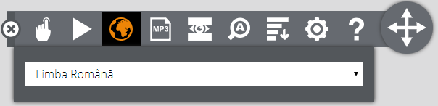
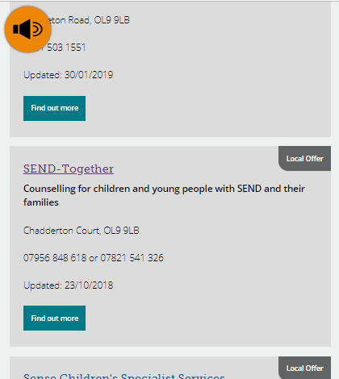

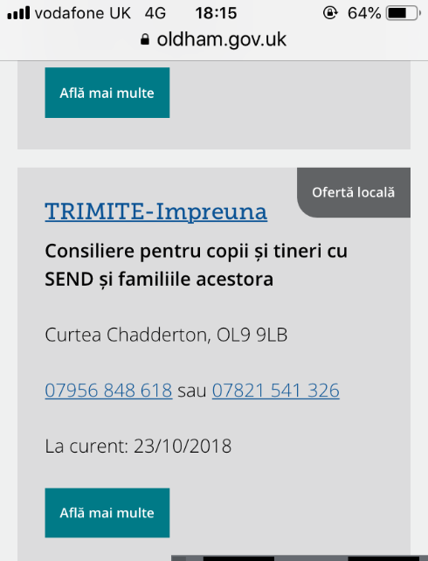
Language Translation Feature
www.oldham.gov.uk/localoffer
Opens up translation and audio Toolbar
From English
to Romanian language
Instantly on any computer, tablet or smart phone.

Slide 28

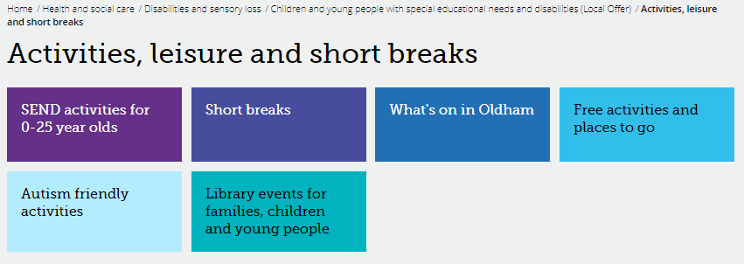
SEND Local Offer – Activities directory
www.oldham.gov.uk/localoffer
158 more activities/services added between July 2018 – April 2019
Please let us know if there are any more we can add: local.offer@oldham.gov.uk

Slide 29


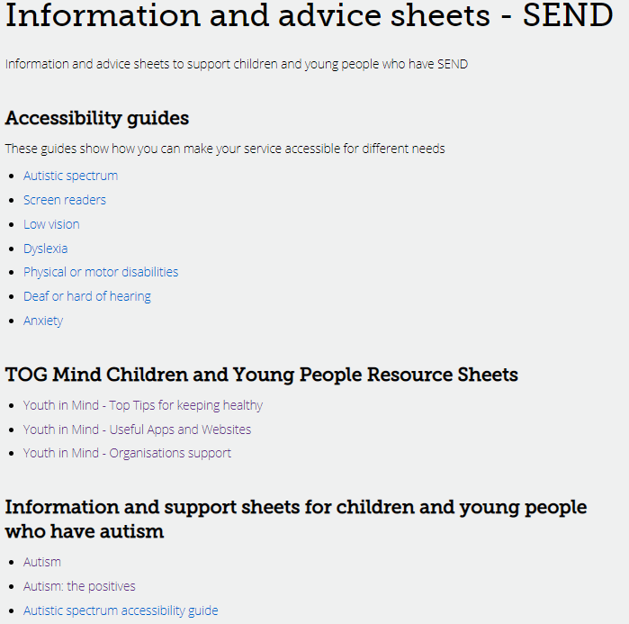
Information and advice sheets - SEND
www.oldham.gov.uk/localoffer

Slide 30
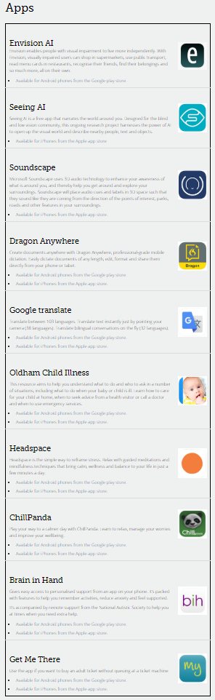
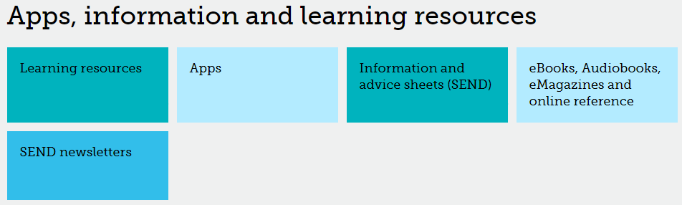
SEND Local Offer – Apps
www.oldham.gov.uk/localoffer
www.oldham.gov.uk/localoffer

Slide 31
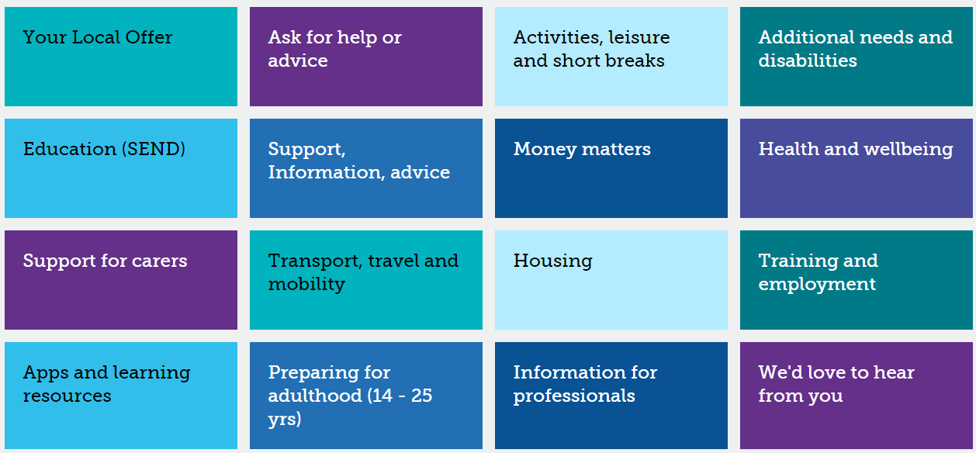
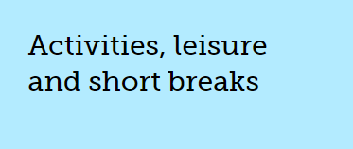
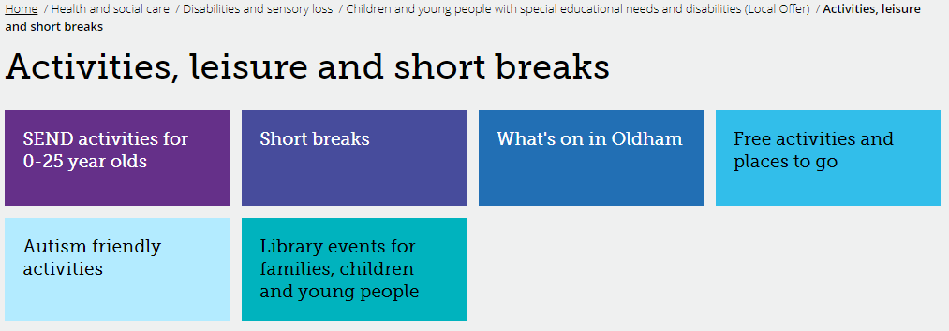
Activities, Leisure and Short Breaks Button
www.oldham.gov.uk/localoffer

Slide 32
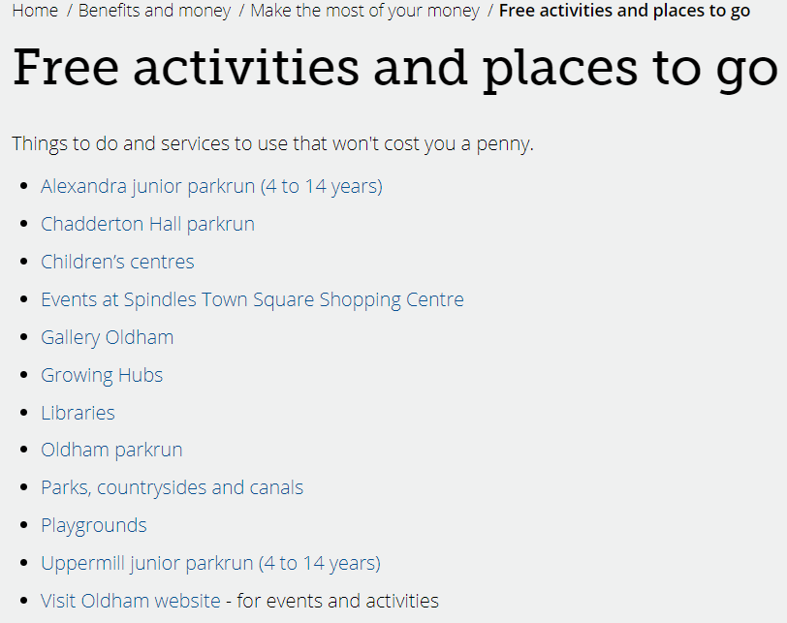
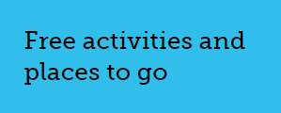
Free activities and places to go
www.oldham.gov.uk/localoffer

Slide 33
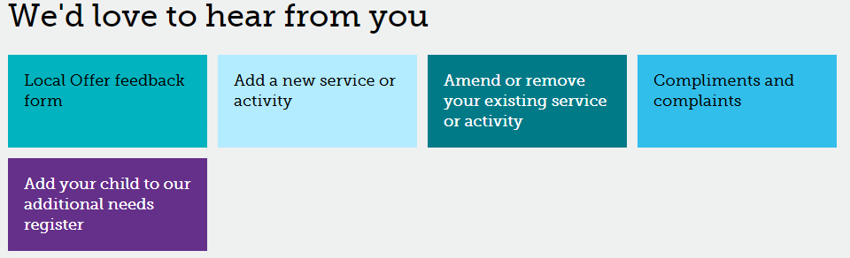
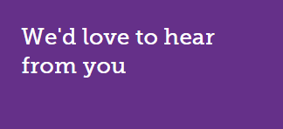

Tell us your views on the Local Offer
www.oldham.gov.uk/localoffer
We are encouraging website visitors to give us feedback on the Local Offer in a number of ways.
The survey pop-up has been added on the Local Offer web pages.

Slide 34
Any Other Urgent Business at full Governing Body Meetings
If a governor wants to raise an additional agenda item then this should be agreed at the start of the meeting by the Chair and all the Governors.
Clerks should also advise if there is enough time to discuss it
Clerks should remind the Chair of this.

Slide 35

New Governors Induction Sessions
Sign up ALL new governors (within the last 24 months) on to the ‘Induction for New Governors’ course
Next Sessions in June/July 2019 Wednesdays 26 June, 3 & 10 July (3 session training for complete course) | Induction for New Governors / Refresher Course | 2.30-5pm | The Honeywell Centre
 |  | OR
 |  | 6-8.30pm | The Honeywell Centre
There are 85 new governors in the last 2 years who have not completed this important training.
This course is also a refresher course for longer serving governors.

Slide 36
Local authority agenda item for information
Item 15.1 - Schools Forum
Governors are asked to receive and note the summary papers outlining discussions held at the meetings of the Schools Forum held during last term on 17 January 2019 and 13 March 2019.
Link to the document: www.oldham.gov.uk/schoolsforum

Slide 37

Local authority agenda item for information
Item 15.2 - Governance Handbook – March 2019
The new and updated edition of Governance handbook was released in March 2019.
The most significant updates and changes can be viewed on page 6 of the handbook which can be viewed here: www.gov.uk/government/publications/governance-handbook

Slide 38
Clerk Update as an Agenda item
Clerks must share any new updates that occur during the term e.g. Appointment of a new Director of Education and Early Years etc.
LOOK OUT for a ‘Clerk Update’ email
Drop in text from email ensuring that the information is written in it’s correct ‘tense’ – i.e. something that happened or is going to happen etc.
Please make sure it is minuted
This is important!

Slide 39

Clerks Update
The following update was emailed to all Clerks on Tuesday 7 May 2019:
Stars in Our Eyes event
Your minute could read ‘The Clerk updated governors encouraging all to take up the opportunity to nominate all the children looked after or care leavers for an award at the Oldham ‘Stars in Our Eyes’ celebration event 2019. Nominations can be made here: www.oldham.gov.uk/stars19 closing date for nominations is Friday 21 June 2019’.

Slide 40
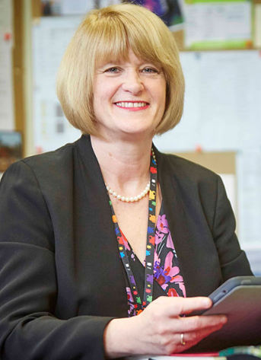
Clerks Update
New addition to the Opportunity Area team
Your minute could read ‘The Clerk updated governors on Patsy Kane OBE who joins the Opportunity Area team as ‘Opportunity Areas Legacy Lead’.
In her role she will be sharing her expertise and work with Oldham’s school leaders on a variety of key initiatives and is also set to bring fantastic support to education in the borough.

Slide 41
A Competency Framework for Governance
To date, the following number of governors have been nominated as lead governors in specific areas:
Lead Governor | Total in place
 | Jan 19 | May 19
Special Educational Needs and Disabilities (SEND) | 58 | 64
Safeguarding of children including Prevent Duty | 56 | 64
Health and safety in education | 51 | 54
Analyse information and data | 47 | 49
Financial health and efficiency compared to organisations locally and nationally | 32 | 49
Human Resource Education Policy | 43 | 43
Closing the gap for EAL Learners (English as an Additional Language) | 48 | 52
Suggested relevant training has been signposted to these governors
Vacant lead governor responsibilities must be filled this term!!

Slide 42

Governor Elections MUST TAKE PLACE!
Governor elections must take place for ALL
Staff Governors where terms of office are coming to an end
Parent Governors where terms of office are coming to an end
Existing people in these posts can/must re-apply
They can not automatically be extended an election must take place.

Slide 43
Governor Vacancies Recruitment – Update
Governor Type | Process for filling vacancy | Current vacancies May 2019
Co-opted | Selected and approved by the Governing Body (agenda item) | 27
Parent | Election - ratified at FGB meeting | 24
Staff | Election - ratified at FGB meeting | 5
Local Authority | Approved by the Lead and Shadow Cabinet members - before the GB meeting (agenda item) | 9
Foundation / Ex Officio | Appointed by the Diocese | 14
Foundation PCC | Appointed by the Parish Council | 7

Slide 44

Staff Governors – ONE THIRD maximum
It is important when governing bodies are appointing school staff in to various governor posts that they must be aware that No more than a third of the governing body can also be staff members at the school
1/3

Slide 45
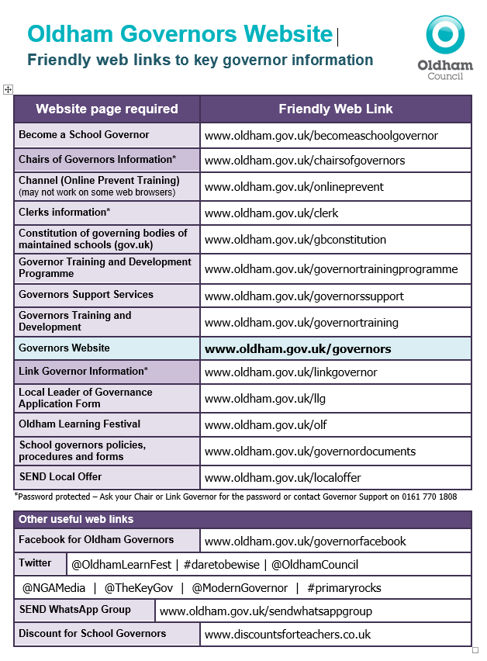
Friendly web links
The friendly web links have been recently updated
New additions include Clerks, social media and governor discounts.
www.oldham.gov.uk/ governors

Slide 46


Inspiring Governance – Advertise Governor Vacancies
Free SERVICE & access to Free TRAINING
https://inspiringgovernance.org
www.inspiringthefuture.org

Slide 47

The BIG Push by Clerks – Summer Term 2019!!
All governors to have access to a secure email address or First Class Accounts
All new governors to complete the induction for New Governors training & Prevent
Competency Framework for Governance – Governors take on a Lead Governor role
Governor Details Data cleanse (including staff email addresses and job titles)
Governors Skills Audit and Matrix (28 required)
Prevent Duty (71 outstanding @ 10/5/19)
DBS checks (58 outstanding @ 10/5/19)
Governors
Clerks
Governor Support
BIG Push 2019!

Slide 48
Me Learning – Clerks Training Log @ Development Academy
All Clerks not employed by Oldham Council have been emailed their password
Confirm if you have accessed this platform

Slide 49
Staff governor’s email address – MUST BE SECURE
Please ask staff governors for the following:
Work email address e.g. joe.king@clownacademy.org
Personal email addresses where a work email is unavailable e.g. hotmail, gmail etc.
Egress
Avoid obtaining the following:
Generic email addresses i.e. info@hogwarts.oldham.sch.uk
A shared email address i.e. friends, relatives or on behalf of another governors email.

Slide 50



Egress Switch – Safe and Secure emailing
Egress Switch email is simple and free to use to protect personal information and commercially sensitive information when sending emails between Oldham Council and other users e.g. governors, members of the public, partner organisations etc.
All governors and Clerks to be set up ready to use and access this service when receiving or sending confidential and sensitive information/documents.
Logging onto the Egress website is required in order to send and receive secure emails.
To create an egress account, please follow the set up guide provided.

Slide 51
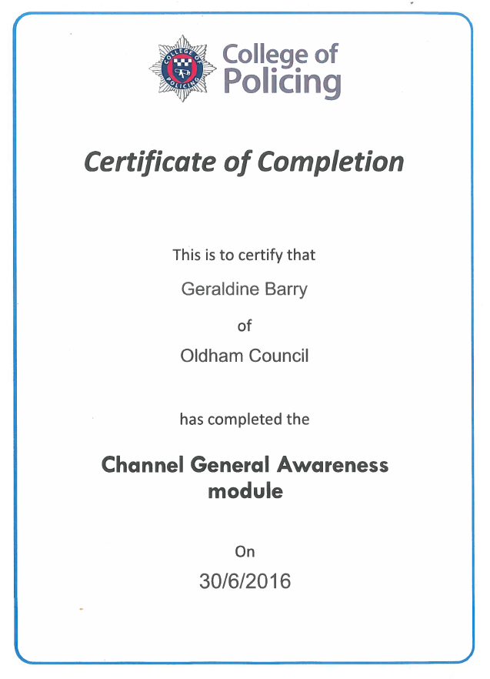
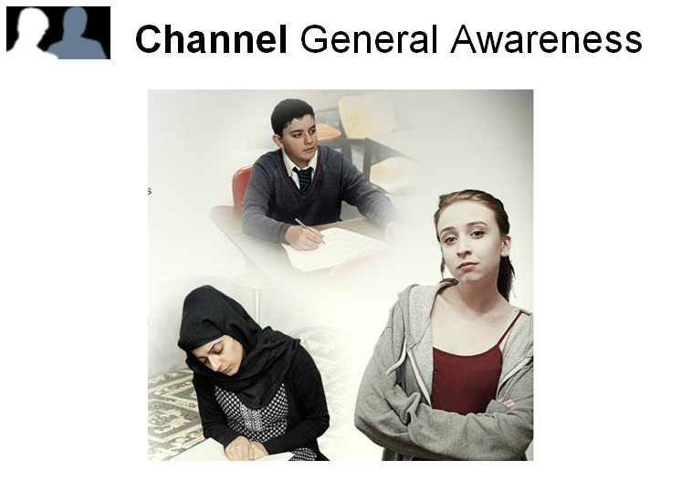
Prevent Online Training
All new Governors and Clerks must do this!
You can access the e-learning by clicking on the website below
http://course.ncalt.com/Channel_General_Awareness
(Please test on a different web browser if you experience any issues)

Slide 52
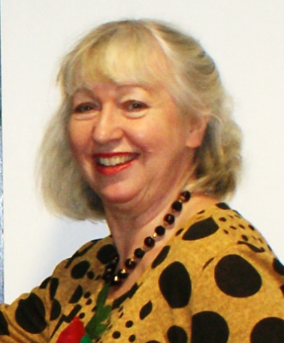
Allocation of school Governing Body/IEB meeting and cover arrangements
Kim from the Governor Support Service will be in touch if or when a school governing body meeting needs a Clerk.

Slide 53

Any other business

Slide 54
Reminders
The following slides contain important reminders

Slide 55
Headteacher’s Report
It is best practice that the Headteacher’s Report is circulated to governors and the Clerk prior to the meeting.
It is best practice for each Governor individually to email the Headteacher with at least one question or comment as well as asking for points for clarification regarding the information contained in the report prior to the meeting so that the Headteacher can answer the questions in the governing body meeting.

