Slide 1
Clerks Information and Briefing
Gerri Barry
Information and Advice Service Manager
Governor Support Service
Monday 14 January 2019

Slide 2
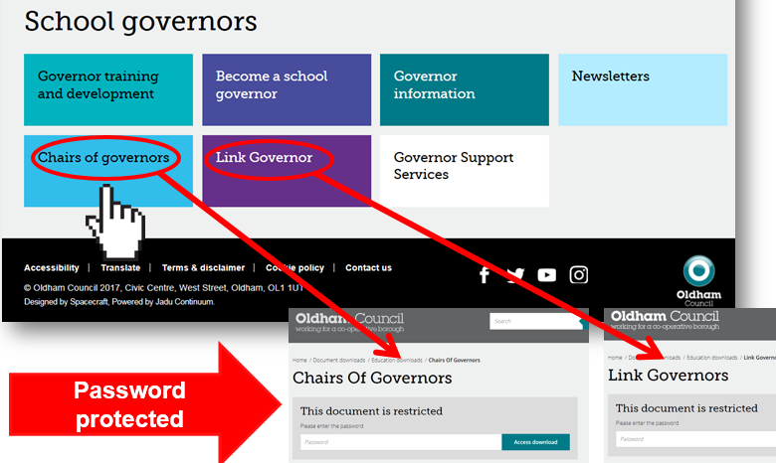
Welcome and introductions
Clerks Briefing | Monday 14 January 2019
Gerri Barry
Information and Advice Service Manager
Happy New Year!
PASSWORD PROTECTED WEBPAGES
www.oldham.gov.uk/chairsofgovernors
www.oldham.gov.uk/linkgovernor

Slide 3
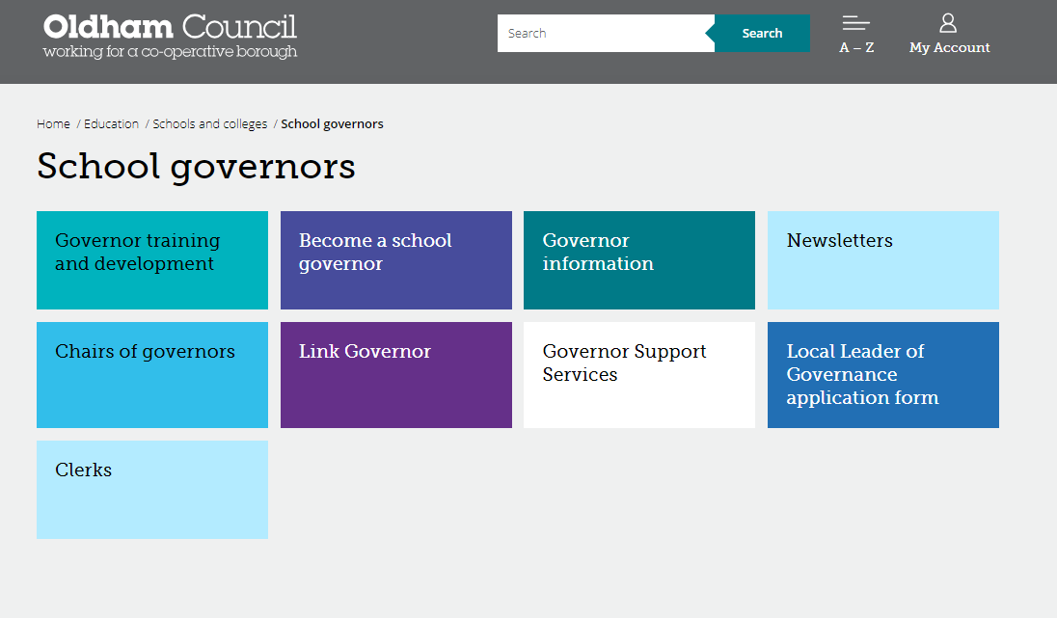
Governor Webpage www.oldham.gov.uk/governors
New
Password protected

Slide 4
Education & Early Years Service – Jan 2019
Economy, Skills and Neighbourhoods Directorate
Director of Education & Early Years
Andrew Sutherland
Education Partnership Leader
Adrian Calvert
Programme Director Opportunity Area
Matthew Bulmer
Head of Learning
Tony Shepherd
Head of Inclusion & Post 16
Donna Lewis
Assistant Director of Education SEND
Dr Shirley Woods-Gallaher
Head of School Support Services (Compliance)
Andy Collinge
SEMHS Manager
Claire Taylor
Head of Virtual School for Children who are Looked After
Jennie Davies
Education Improvement Manager
Paula Healey
Inclusion Manager
Anne Clark
SEND Service Manager
Paula Green
Education Psychology
& Prevention Services
Dr Helen Wyton
Education Provision Manager
Andy Wood
Information & Advice Service Manager
Gerri Barry

Slide 5
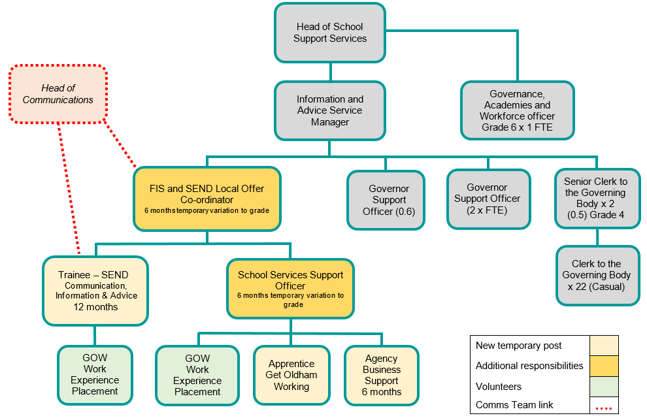
Temporary Structure to Support Further Development of Oldham’s SEND Local Offer
Welcome to Hellal and Nicola

Slide 6


#OLF19
@OldhamLearnFest
#daretobewise
Keep your calendar free!
Encourage your colleagues, contacts and partners to SAVE THE DATE!
Notes:
Following are from the success of OLF18:
Oldham learning festival is being planned. It will run for one week, 1st July to 7th July 2019. With the main programme running Monday to Friday in and around the QE Hall in Oldham.
All schools are invited to get involved and for staff to attend.
More information will be issued when it becomes available.
Follow us on Twitter @OldhamLearnFest – Hashtag OLF19 – Hashtag Dare to be wise

Slide 7



SECURE Email or Egress
All new and existing governors MUST have a secure email or register with Egress
215 governors currently DO NOT have a secure email!

Slide 8



Egress Switch – Safe and Secure emailing
Egress Switch email is simple and free to use to protect personal information and commercially sensitive information when sending emails between Oldham Council and other users e.g. governors, members of the public, partner organisations etc.
All governors and Clerks to be set up ready to use and access this service when receiving or sending confidential and sensitive information/documents.
Logging onto the Egress website is required in order to send and receive secure emails.
To create an egress account, please follow the set up guide provided.

Slide 9
Good practice for Clerks
Meeting dates - remind Chairs and Headteachers there should be no meetings within the first 4 weeks of term.
Avoid using governors names in minutes.
The do not’s …
  Do not write back office/admin issues into the governing body minutes.
  Do not agree to different templates or using different colours or adding in additional action lists. The school will have to do this.
  If they have gone paperless they cannot go back to paper - the school will need to come up with a solution e.g. Folder in school, web folder with password for governors.
  Do not write pass words or key instructions in the minutes
  Do not go into detail about staffing issues or complaints

Slide 10
Steer the Chair.
Through the Chair …..
  Encourage governors to ask questions – especially at the Headteacher’s report.
  Remind governors that if they want to talk about a staffing issue that could go to an appeal then if it’s discussed in front of all the governors then they are ‘tarnished’ and cannot sit on an appeal panel.

Slide 11
Staff governor’s email address – MUST BE SECURE
Please ask staff governors for the following:
  Work email address e.g. joe.king@clownacademy.org
  Personal email addresses where a work email is unavailable e.g. hotmail, gmail etc.
  Egress
Avoid obtaining the following:
  Generic email addresses i.e. info@hogwarts.oldham.sch.uk
  A shared email address i.e. friends, relatives or on behalf of another governors email.

Slide 12

New Governors Induction Sessions
Sign up ALL new governors (within the last 24 months) on to the ‘Induction for New Governors’ course
Next Sessions in January 2019 Tuesdays 15, 22 and 29 (3 session training for complete course) | Induction for New Governors / Refresher Course | 2.30-5pm | The Honeywell Centre
 |  | OR
 |  | 6-8.30pm | The Honeywell Centre
There are 137 new governors in the last 2 years who have not completed this important training.
This course is also a refresher course for longer serving governors.

Slide 13

A Guide to Governor Induction
www.sbwgovernance.co.uk/the-clerk

Slide 14
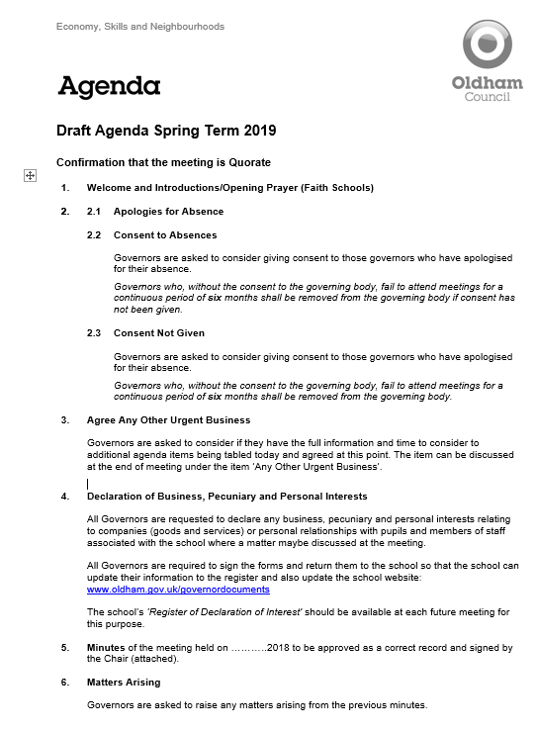
Spring term agenda items
Spring Term Agenda 2019

Slide 15
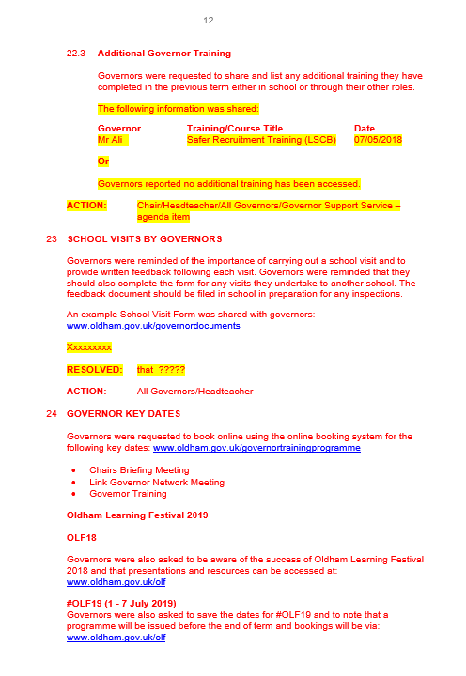
Minute template
Check the minute “fits” and that the tense is correct (past, present etc.)
RED text is standard on the template which signifies that no changes have been made.
BLACK text is what you have typed in i.e. your minutes, changes, amendments etc.
Yellow highlighted text will always need changing or deleting.
Hyperlinks are generally blue.

Slide 16

Quality Assurance - Check your Minutes
Please ensure that your minutes are:
  Spell checked
  Double-checked
  Look at formatting
  Are they good enough to send to the Chair and Headteacher?
Buddy up with another Clerk to check your minutes

Slide 17


Slide 18


Slide 19


Slide 20
Any Other Urgent Business at full Governing Body Meetings
If a governor wants to raise an additional agenda item then this should be agreed at the start of the meeting by the Chair and all the Governors.
  Clerks should also advise if there is enough time to discuss it
Clerks should remind the Chair of this.

Slide 21
Local authority agenda item for action
There must be an action in the minutes!
Remind the Chair if the governors skip over it!!!

Slide 22

Local authority agenda item for action
Item 16.1 - Send Governance Review Guide
  Governors are asked to ensure that they are fully aware of their responsibility around SEND statutory guidance and to be aware that Ofsted Inspectors will be returning to Oldham in March/April 2019.
  The SEND Governance Review Guide has been launched, focusing on how the governing board can support high quality outcomes for learners with SEND. The document aims to ensure that governors are able to properly interrogate SEND support and planning.
  Available to download from https://sendgov.co.uk

Slide 23

Local authority agenda item for action
Item 16.2 - SEND Resources for Governors
  Governors to note that there are useful resources for governors with responsibility for SEND available from the Driver Youth Trust. www.driveryouthtrust.com/governors
Item 16.3 - SEND WhatsApp group
  Governors should note that as well as the Oldham Governors Facebook page, governors and staff with a SEND responsibility are welcome to join a WhatsApp group and all are welcome to ask questions on the site or share thoughts:
  https://chat.whatsapp.com/BrsN4jxHFhX1PIk6ZwtDdY

Slide 24

Local authority agenda item for action
Item 16.4 - School Website SEND Information
  Governors are asked to ensure that the school website is up-to-date, web links are working and that it meets statutory requirements regarding SEND.
  All parents and carers of SEND pupils should have been given the Oldham’s SEND Local Offer leaflet, either hard copy or electronically.
  Also accessible via www.oldham.gov.uk/governordocuments

Slide 25


SEND Local Offer – NEW Information
New Animated Banner
New Buttons and content added
www.oldham.gov.uk/localoffer

Slide 26


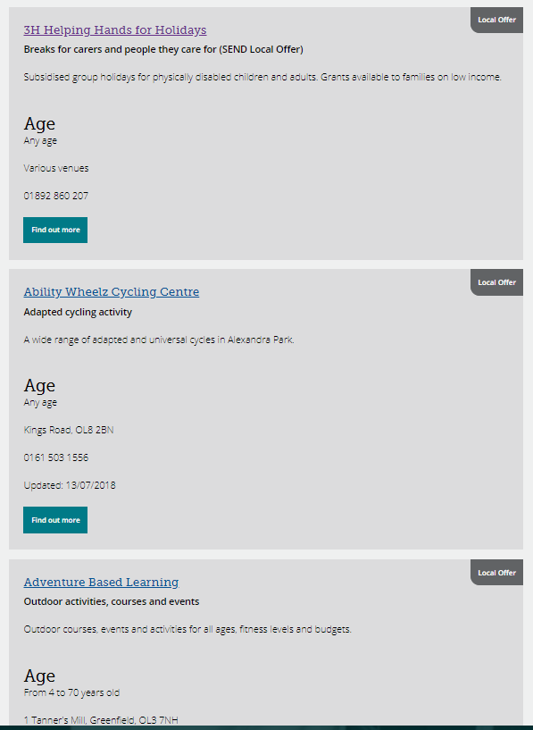
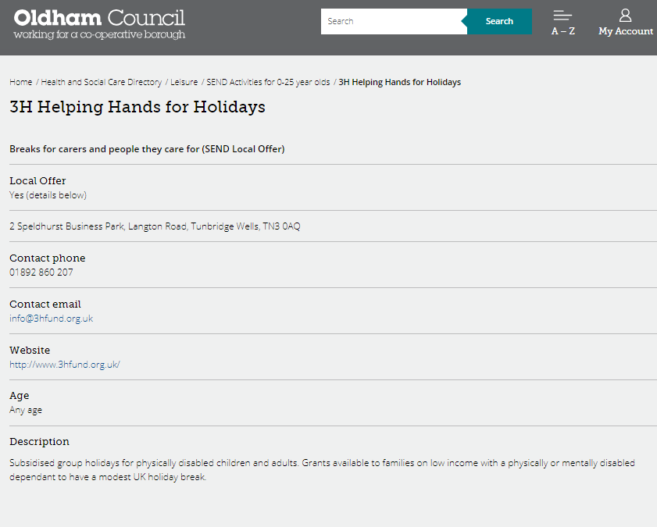
SEND Local Offer – Activities directory
www.oldham.gov.uk/localoffer

Slide 27
Local authority agenda item for information
Item 17.1 - Schools Forum
  Governors are asked to access and note the summary papers outlining discussions held at the meetings of the Schools Forum during the Autumn term on 11 September and 28 November 2018
  Link to the document: www.oldham.gov.uk/schoolsforum

Slide 28
Local authority agenda item for information
Item 17.2 - Records Responsibilities and Archiving Guidance for Closing Schools/Schools Merging to become Academies
  Governors are asked to note the Records Responsibilities and Archiving Guidance for Closing Schools and Schools Merging to become Academies.
  The document is for action when a school closes and/or merges to become new entities.
  Attached below is a short description for Governors on the reasons for publishing such guidance and what governors responsibilities are in relation to this.
  Governors are asked to note the document and ensure it is actioned if required in the future. www.oldham.gov.uk/governordocuments

Slide 29
Clerk Update as an Agenda item
  Clerks must share any new updates that occur during the term e.g. Appointment of a new Director of Education and Early Years etc.
  LOOK OUT for a ‘Clerk Update’ email
    Drop in text from email ensuring that the information is written in it’s correct ‘tense’ – i.e. something that happened or is going to happen etc.
  Please make sure it is minuted
This is important!

Slide 30
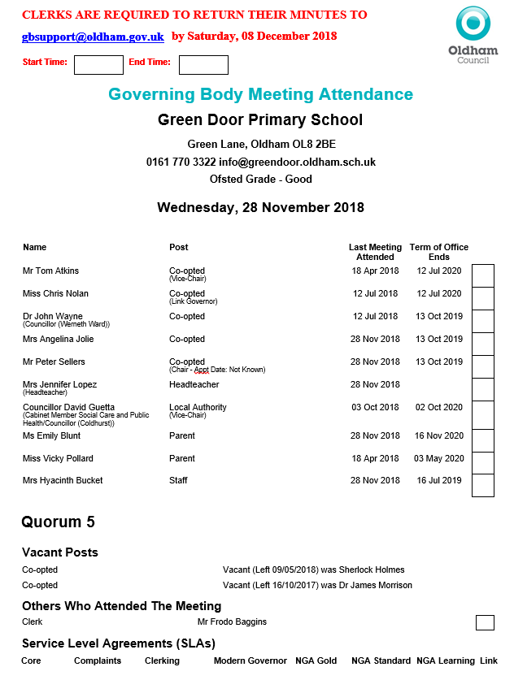
Meeting attendance register
Check with Chairs before the start of the meeting.
  Highlight Missing information
  Job Titles
  Terms of Office coming to an end
  Vacant Posts
  Governors who have not attended since last year
  Any other errors
New Additions
  Meeting ‘start’ and ‘end’ times
  Full school address
  Service Level Agreement (SLA) info

Slide 31
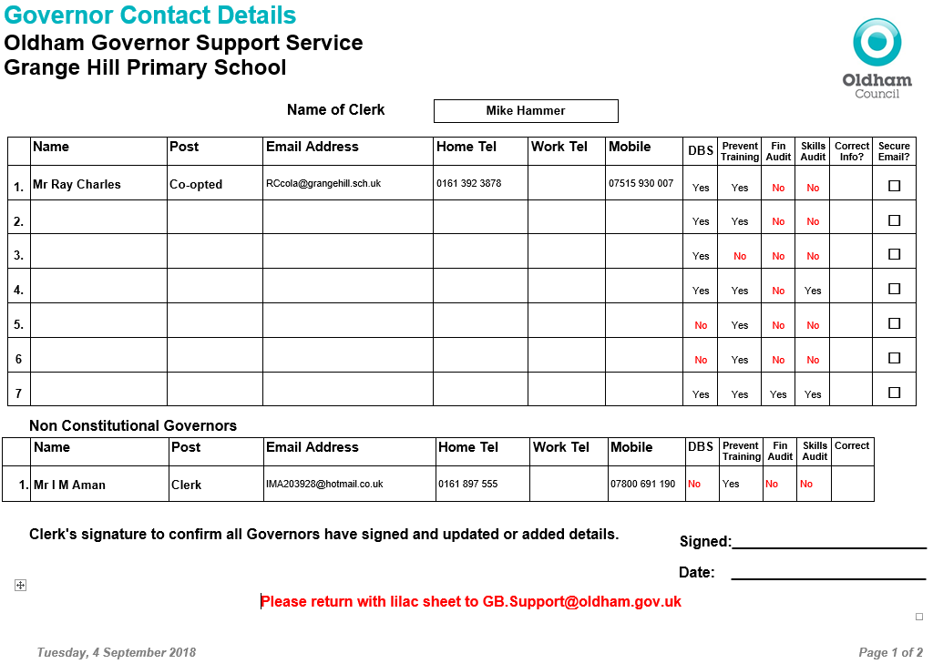
Updated Governor Contact Details Form
Prevent Required by all Governors
Required by all on Finance Committee. Good practice for all Governors
Individual skills matrix completed by all governors and returned to the Chairs to Collate
DBS forms must be completed with governors at school within 21 days
New

Slide 32
A Competency Framework for Governance
To date, the following number of governors have been nominated as lead governors in specific areas:
Lead Governor | Total in place
 | Sep 18 | Jan 19
Special Educational Needs and Disabilities (SEND) | 53 | 58
Safeguarding of children including Prevent Duty | 53 | 56
Health and safety in education | 51 | 51
Analyse information and data | 44 | 47
Financial health and efficiency compared to organisations locally and nationally | 48 | 32
Human Resource Education Policy | 40 | 43
Closing the gap for EAL Learners (English as an Additional Language) | 46 | 48
Suggested relevant training has been signposted to these governors
Vacant lead governor responsibilities must be filled this term!!

Slide 33
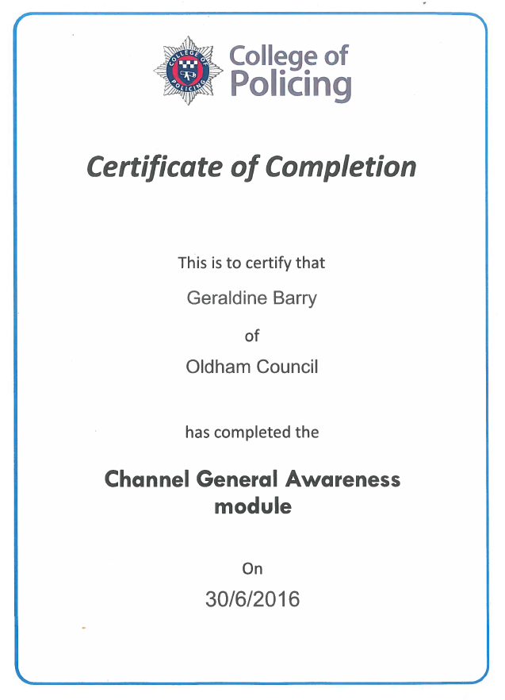
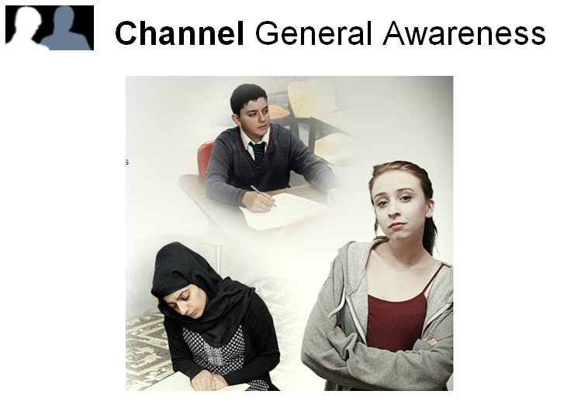
Prevent Online Training
All new Governors and Clerks must do this!
You can access the e-learning by clicking on the website below
http://course.ncalt.com/Channel_General_Awareness
(Please test on a different web browser if you experience any issues)

Slide 34
Governor Vacancies Recruitment - Increase 2019
Governor Type | Process for filling vacancy | Current vacancies January 2019
Co-opted | Selected and approved by the Governing Body (agenda item) | 37
Parent | Election - ratified at FGB meeting | 26
Staff | Election - ratified at FGB meeting | 5
Local Authority | Approved by the Lead and Shadow Cabinet members - before the GB meeting (agenda item) | 9
Foundation / Ex Officio | Appointed by the Diocese | 15
Foundation PCC | Appointed by the Parish Council | 5

Slide 35


Inspiring Governance – Advertise Governor Vacancies
Free SERVICE & access to Free TRAINING
https://inspiringgovernance.org
www.inspiringthefuture.org

Slide 36

The BIG Push by Clerks – Spring Term 2019!!
All governors to have access to a secure email address or First Class Accounts
All new governors to complete the induction for New Governors training & Prevent
Competency Framework for Governance – Governors take on a Lead Governor role
Governor Details Data cleanse (including staff email addresses and job titles)
Governors Skills Audit and Matrix (28 required)
Prevent Duty (98 outstanding @ 14/1/18)
DBS checks (70 outstanding @ 14/1/18)
Governors
Clerks
Governor Support
BIG Push 2019!

Slide 37
Me Learning – Clerks Training Log @ Development Academy
All Clerks not employed by Oldham Council have been emailed their password
Confirm if you have accessed this platform

Slide 38
HR Payroll System – New Regulations April 2019
Payslips
The Employment Rights Act 1996 (Itemised Pay Statement) (Amendment) Order 2018
It requires payslips to state number of hours being paid where wages vary according to time worked; either as an aggregate number of hours or as separate figures for different types of work (or rate of pay).
It comes into force on 6 April 2019.

Slide 39
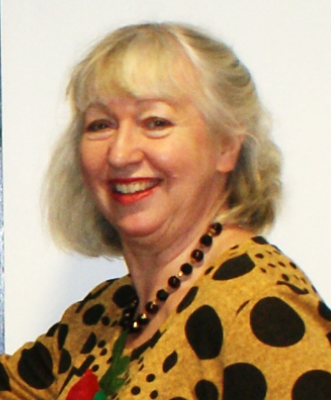
Allocation of school Governing Body/IEB meeting and cover arrangements
Kim from the Governor Support Service will be in touch if or when a school governing body meeting needs a Clerk.

Slide 40

Any other business

Slide 41
Reminders
The following slides contain important reminders

Slide 42
Headteacher’s Report
It is best practice that the Headteacher’s Report is circulated to governors and the Clerk prior to the meeting.
It is best practice for each Governor individually to email the Headteacher with at least one question or comment as well as asking for points for clarification regarding the information contained in the report prior to the meeting so that the Headteacher can answer the questions in the governing body meeting.

