Slide 1
Clerks Information and Briefing
Gerri Barry
Information and Advice Service Manager
Governor Support Service
Tuesday 18 September 2018

Slide 2
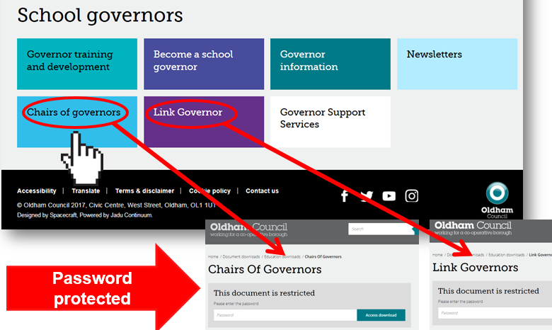
Welcome and introductions Clerks Briefing | Tuesday 18 September 2018
Gerri Barry Information and Advice Service Manager
PASSWORD PROTECTED WEBPAGES
www.oldham.gov.uk/chairsofgovernors
www.oldham.gov.uk/linkgovernor

Slide 3
Education & Early Years Service – Sept 2018
Economy, Skills and Neighbourhoods Directorate
Director of Education & Early Years
Andrew Sutherland
Education Partnership Leader
Adrian Calvert
Opportunity Area Lead
Clare Cheetham
Head of Learning
Tony Shepherd
Head of Inclusion & Post 16
Donna Lewis
Assistant Director SEND
Dr Shirley Woods-Gallaher
Head of School Support Services (Compliance)
Andy Collinge
SEMHS Manager
Claire Taylor
Head of Virtual School for Children who are Looked After
Jennie Davies
Education Improvement Manager
Paula Healey
Principal Educational Psychologist & Preventative Services Lead
Helen Wyton
Inclusion Manager
Anne Clark
SEND Service Manager
Vacant
Education Provision Manager
Paula Green
Information & Advice Service Manager
Gerri Barry
SEND Manager
Adrian Beasley

Slide 4
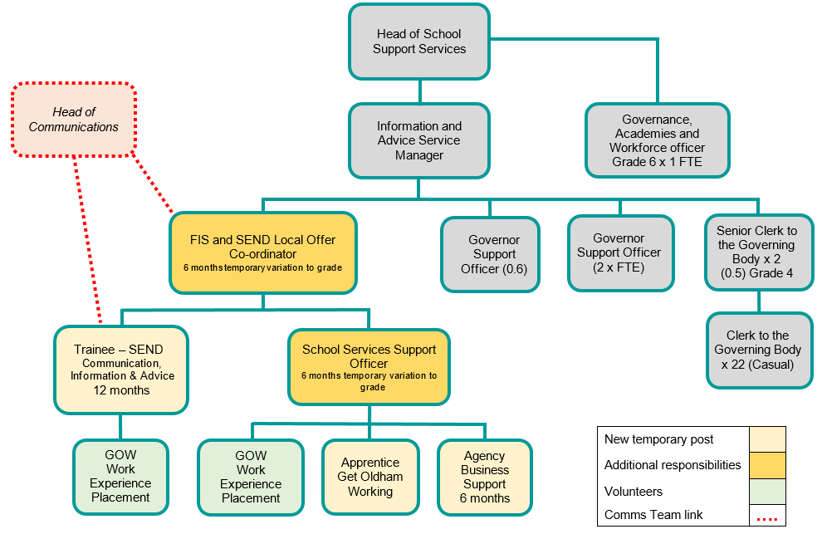
Temporary Structure to Support Further Development of Oldham’s SEND Local Offer

Slide 5



SECURE Email or Egress
All new and existing governors MUST have a secure email or register with Egress
390 governors currently DO NOT have a secure email!

Slide 6



Egress Switch – Safe and Secure emailing
Egress Switch email is simple and free to use to protect personal information and commercially sensitive information when sending emails between Oldham Council and other users e.g. governors, members of the public, partner organisations etc.
All governors and Clerks to be set up ready to use and access this service when receiving or sending confidential and sensitive information/documents.
Logging onto the Egress website is required in order to send and receive secure emails.
To create an egress account, please follow the set up guide provided.

Slide 7
Staff governor’s email address – MUST BE SECURE
Please ask staff governors for the following:
Work email address e.g. joe.king@clownacademy.org
Personal email addresses where a work email is unavailable e.g. hotmail, gmail etc.
Egress
Avoid obtaining the following:
Generic email addresses i.e. info@hogwarts.oldham.sch.uk
A shared email address i.e. friends, relatives or on behalf of another governors email.

Slide 8

New Governors Induction Sessions
Sign up ALL new governors (within the last 24 months) on to the ‘Induction for New Governors’ course
Next Sessions in January 2019 Tuesdays 15, 22 and 29 (3 session training for complete course) | Induction for New Governors / Refresher Course | 2.30-5pm | The Honeywell Centre
 |  | OR
 |  | 6-8.30pm | The Honeywell Centre
There are 137 new governors in the last 2 years who have not completed this important training.
This course is also a refresher course for longer serving governors.

Slide 9

A Guide to Governor Induction
www.sbwgovernance.co.uk/the-clerk

Slide 10
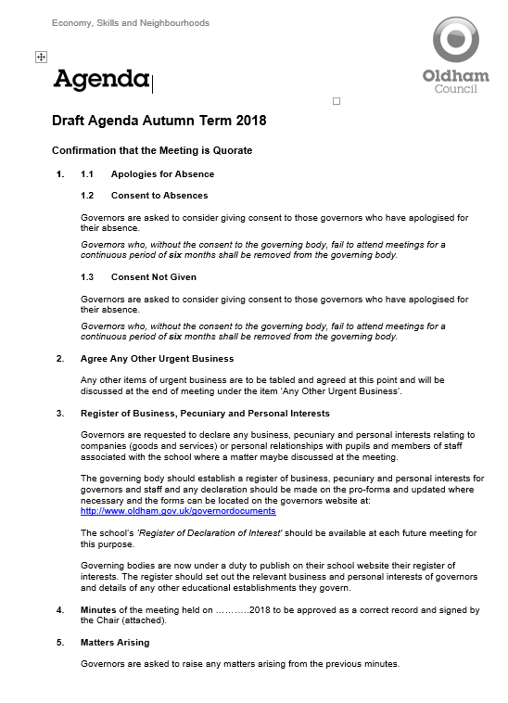
Autumn term agenda items
Agenda Autumn Term 2018

Slide 11

Quality Assurance - Check your Minutes
Please ensure that your minutes are:
Spell checked
Double-checked
Buddy up with another Clerk to check your minutes

Slide 12
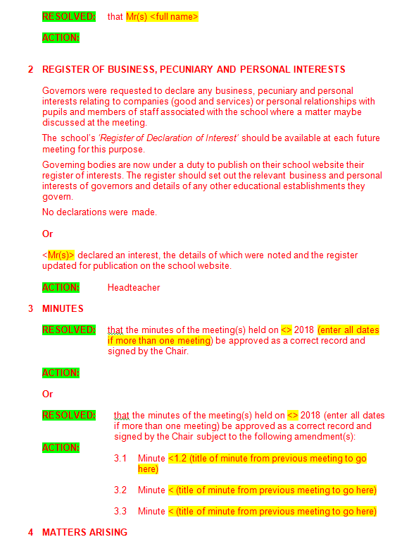
Minute template – Q IS IT WORKING?
Check the minute “fits” and the date wasn’t passed before the meeting
Both versions of the minute template now consists of RED text.
When the template has text added, amended or changed then turn text BLACK.
RED to signify NO changes made.
BLACK to signify the ‘exact’ changes made.
RESOLVED and ACTION are now in green. Please delete these rows if they are not required
BLUE BOX - Please keep in your minutes

Slide 13
Headteacher’s Report
It is best practice that the Headteacher’s Report is circulated to governors and the Clerk prior to the meeting.
It is best practice for each Governor individually to email the Headteacher with at least one question or comment as well as asking for points for clarification regarding the information contained in the report prior to the meeting so that the Headteacher can answer the questions in the governing body meeting.

Slide 14
Local authority agenda item for action
There must be an action in the minutes!
Remind the Chair if the governors skip over it!!!

Slide 15
Any Other Urgent Business at full Governing Body Meetings
This should be agreed at the start of the meeting by the Chair and Governors.
Clerks should remind the Chair of this.

Slide 16
Local authority agenda item for action
Item 12.1 - School Admission Arrangements for Admissions in the Academic Year 2020/21
All governing bodies are asked to note the content of the briefing paper, “School Admission Arrangements September 2020” – Link to the document can be found at:
www.oldham.gov.uk/schooladmissionarrangements
www.oldham.gov.uk/proformaadmissionarrangements
The School Admissions Code December 2014 (The Code) clearly sets out the responsibilities of all admission authorities.
The Code has the force of law and imposes a number of mandatory requirements on the admission authorities of maintained schools, governing bodies and Local Authorities.
Academies and Free Schools are required by their funding agreements to comply with the Code.

Slide 17
Local authority agenda item for action
Item 12.1 - School Admission Arrangements for Admissions in the Academic Year 2020/21
Governors of schools that are their own Admissions Authority and Academies/Free Schools are asked to:
Notify the LA if changes are proposed to their published admission arrangements, including any proposed change to the PAN, or to notify the LA that no changes are to be proposed.
Confirm that they will be in a position to notify the LA no later than 28 February 2019 of the full admission arrangements that will apply to admissions in the academic year 2020/21.
Confirm that they will be in a position to notify the LA no later than 31 October 2019 if they intend to admit above their PAN in the admissions round commencing September 2019 for admission to school in September 2020.

Slide 18
Local authority agenda item for action
Item 12.2 - Oversight of Work on Prevent
All schools have a duty under the Counter-Terrorism and Security Act 2015 to give due regard to the need to prevent people from being drawn into terrorism in everything they do. Schools have previously completed self-assessments of their response to the Prevent Duty.
It is recommended that governors review their school’s Prevent self-assessment, including consideration of training needs for staff and governors.
They also need to have an oversight of any Prevent related concerns regarding the school (for example if there have been safeguarding referrals relating to Prevent).

Slide 19
Local authority agenda item for information
Schools Forum
Governors are asked to access and note the summary papers outlining discussions held at the meeting of the Schools Forum during the Summer term on 16 May 2018.
Link to the document: https://www.oldham.gov.uk/schoolsforum

Slide 20
Clerks Update as an Agenda item
Clerks must share any new updates that occur during the term e.g. Appointment of a new Director of Education and Early Years etc.
Check your emails for updates
Please make sure it is minuted
This is important!

Slide 21
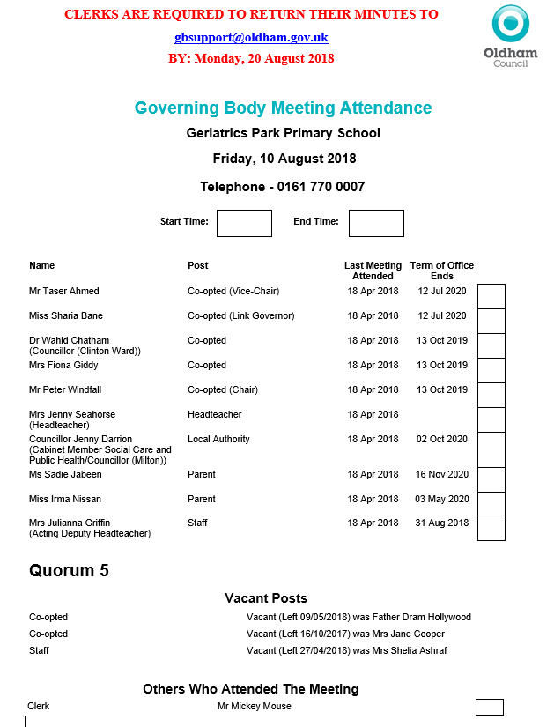
Meeting attendance register
Check with Chairs before the start of the meeting.
Highlight Missing information
Job Titles
Terms of Office coming to an end
Vacant Posts
Governors who have not attended since last year
Any other errors
NEW ADDITION – meeting ‘start’ and ‘end’ times

Slide 22
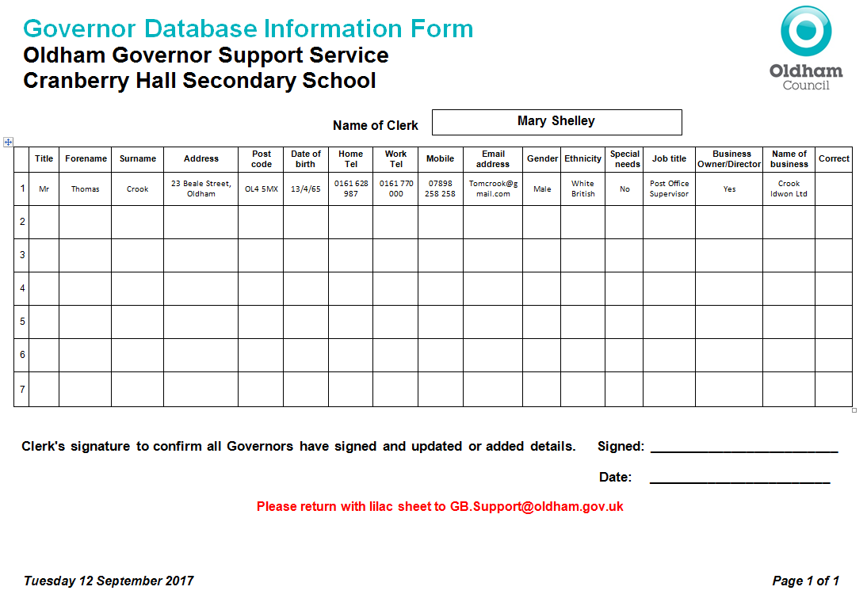
Governor Information Cleanse and Update
Governor to tick to confirm correct or provide updated details
If there are gaps then details need to be provided
ASK THE CHAIRS TO HELP!

Slide 23
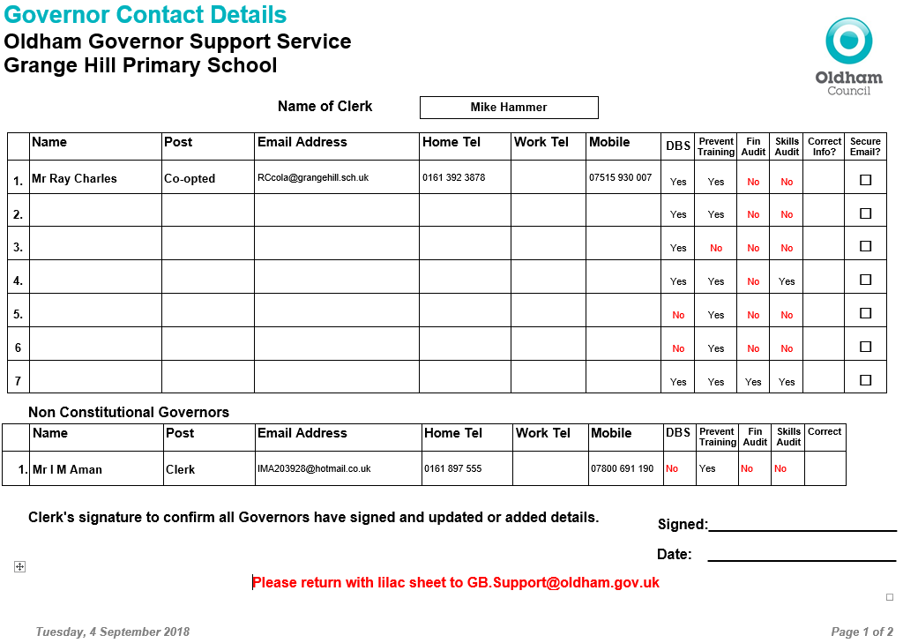
Updated Governor Contact Details Form
Prevent Required by all Governors
Required by all on Finance Committee. Good practice for all Governors
Individual skills matrix completed by all governors and returned to the Chairs to Collate
DBS forms must be completed with governors at school within 21 days
New

Slide 24
A Competency Framework for Governance
To date, the following number of governors have been nominated as lead governors in specific areas:
Important for all schools
Ofsted inspectors due back in Sept/Nov 2018
Lead Governor | Total in place
 | May 18 | Sep 18
Special Educational Needs and Disabilities (SEND) | 61 | 53
Safeguarding of children including Prevent Duty | 55 | 53
Health and safety in education | 50 | 51
Analyse information and data | 48 | 44
Financial health and efficiency compared to organisations locally and nationally | 47 | 48
Human Resource Education Policy | 39 | 40
Closing the gap for EAL Learners (English as an Additional Language) | 49 | 46
Suggested relevant training has been signposted to these governors
Vacant lead governor responsibilities must be filled this term!!

Slide 25
New Governors – Group Activity
Working in Pairs make a list of what you need to do when a new governor joins a governing body
What paperwork do they need?

Slide 26
Me Learning – Development Academy
All Clerks not employed by Oldham Council have been emailed their password
Confirm if you have accessed this platform

Slide 27
Governor Vacancies Recruitment
Governor Type | Process for filling vacancy | Current vacancies Sept 2018
Co-opted | Selected and approved by the Governing Body (agenda item) | 44
Parent | Election - ratified at FGB meeting | 29
Staff | Election - ratified at FGB meeting | 6
Local Authority | Approved by the Lead and Shadow Cabinet members - before the GB meeting (agenda item) | 6
Foundation / Ex Officio | Appointed by the Diocese | 16
Foundation PCC | Appointed by the Parish Council | 6

Slide 28


SAVE THE DATE – OLF 2019
#OLF19
@OldhamLearnFest
Monday 1st to Sunday 7th July 2019
Keep your calendar free
Encourage your colleagues, contacts and partners to SAVE THE DATE!

Slide 29

The BIG Push by Clerks – Autumn Term 2018!!
All governors to have access to a secure email address
All new governors to complete the induction for New Governors training.
Competency Framework for Governance – Lead Governors
Governor Details Data cleanse (including staff email addresses)
Governors Skills Audit and Matrix
Prevent Duty (70 outstanding @ 18/9/18)
DBS checks (76 outstanding @ 18/9/18)
Governors
Clerks
Governor Support
The BIG Push!

Slide 30
HR Payroll System – New Regulations April 2019
Payslips
The Employment Rights Act 1996 (Itemised Pay Statement) (Amendment) Order 2018
It requires payslips to state number of hours being paid where wages vary according to time worked; either as an aggregate number of hours or as separate figures for different types of work (or rate of pay).
It comes into force on 6 April 2019.

Slide 31
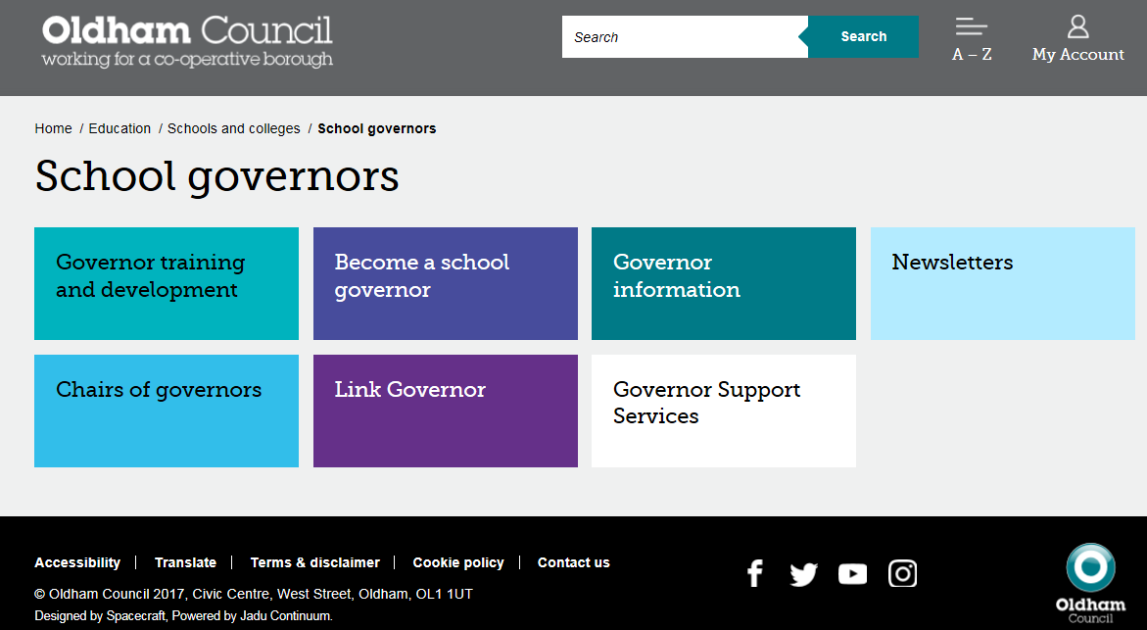
Governor Webpage www.oldham.gov.uk/governors
Password protected

Slide 32
TOP Awards 2018
The TOP Awards 2018 nominations are still open and don’t forget there’s an exciting new category for this year. 28 Sept Closing date!
For the first time ever, you can nominate colleagues for the ‘Fit for Oldham Award’ which celebrates improvements employees have made to their own health and wellbeing.
The full range of this year’s award categories include:
> Employee of the Year > Fit for Oldham Award > Front Line Services Award
> Leader of the Year > Team of the Year > Young Employee of the Year
You can nominate employees from Oldham Council, Oldham Cares, Unity Partnership, MioCare, Oldham Community Leisure and Oldham schools.
Nominations are open to staff and residents.
The nomination form as well as more information on each of the categories is available on our website by visiting www.oldham.gov.uk/TOPAwards
You have until Friday 28 September 2018 to nominate and to recognise your colleagues for the fantastic work they do.

Slide 33


SEND Local Offer – NEW Information
Give us your feedback
www.oldham.gov.uk/localoffer

Slide 34

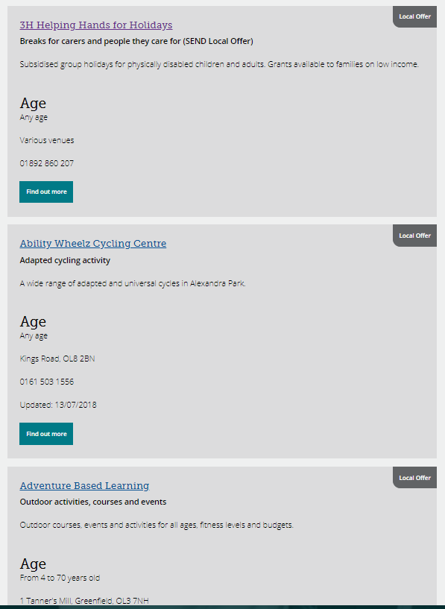
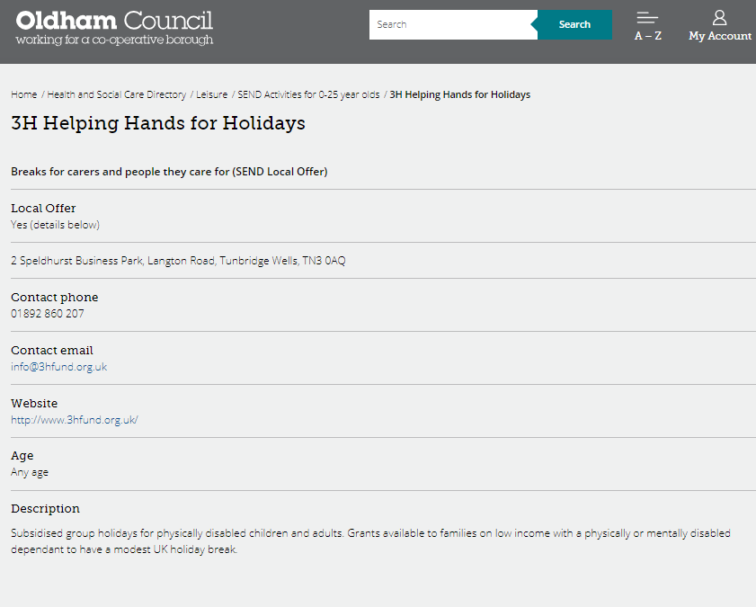
SEND Local Offer – Activities directory
www.oldham.gov.uk/localoffer

Slide 35
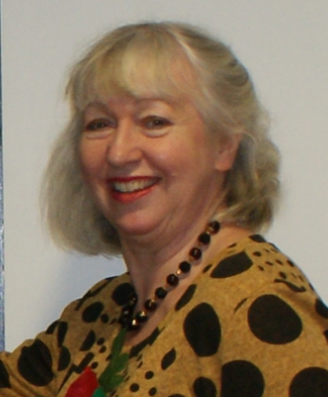
Allocation of school Governing Body/IEB meeting and cover arrangements
Kim from the Governor Support Service will be in touch if or when a school governing body meeting needs a Clerk

Slide 36

Any other business

Slide 37
Reminders
The following slides contain important reminders

Slide 38


Inspiring Governance - Governor Vacancies
Free SERVICE & access to Free TRAINING
https://inspiringgovernance.org
www.inspiringthefuture.org

Slide 39
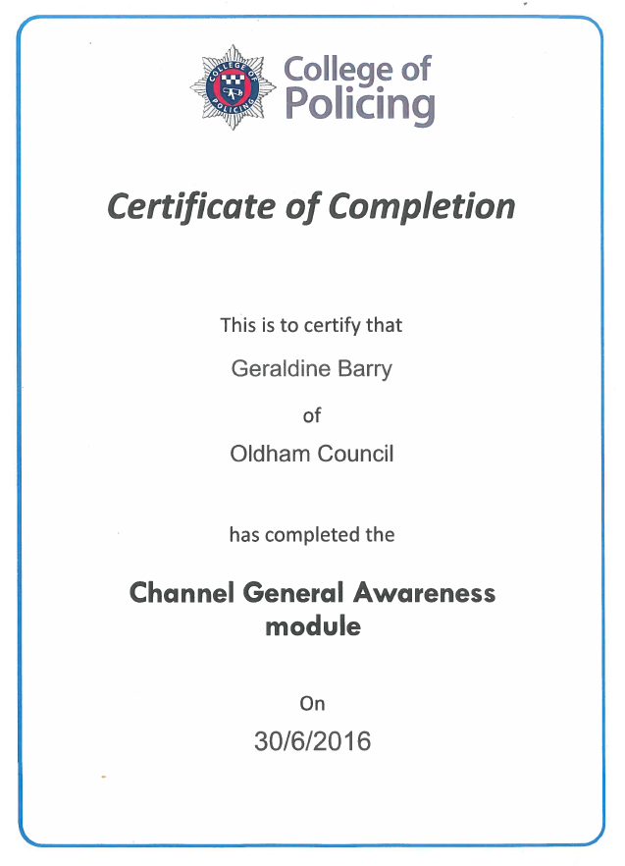
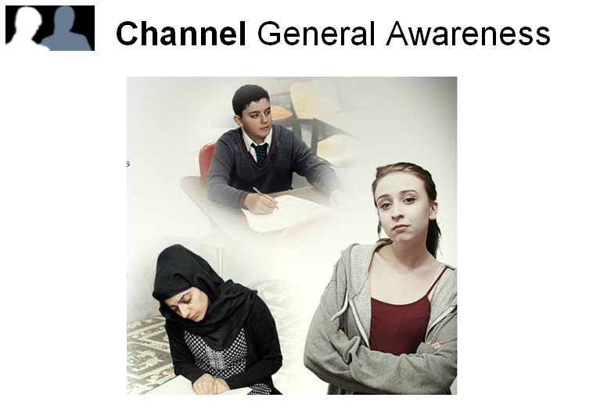
Prevent Online Training
You can access the e-learning by clicking on the website below
http://course.ncalt.com/Channel_General_Awareness

